Slide 1
Physics Division
Notes:
Physics department offers both M.Phil. and Ph.D. programs for full-time postgraduate students. In alignment with the university and faculty’s overarching vision, our mission and goal as a research unit are to become locally pre-eminent, leading in Asia, and globally competitive in selected sub-fields in research.

Slide 2
小而精 A small but productive unit (~200 publications annually) - e.g., in 2017, the department produced 270 papers, among which, 14 were listed by the Web of Sciences as the top 1% “highly cited” papers, and 4 as the top 0.1% cited “hot” papers.
优势领域 Strong in research in certain areas, e.g., on quantum matter and quantum materials (2D and topological materials in particular), as well as astronomy and astrophysics, including, 7 in Science, 35 in Nature and Nat. series, 45 in PRL over the past 5 years 2 papers on 2DM [PRL 108, 196802 (2012); Nat. Nano. 7, 490 (2012)], each received ~2000 citations
荣誉 Recognitions: - 6 National Natural Science Awards - 8 Croucher Senior Research Fellowship/Innovation Awards - 11 DRAA/ORA/OYRA
Notes:
Currently, there are 24 faculty members in our Research Division. There are four strategic research areas. They are condensed matter physics, astrophysics, quantum information science and optics and photonics including atomic and molecular physics.
HKU has long-standing research strengths in the first two research areas: condensed matter physics and astrophysics, which have delivered world-class research outcomes. We intend to further strengthen these two research areas, particularly the experimental side of condensed matter physics.

Slide 3
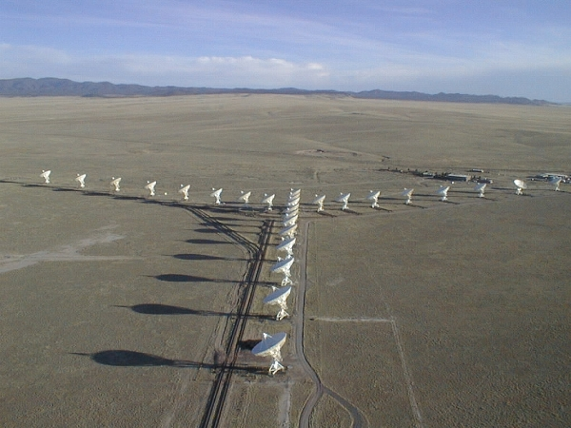
Research groups
Astronomy and Astrophysics Group Q.A. Parker, J.J.L. Lim, M.H. Lee, M. Su, S.C.Y. Ng, Jane. L.X. Dai
Notes:
The astronomy and astrophysics group's researches mainly focus on high-energy astrophysics, late stage stellar evolution, observational cosmology and planetary science. Our on-campus facilities in observational astrophysics include a 40 cm diameter reflector telescope located on the top of the CYM physics building equipped with charged couple device (CCD) imager and spectrometer, and two 2.3 m diameter Small Radio Telescopes all used for teaching, training and outreach. For professional observational astrophysics research we win access to a wide range of cutting-edge international telescopes via competitive peer review. These include ground based facilities such as the Gemini 8-metre Telescopes in Chile and Hawaii, the 8-metre telescopes of the European Southern Observatory in Chile, telescopes of the Beijing Astronomical Observatories and South African and Australian facilities. We also win access to space based facilities like the Hubble Space Telescope and Chandra X-Ray Observatory. The quality of our projects and proposals leads to success in gaining such access on a regular basis. We are currently building MoUs with key strategic partners in the mainland such as the Kavli Institute for Astronomy and Astrophysics at Peking University, the Space and Astronomy group at Nanjing University and the microsatellites research group at Zhejiang University. These links will provide enhanced opportunities for our students in elite mainland research groups.

Slide 4
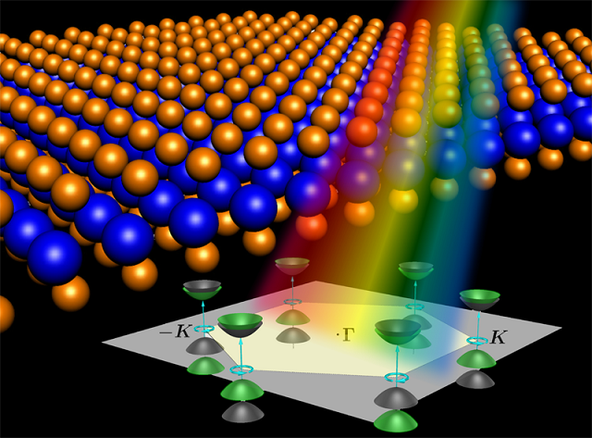
Research groups
Experimental Condensed Matter Physics M.H. Xie, X.D. Cui, A.B. Djurišić, S.J. Xu, D.K. Ki, F.C.C. Ling
Theoretical Condensed Matter Physics Z.D. Wang, S.Q. Shen, W. Yao, S.Z. Zhang, Z.Y. Meng, C.J. Wang
Notes:
Condensed matter physics group’s research consists of both experimental and theoretical aspects. Regarding experimental condensed matter and material science, research activities include electronics and optoelectronics of two-dimensional materials, organic/inorganic nanocomposite optoelectronic devices, epitaxial thin films and surface properties of new quantum materials, defects and nanostructures in semiconductors, and semiconductor optics.
Theoretical condensed matter physics is a very important area in physical sciences. It concerns with many fundamental subjects and has very wide and potentially important applications in material science, biophysical science, high technology, and even economy and finance. We have very active research activities in this field with focuses in topological matters, 2D materials, spintronics and valleytronics, nanoelectronics, quantum many-body physics.

Slide 5
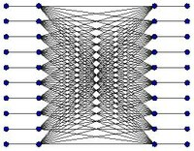
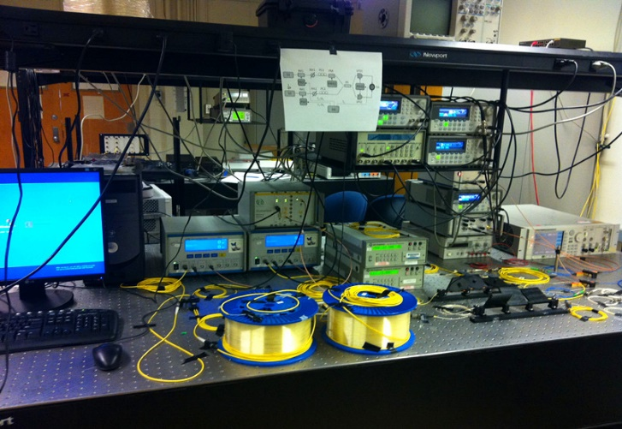
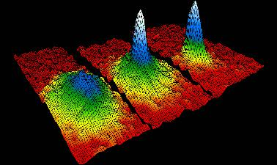
Quantum Information Science group:
H.F. Chau, H.K. Lo, Z.D. Wang, S. Z. Zhang
Notes:
Quantum information science is the study of information processing using the laws of quantum mechanics, rather than classical physics. Quantum information processing promises to revolutionize information processing as we know it today. On one hand, quantum computing offers an exponential speed-up to some specific computing problems such as the factoring of large integers, thus breaking standard public key encryption schemes such as RSA. On the other hand, quantum cryptography promises information-theoretic security, a Holy Grail in communication security. A Quantum Internet allows quantum signals to be exchanged between two locations all over the world.
To unleash the full power of quantum information processing, numerous conceptual and engineering challenges remain. Some of the notable problems in this cutting edge research field include how to build a quantum computer, how to secure data transmission in the quantum world, are there novel information processing tasks made possible by quantum mechanics, and the nature of quantum entanglement. Teaming up with experts in the Condensed Matter Physics Group as well as the Optics and Photonics Group, researchers in the HKU Physics Department, Quantum Information Science Group attack these
problems by studying the feasibility of various quantum computer proposal including superconducting quantum circuits, cold atoms and topological quantum computing. They provide the foundations of security to quantum cryptographic protocols. They also propose new quantum cryptographic methods and investigate their security and efficiency in practice. Last but not least, they study novel quantum communication tasks make possible by means of coherent superposition of time order.

Slide 6
Optics and Photonics group:
A.B. Djurišić, T.T. Luu, , S.J. Xu,, S. Zhang
Notes:
Light-matter interaction powers a vast majority of phenomena happening in our daily life, from our visual observation to the lithography process that makes the integrated circuits empowering our ubiquitous electronic devices. Therefore, Optics and Photonics, study of light-matter interaction and its applications, have always been a fundamental pillar of physics. At every revolution of modern science and technology, one can find signature of Optics and Photonics, from special relativity, general relativity, to more practical applications such as laser, telecommunication, to quantum information. Hence, pursuing research in Optics and Photonics would likely equip students with the highly qualified skills which are not only required for frontier research in academia, but also to an extremely high job satisfaction regardless of the institution where they work. In HKU, Department of Physics is expanding in the direction of light-matter interaction with research groups focusing on manipulating matter and light

Slide 7
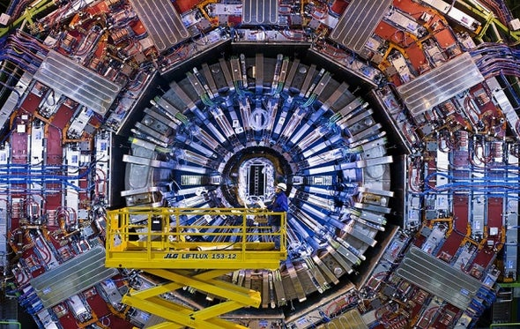
Research groups
Experimental Nuclear and Particle Physics J.H.C. Lee, Y.J. Tu
Atomic, Optical and Quantum Physics
Z.D. Wang, H.F. Chau, S.Z. Zhang, T.T. LUU, S. Zhang, H.K. Lo
Notes:
the nuclear and particle physics groups are established as part of the Joint Consortium for Fundamental Physics by three universities in Hong Kong – HKU, CUHK and HKUST, through which we participate in international collaborations on big science.

Slide 8
MPhil and PhD Programs
MPhil:
Duration: 2 years
Registration: Sep. 1 or Jan 1, each year
PhD:
Duration: 3~4 years
Registration: 1st of each month
In total, about 15 students each year

Slide 9
MPhil and PhD Programs
MPhil - a Bachelor's degree with honours (or equivalent qualification) from a recognized university.
PhD - a Bachelor's degree with honours and a Master's degree (or equivalent qualification) from a recognized university; or - a Bachelor's degree with first class honours (or equivalent qualification) from a recognized university.
English requirement - TOEFL: overall score of 80 or above, or - IETLS: band 6 with no subtest lower than 5.5
Deadlines (20/21) Main round (Sep. 1 – Dec.2), first clearing round (Dec. 3 – Apr. 30), second clearing round (May 1 – Aug. 31)
More details can be found at https://www.gradsch.hku.hk/gradsch/prospective-students/how-to-apply
and https://www.physics.hku.hk/prospective-students/rpg-admission

