Slide 1


Theoretical Efforts in Identification of Interstellar Organic Molecules
SeyedAbdolreza Sadjadi
December 17, 2015
Laboratory for Space Research (LSR)
The University of Hong Kong
ssadjadi@hku.hk
http://www.scifac.hku.hk/kwok/sal/abdi.html
11th Pacific Rim Conference on Stellar Astrophysics

Slide 2
computational quantum chemistry & infrared spectroscopy
modeling
PES
calculations
simulation
interpretation
prediction
11th Pacific Rim Conference on Stellar Astrophysics

Slide 3
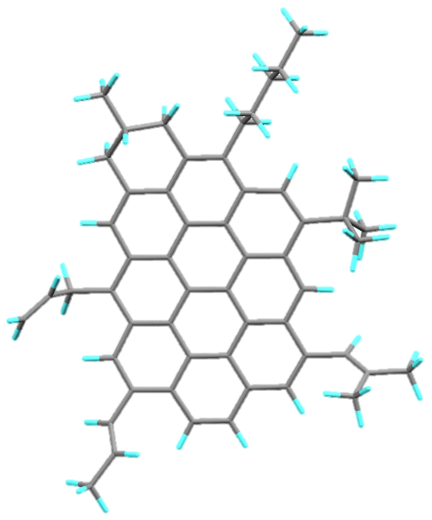
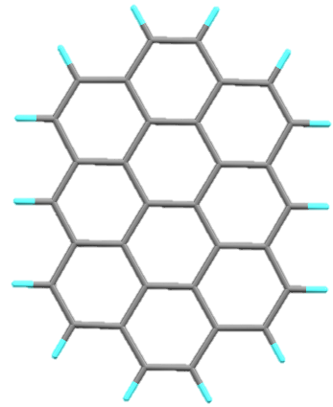
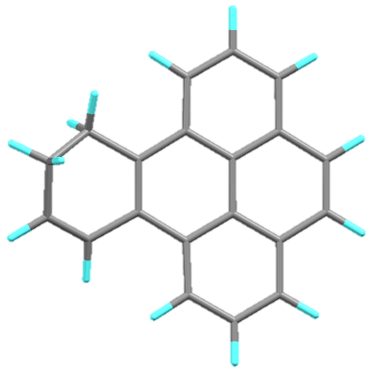
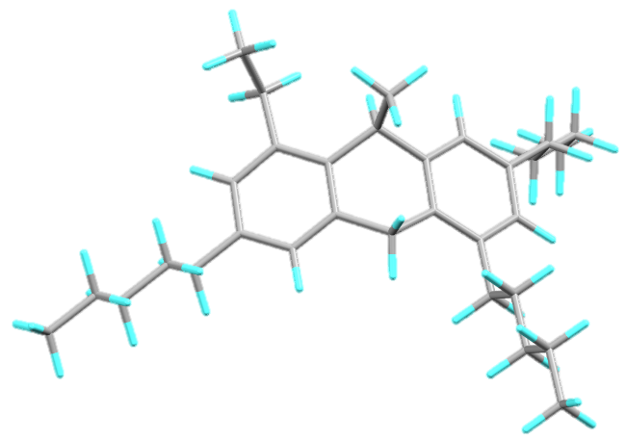
PAH model and its derivatives
observations and proposed models
11th Pacific Rim Conference on Stellar Astrophysics

Slide 4
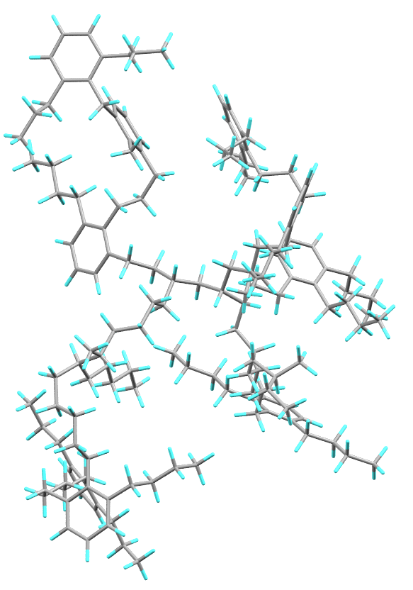
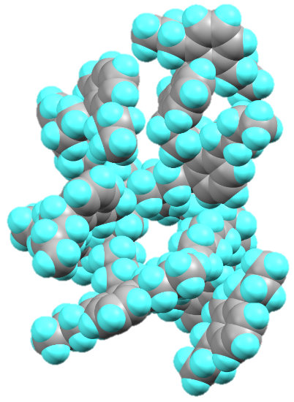
MAON model and PES calculations
calculated geometry of C₁₅₅ H₂₄₀
B3LYP/PC1 (extra care on polarization effects)
_{30 CPUs , 20 days}
Kwok and Zhang, Nature, 479:80 (2011)
Sadjadi, Zhang and Kwok, ApJ, 807:95 (2015 July 1)
11th Pacific Rim Conference on Stellar Astrophysics

Slide 5
simulation
simulated IR spectra for C₁₅₅ H₂₄₀, DFT/Drude, T=500 K
Sadjadi, Zhang and Kwok, ApJ, 807:95 (2015 July 1)
11th Pacific Rim Conference on Stellar Astrophysics

Slide 6
MAONs infrared fingerprint
simulated IR spectra for 40 MAONs, DFT/Drude, T=500 K
Sadjadi, Zhang and Kwok, ApJ, 807:95 (2015 July 1)
11th Pacific Rim Conference on Stellar Astrophysics

Slide 7
PAHs infrared fingerprint
simulated IR spectra for 60 PAHs, DFT/Drude, T=500 K
Sadjadi, Zhang and Kwok, ApJ, 807:95 (2015 July 1)
Annual meeting of the Hong Kong Astrophysical Society

Slide 8
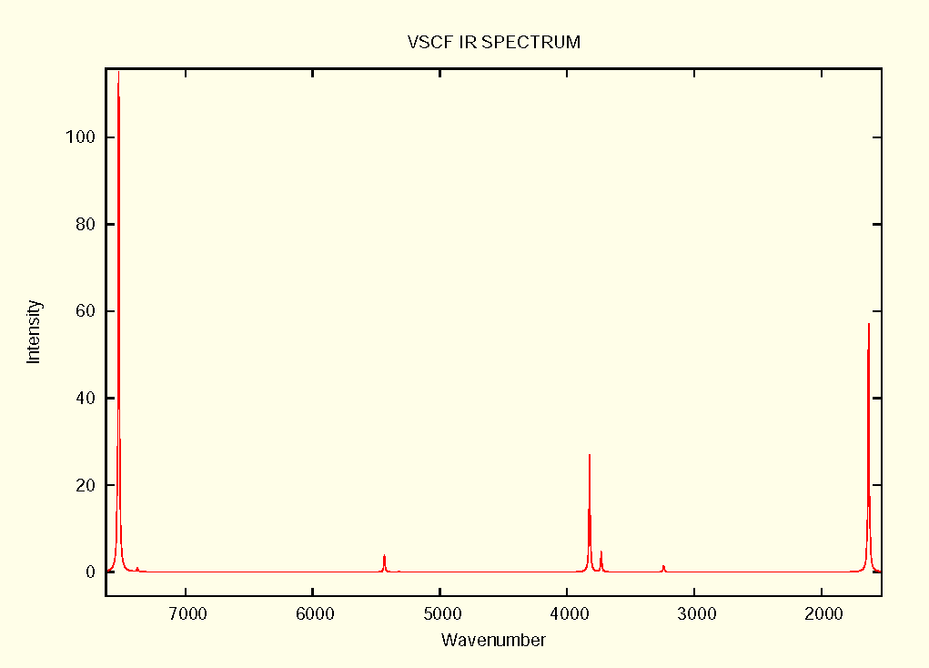
calculations of overtones and combination bands
Vibrational Self-Consistent Field (VSCF) calculations
perturbation theory, MP2/DZ or TZ
water molecule
7524 (O_F3) strong
7524 (F2+F3) very weak
1629(F1)
3823(F3)
3731(F2)
7377(O_F2)
5435 (F1+F3)
5322(F1+F2)
3240 (O_F1)
(cm⁻¹ )
Annual meeting of the Hong Kong Astrophysical Society

Slide 9
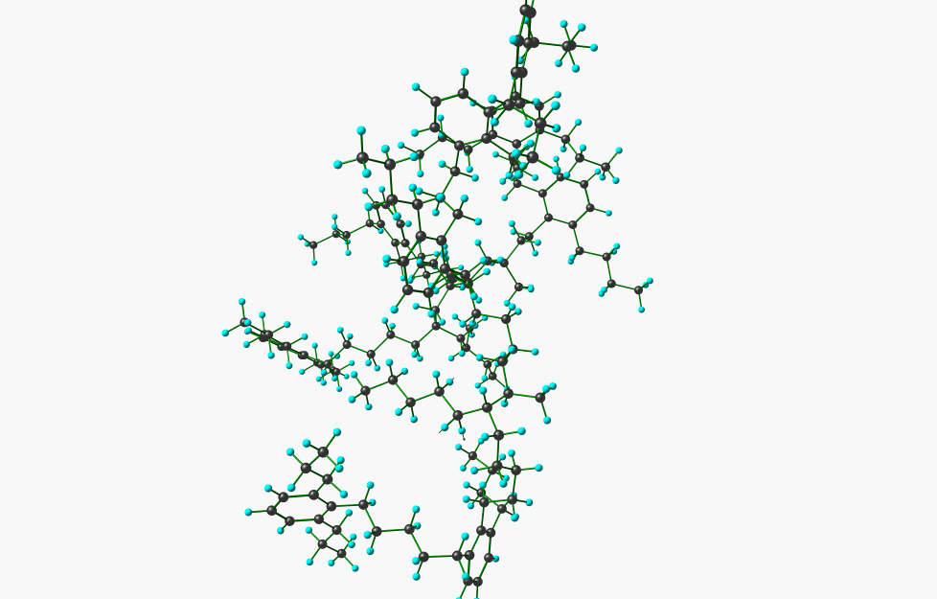
graphical interpretation
C₁₅₅ H₂₄₀ (vibrational motion at 3.4 µm)
asymmetric methylene C-H stretching
11th Pacific Rim Conference on Stellar Astrophysics

Slide 10
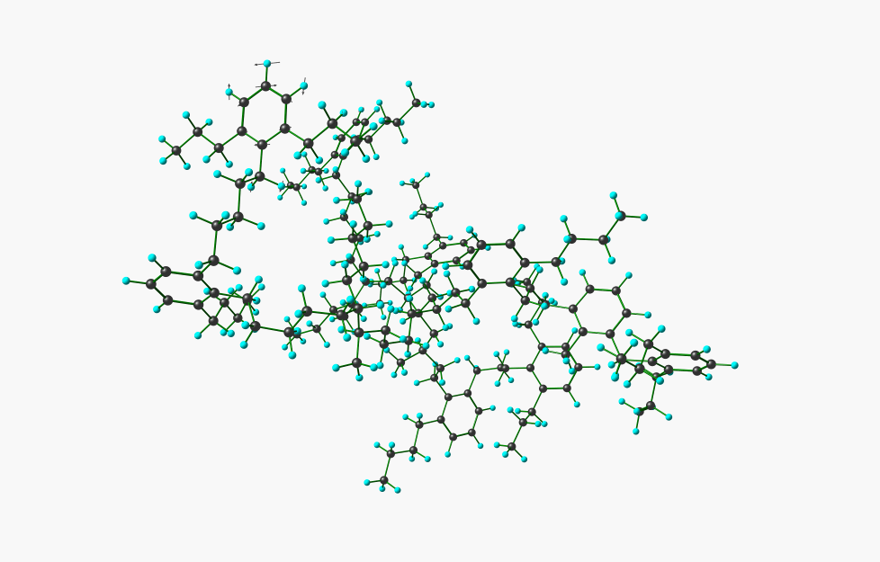
graphical interpretation
C₁₅₅ H₂₄₀ (vibrational motion at 6.35 µm)
aromatic C-C stretching coupled with
C-H in plane bending
11th Pacific Rim Conference on Stellar Astrophysics

Slide 11
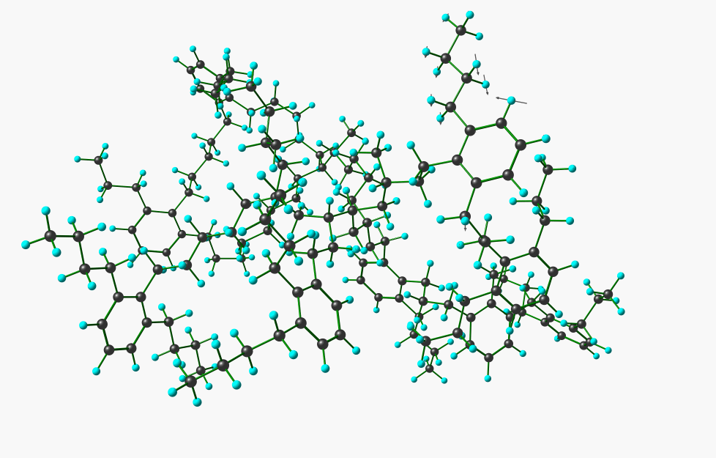
graphical interpretation
C₁₅₅ H₂₄₀ (vibrational motion at 8.13 µm)
methylene wagging
Annual meeting of the Hong Kong Astrophysical Society

Slide 12
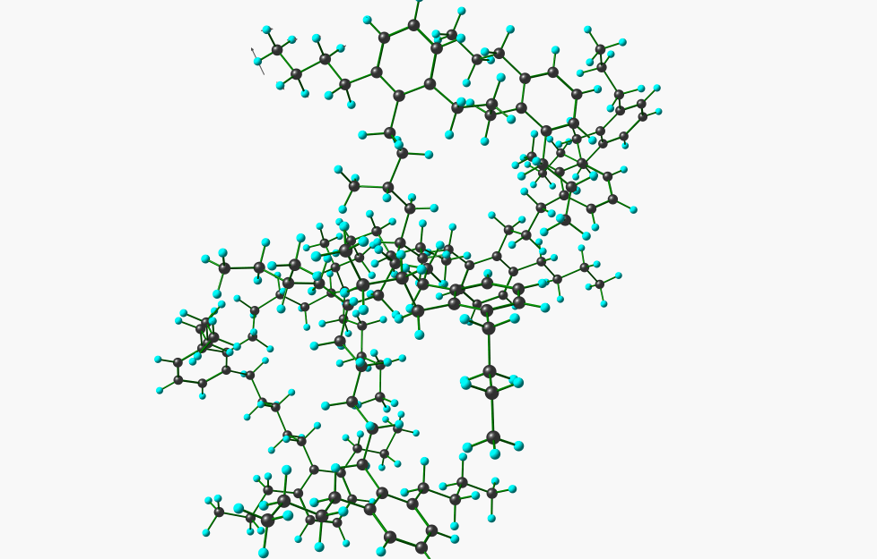
graphical interpretation
C₁₅₅ H₂₄₀ (vibrational motion at 11.16 µm)
aromatic C-H, OOP coupled with
Methyl & methylene vibrations
11th Pacific Rim Conference on Stellar Astrophysics

Slide 13
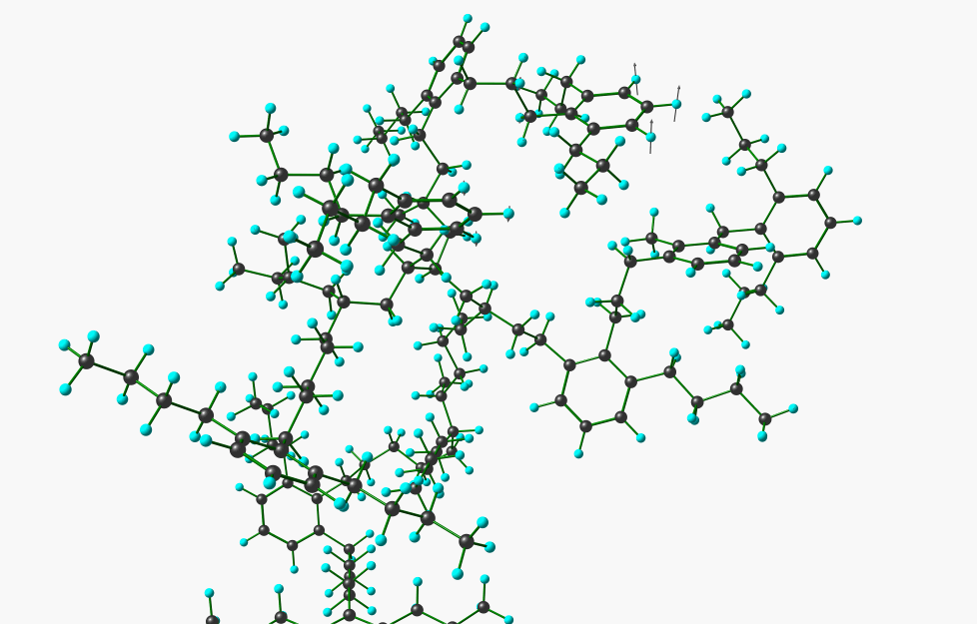
graphical interpretation
C₁₅₅ H₂₄₀ (vibrational motion at 13.20 µm)
aromatic C-H, OOP
11th Pacific Rim Conference on Stellar Astrophysics

Slide 14
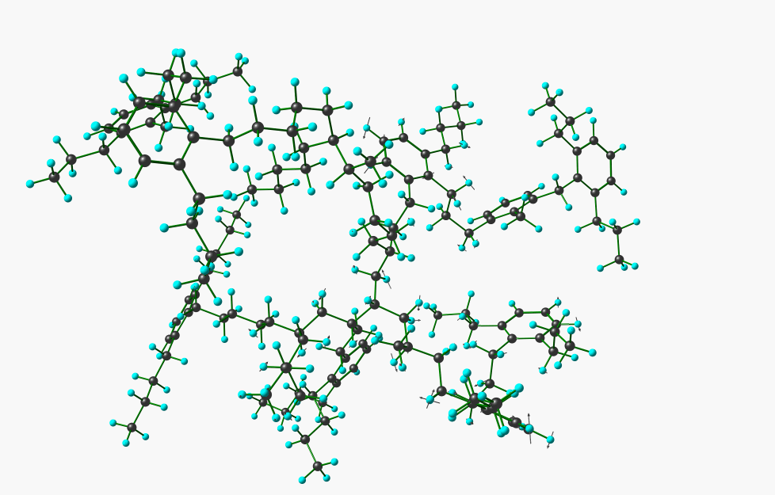
graphical and quantitative interpretations
C₁₅₅ H₂₄₀ (vibrational motion at 19.06 µm : 32% aromatic, 68% aliphatic)
complex vibrations
11th Pacific Rim Conference on Stellar Astrophysics

Slide 15



interpretation of infrared spectra
Quantum Mechanics
Displacement Vector Analysis
Molecular Mechanics
1945
force field
$$\hat{H}Ψ=EΨ$$
$$I_{k,i}^{CART}= \sum_{j}^{3N}{\frac{D_{k,j}L_{j,i}}{\sqrt{m_{k}}}}$$
$$N_{i}=\sqrt{{(\sum_{k}^{3N}{{{(I}_{k,i}^{CART})}^{2}})}^{−1}}$$
11th Pacific Rim Conference on Stellar Astrophysics

Slide 16
displacement vector analysis
60 neutral honeycomb like PAH
227 vibrations
112
Pure OOP
%solo, %duet, %trio, %quarto
solo
duet
Sadjadi, Zhang and Kwok, ApJ, 807:95 (2015 July 1)
11th Pacific Rim Conference on Stellar Astrophysics

Slide 17
prediction
unknown IR spectra
functional group
similarities
neural networks
Tabulated band positions
Spectra database
(250,000 Molecule)
Intellectual finding of
complex relationships
between any kinds of spectroscopic properties
and molecular specifications
All these approaches are followed in our Lab
11th Pacific Rim Conference on Stellar Astrophysics

Slide 18
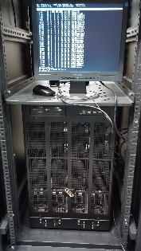


backbone of our theoretical approach
DFT
vibrational analysis
fingerprint
broadening
Sadjadi, Zhang and Kwok, ApJ, 801:34 (2015 March 1)
11th Pacific Rim Conference on Stellar Astrophysics

Slide 19
pictorial conclusion
spectra
molecule
spectra
CQC ?
CQC
forward transformation
of molecule(s) to the spectra
molecule
backward transformation
of spectra to its molecular origin
11th Pacific Rim Conference on Stellar Astrophysics

Slide 20



Acknowledgments
I am grateful to my supervisor:
Professor Sun Kwok
my two colleagues:
Dr. Yong Zhang Dr. Chih-Hao Hsia
Professor Quentin Parker’s group and all other colleagues in our LSR
My colleagues in Chemistry Department (Professor G.H.Chen’s group)
11th Pacific Rim Conference on Stellar Astrophysics

