Slide 1
The new Hong-Kong/AAO/Strasbourg Hα PN database: HASH
Quentin A Parker
Ivan Bojicic, David Frew (HKU)

Slide 2
The New HKU Late Stage Stellar evolution research group
Over the last 10 years established arguably one of the strongest groups in PN research at Macquarie University
we have now moved to HKU where an existing strong team was already present under Prof. Sun Kwok
2 PhD students currently recruited (offers made & accepted)
One PhD scholarship still available….

Slide 3
GRATUITOUS PLUG
APNVII – HKU 2017 – September
(exact date TBC)

Slide 4
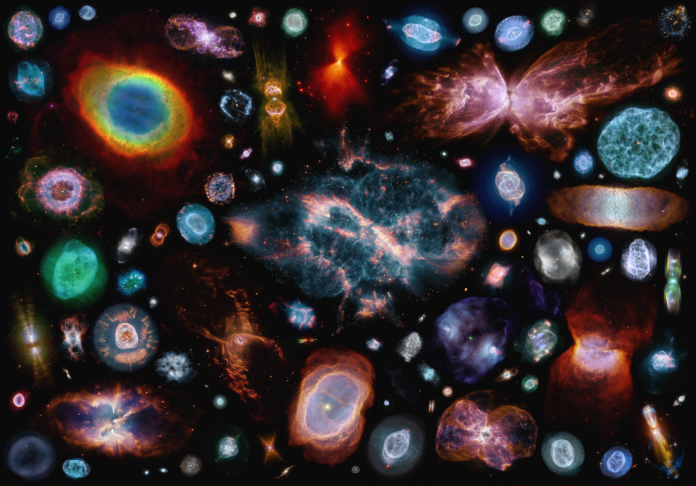

Slide 5
On-going progress@HKU in PN research
More DISCOVERIES – MASH, IPHAS, VPHAS+, DSH → 3500+ ( – see poster by Draskovic for SMC and Kronberger and Acker for our Galaxy)
Better PN DISTANCES – SB-r relationship Frew, Parker & Bojicic. 2015, MNRAS, (Frew this meeting) and see poster by Vickers for post-AGB stars
Accurate FLUXES (e.g. via SHASSA – Frew, Bojicic & Parker, 2013) – homogeneous, reliable fluxes (Ha & [OIII] ) for 1st time for large numbers of PN in our Galaxy and LMC
Eliminating MIMICS: new methodologies and data → PN catalogues of high purity (e.g. Frew & Parker 2010, Sabin et al 2013) → feeds into everything!

Slide 6
On-going progress@HKU in PN research
Thousands of Interesting non PN catalogued: Miscellaneous Emission Nebulae - rejected PN (MEN)
PNLFS generated and studied (unprecedented samples now available for the Bulge , LMC (Reid & Parker) and local 2Kpc volume (Frew et al) over an 8-10mag range
Multi-wavelength studies undertaken - optical, MIR, radio, X-ray → helps to eliminate mimics
CSPN characteristics derived including [WR] types
BINARITY investigated using local volume sample 1,2, 3 Kpc (most complete census available- Frew, PhD thesis 2008, Frew et al in prep)
AGB Haloes uncovered and observed
IFU studies (SHAPE morpho-kinematic analysis)

Slide 7
20th November 2015

Slide 8
There have been a LOT of Galactic PNe discovered over the last 15 years, more than doubling the totals accrued by all telescopes over the previous 200+ years..
The scope of PNe studies for these ~3500 GPN must reflect this new landscape and include them…
Studies should ensure that representative samples from the current known Galactic PNe population are used/studied/re-observed and not just the usual “easy” PNe available in previous catalogues pre MASH-I & MASH-II,IPHAS and DSH (see posters by Kronberger & Acker)

Slide 9
Motivation for a new integrated platform for PN research
Provide, for the first time, an accessible, reliable on-line ’one-stop’ shop for essential, up-to date information for all known Galactic & MC PNe
Reliably remove the many PN mimics/false ID’s that have biased previous compilations and subsequent studies
Provide accurate, updated positions, sizes, morphologies, radial velocities, fluxes, multi-wavelength imagery and spectroscopy wherever possible
Link to CDS/Vizier and hence provide archival history for each object
Provide an SQL interface to sift, select, browse, collate, investigate, download and visualise the complete currently known Galactic PNe diaspora
And hence to provide the community with the most complete data with which to undertake new science!
It is late but release is finally imminent

Slide 10
Breakdown of current numbers 9157 total entries in database
Now 3288 T,L,P PNe included (down from 3420 in 2013)
Includes ~300
New IPHAS
and DSH
discoveries

Slide 11
MAIN database: Basic content
Consolidated and federated Galactic PN database of ~3300 True, Likely and Possible (T,L,P) PNe – neglected lists checked and ingested
Corrected/updated co-ordinates (and hence PN G ll.l,bb.b) for all T,L,P Galactic PNe provided
Improved PN T,L,P identifications given
Removal of contaminants
Improved angular size estimates
Assigned morphologies according to consistent MASH ERBIAS scheme
WCS matched multi-wavelength images in more than 20 bands
Significantly increased spectroscopic coverage for catalogue entries
E.g. ~1050 spectra from Acker (1985-1998) available on-line for 1st time

Slide 12
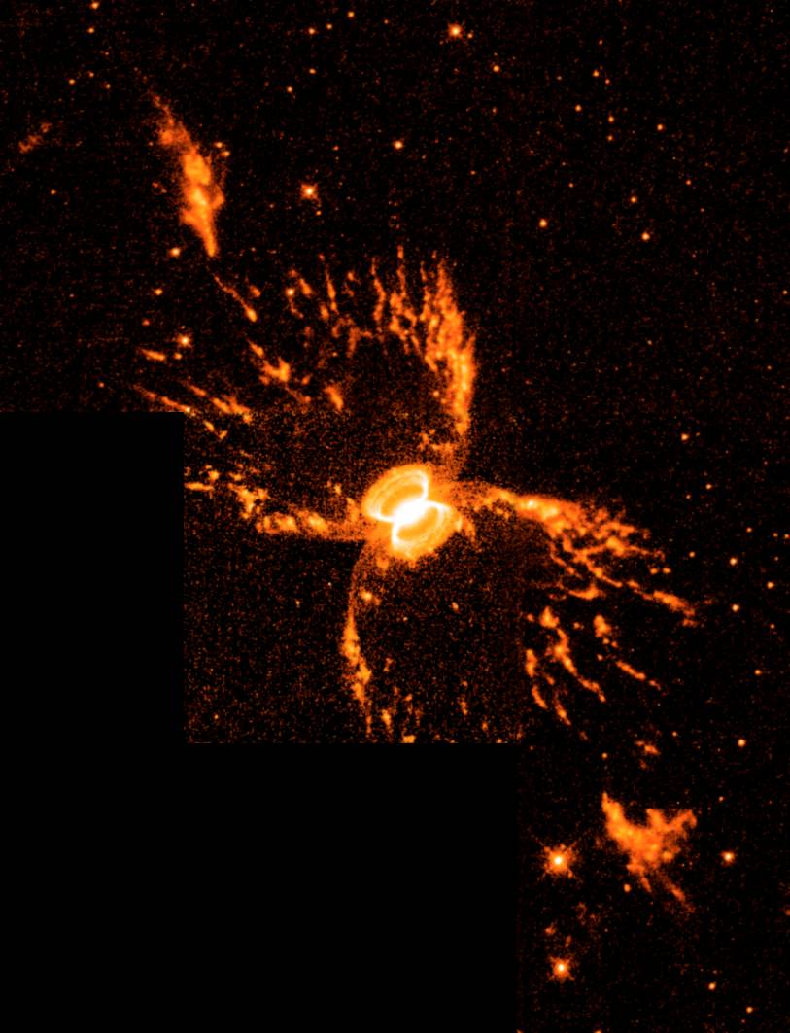
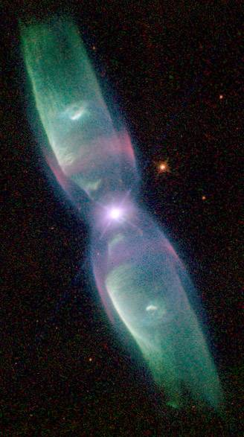
The problem of contaminants
A major problem undermining the value of previous PN surveys (e.g. in GLIPMSE zone shown 45% of previously known pre MASH PN are contaminants – Cohen et al 2010).
PN identification complicated by wide variety of morphologies, ionization characteristics and brightness distribution of the PN family
Characteristics reflect stages of nebular evolution, progenitor mass and chemistry and the possible influence of common envelope binaries, magnetic fields or even sub-solar planets.
Have tested a range of criteria to eliminate contaminants → done by assessing morphology, emission-line intensities and widths, ionization structure, systemic velocity, ionized mass and the properties of the central star (if possible)
Only recent online availability of multi-wavelength imaging surveys and other data has enabled our new discrimination tools to be developed (Frew & Parker, 2010, Parker et al. 2013, Frew et al, in prep.)
Hen 2-104
M 2-9

Slide 13
Some current PN catalogue entries are obvious interlopers once you look at them with
modern imaging…..ermm……. Galaxies anyone?

Slide 15
Assigning the correct photometry is important

Slide 16
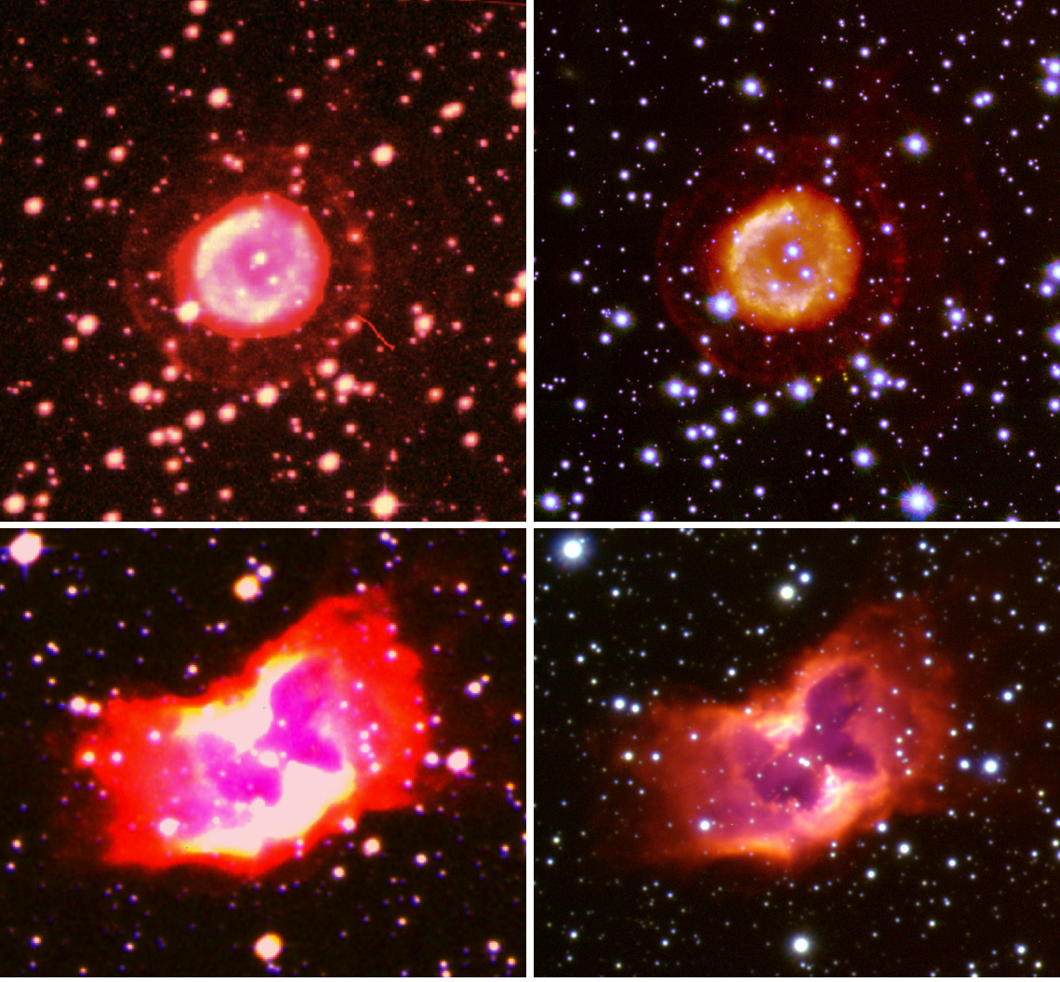
Making use
of new surveys
and data.
SHS on left
VPHAS+ right
Which has a ‘u’
band for CSPN
ID

Slide 17
Updated & improved PN co-ordinates
Despite recent papers on the provision of accurate PN co-ordinates (e.g. Kerber et al. 2003, Kimeswenger et al. 2001 and even MASH: Parker et al 2006 – mea culpa) it is surprising how poor some PN positions remain!
Sometimes this is because only part of the PNe’s extent is used to provide the position from broad band data whereas Hα images give a truer picture
On-line surveys in various narrow and broad-bands with accurate astrometry now enables a more robust mechanism to check PNe positions
All Galactic T,L,P PNe checked & positional offsets corrected where necessary.
Accurate, homogeneously derived PNe positions part of the new database.
Obtained by aperture and centroid fitting to Hα images at 80% contour

Slide 18
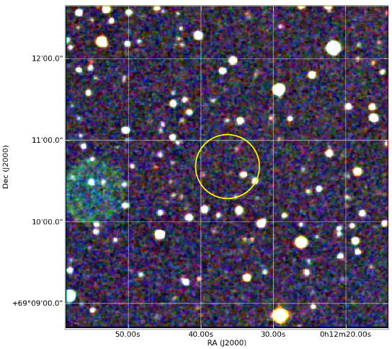
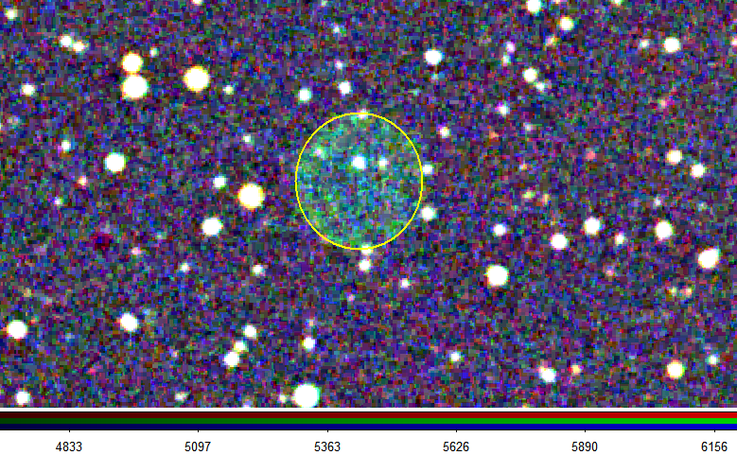
idPNMain | idtiff1 | PNG_Tiff | NEW PNG | Offset (arcsecs) | offset / diameter | Catalogue | COORD Catalogue | PN status
4123 | 735 | 119.4+06.5 | 084.0+09.5B | 101.5923193 | 210.11% | KOHOUTEK 2001 | ACKER_1992_main | y
Serious offsets found and corrected
Before
After

Slide 19
Histogram of CDS/published versus new position offsets

Slide 20
MAIN database: CDS Structure
A CDS/Vizier front end has been built for the new MASPN database
Consolidated Galactic PN database of ~3300 T,L,P PNe
~9200 objects in total including LMC/SMC PNe, rejected PNe (objects identified at least once before in the literature as a PN/PN candidate), pre-PNe, Symbiotic stars, emission line stars of various kinds etc.

Slide 21
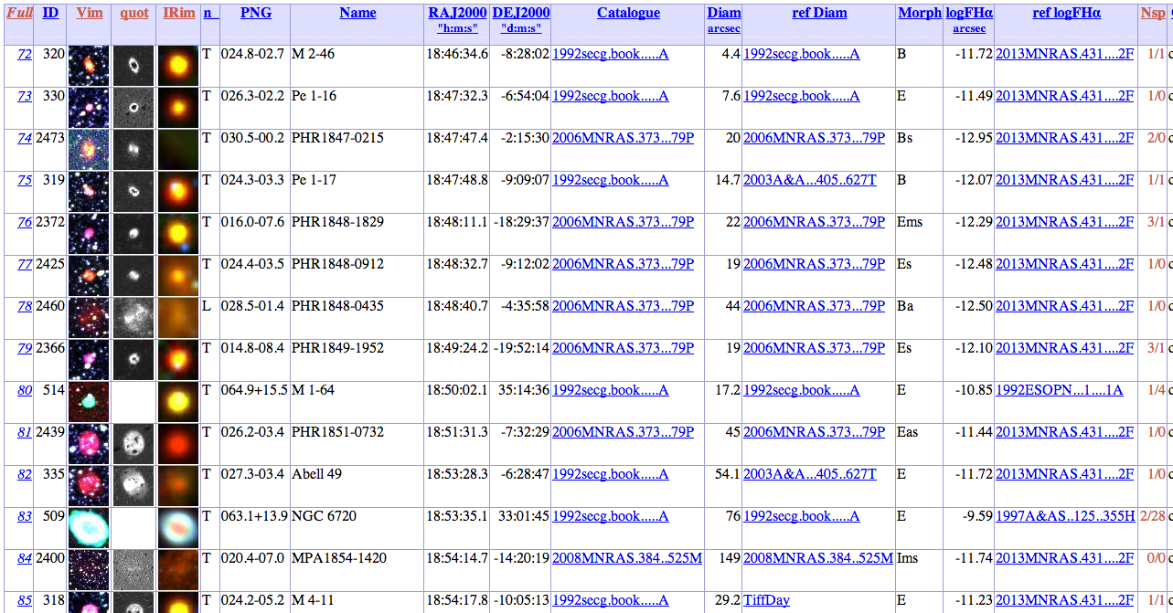
MAIN database: CDS Structure

Slide 22
HASH user Interface: Technical stuff
Data is stored in a MySQL database
Front-end code is built using HTML, CSS, PHP and Javascript (JQuery) programing languages
Fits cutouts and online images have been created using the Python programing language (using PyRAF, Matplotlib, APLpy and Astropy libraries)
Access to main user interface is login-based (i.e. you’ll need an account) but basic data/image/tables accessible through Vizier

Slide 23
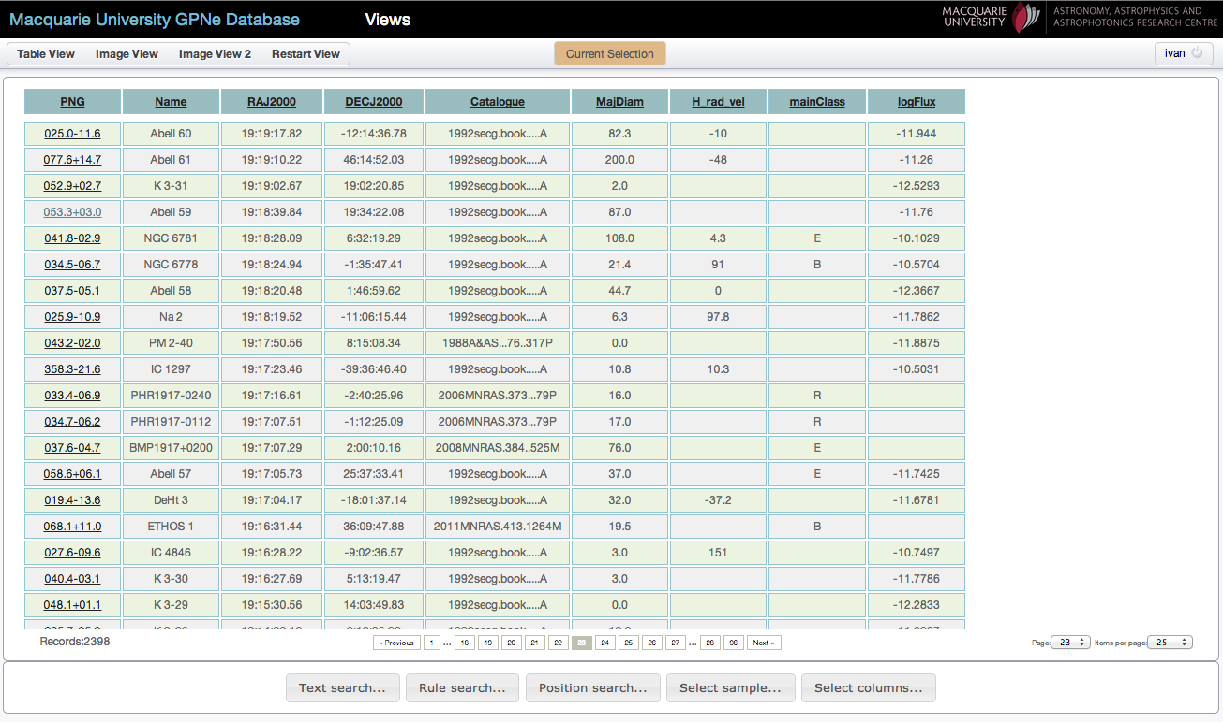
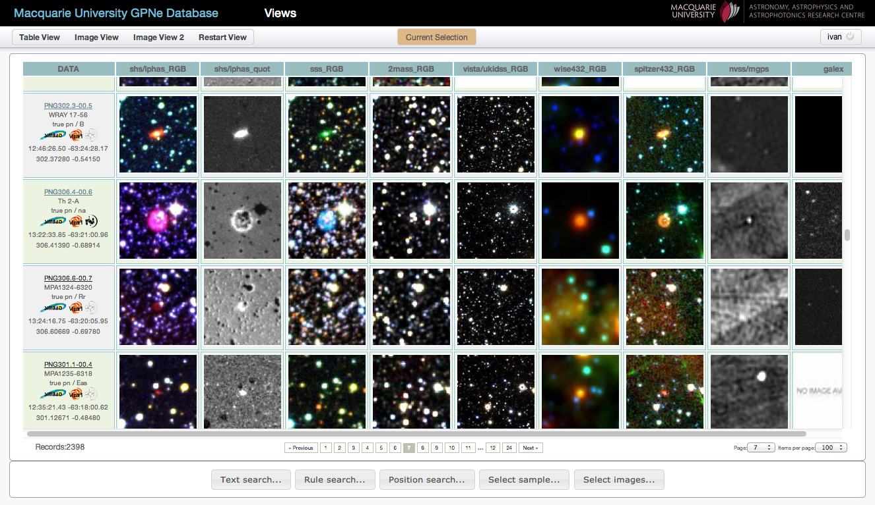
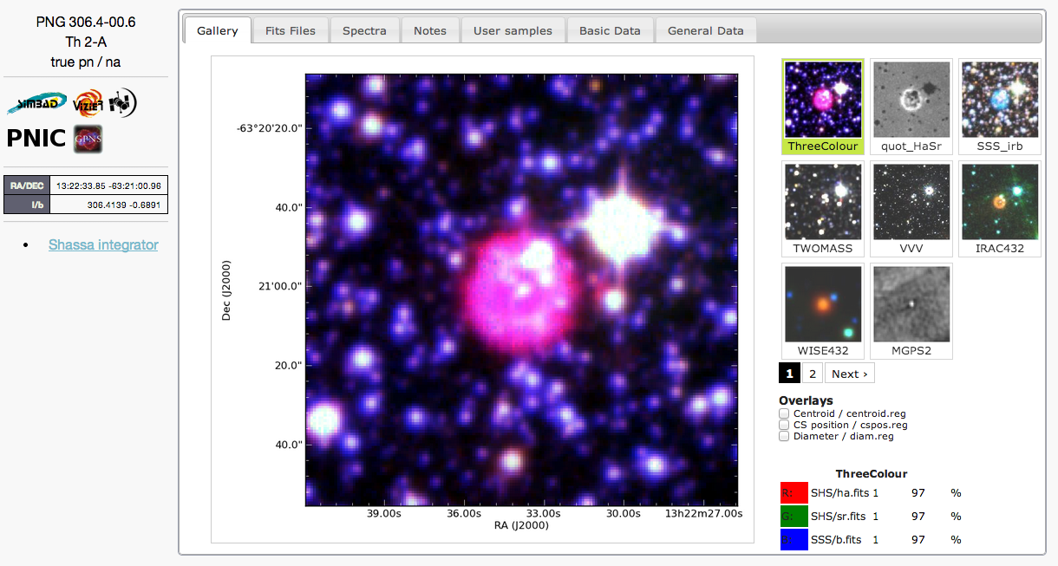
User Interface: basic workflow
Text
e.g. “NGC 7027”
Rule
e.g. “majD < 25arcsec and
logFHa < -12.5 ”
and/or
Can be combined e.g. “True, and Bipolar PNe, located in the direction of GB with majD < 35rcsec and F(6cm) < 60mJy”
Position
and/or
Table View
Predefined
sample(s)
e.g. PN status,
Catalogue, Morph.,etc.
Selected Object
Image View

Slide 24
Statistical summary: (as of 01/12/15)
Database now contains 9200 objects:
3350 reduced spectra for 2300 unique objects (1900 T PNe) from Beaulieu et al. 1999, Hora et al. 1999, Boumis et al. 2003; 2006, Jacoby & Van de Steene 2004, Parker et al. 2006, Suarez et al. 2006, Sabin et al. 2014 and including 1050 spectra from Acker et al (previously unpublished)
ELCAT Emission line fluxes for ~750 True PNe from ( Kaler et al. 1997) + ~400 True PNe from “post-ELCAT” publications (work in progress)
>400 000 pre-made fits cutouts and ~71 000 pre-made images from 20 major imaging surveys (SHS, IPHAS, UKIDSS, VVV, GLIMPSE, WISE, GALEX, NVSS …)
Consolidated and standardized datasets for angular dimensions, integrated Hα, Hβ, radio continuum and IR fluxes, radial velocities, etc. (work in progress)

Slide 25
HASH Database

Slide 26
Detailed manual

Slide 27
‘WALL’ option to move objects around to gather PN into similar groups

Slide 28
IPHAS survey images ingested – VPHAS+ in train

Slide 34
Selected object from Table

Slide 35
Can check SIMBAD entry via click on icon

Slide 36
Can click on spectra tab

Slide 37
Can interactively zoom-in & overplot multiple spectra
Notes:
Spectra are normalised to brightest visible line

Slide 38
Detailed notes can be associated with each PN entry…

Slide 39
Can cycle through all available multi-wavelength images

Slide 40
Purified/Improved PNe IDs
Clear discrimination tools developed (e.g. Frew & Parker, 2010)
Newly consolidated multi-wavelength imagery assists this process
Extensive additional spectroscopy further aids ID and classification
New T, L, P or ‘NOT PN’ (or other category) given to all entries based on best available photometric, imagery and spectroscopic evidence
T: Has to have confirmatory spectroscopy as well as other evidence
L: As above but no spectra
P: some aspects of available data inconclusive for a likely PN ID

Slide 41
All “known” PNe being checked against all current evidence – images *and* spectroscopy and if necessary re-assigned….

Slide 42
Clearly ‘NOT” a PN…….

Slide 43
Another example of PN→ Not PN

Slide 44
Not PN imagery or spectrum

Slide 45
While some objects finally receive the true PN recognition they deserve ☺

Slide 46
Compact Hα emitter resolved on UKIDSS with PN optical spectrum

Slide 47
PN claims…..tested
CDS entries simply reflect the latest refereed publications and claims on object status whether reliable or not!
“we have found four new PN, three of which are shown in Fig. 6.
These objects were selected based on the appearance of their H2 line emission.”
(Froebrich et al. MNRAS, 2011)
- We classify these four objects as T, L, P and ‘Not PN’ based on our rules and visualisation

Slide 48
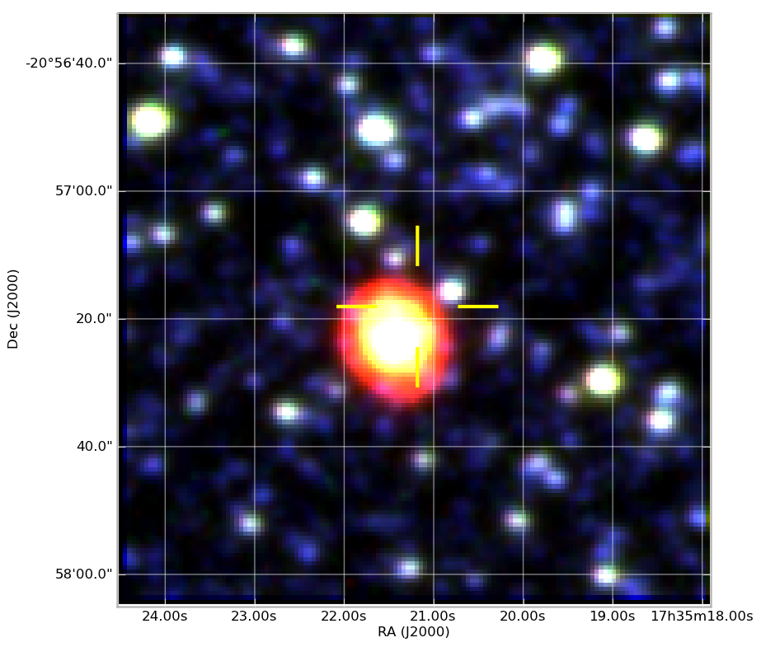
idPNMain | idtiff1 | PNG_Tiff | NEW PNG | Offset (arcsecs) | offset / diameter | Catalogue | COORD Catalogue | PN status
4106 | 267 | 005.5+06.1 | 005.5+06.1 | 6.32670155 | 32.58% | ACKER 1992 | ACKER_1992_main | y
Smaller corrections also applied
After
Before

Slide 49
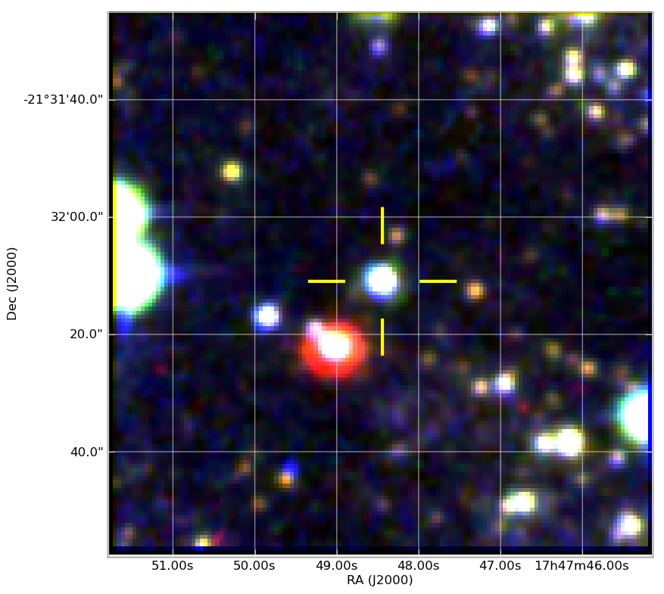
idPNMain | idtiff1 | PNG_Tiff | NEW PNG | Offset (arcsecs) | offset / diameter | Catalogue | COORD Catalogue | PN status
185 | 296 | 006.5+03.4 | 006.5+03.4 | 14.336716 | 150.65% | KOHOUTEK 2001 | KERBER_2003 | y
Even some well known PNe have poor
catalogued co-ordinates in SIMBAD (PBOZ 29)
After
Before

Slide 50
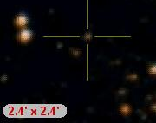

Slide 51
Tidying up confusion in the CDS (for PN….)

Slide 52
Are there two different PN?

Slide 53
Clarified ID & position – a single object!

Slide 54
Propagation of errors through the system for putative PN
Many people take CDS entries and ID’s at face value.
This is o.k. mostly and for many types of sources and object catalogues but currently caveat emptor for PN
Some objects have gone from a “possible” PN ID in many a previous reference only to get included in a catalogue of PN positions which CDS then latches onto…. so the object then becomes a “True” PN….

Slide 55
PN as emulsion flaws…22 references in Simbad!

Slide 56
Clearly not a PN - or anything else for that matter

Slide 57
Image flux integrator built-in

Slide 58
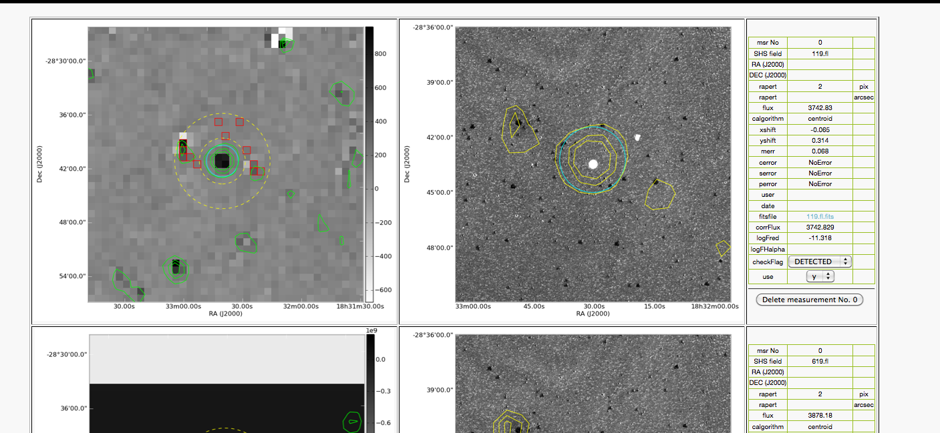
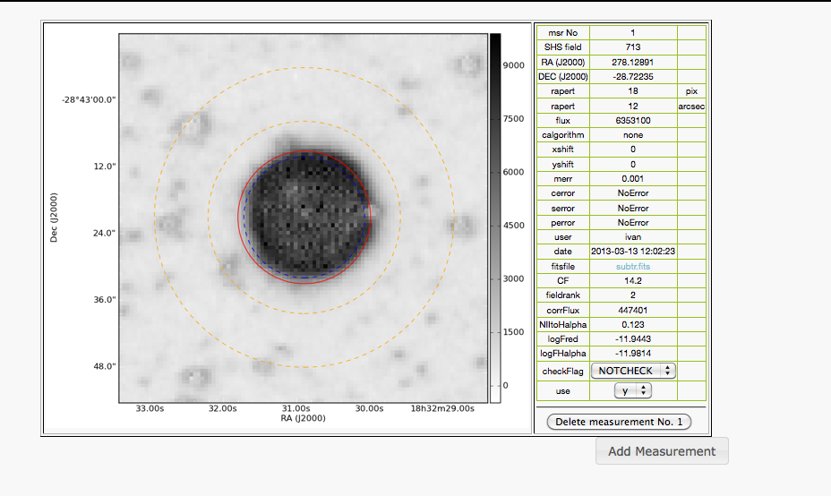
PN Hf 2-2 (SHASSA)
Online “Integrator”:
semi-automated photometry pipeline for extended objects
“drives” an IRAF’s photometry pipeline (scripted in PYRAF) and displays results in online form
allows quick examination and modification of used photometry parameters (aperture/annulus size and position)
online interface enables remote examination of used parameters and results
For now it’s “custom made” for SHASSA, SHS and IRAC (still in testing)
PN Hf 2-2 (SHS)

Slide 59
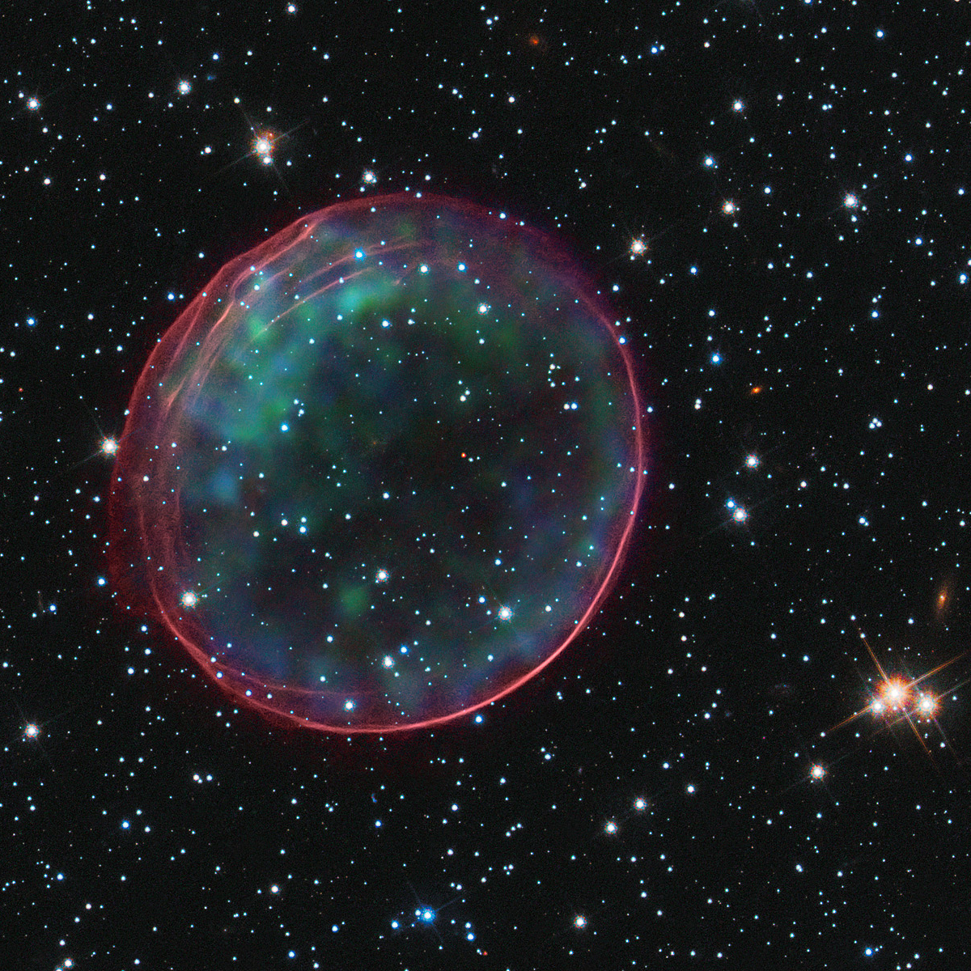
THANK YOU……
and this is a not a PN….
MASPN Database V1.0
goes live in January 2014.
THANK YOU

Slide 61
Multi-wavelength studies of PNe and their mimics –only object at BRHC is a true PN!
RCW 58, WR ejecta
PCG 11, WR ejecta
GK Per, nova shell
NGC 6164, Of* ejecta
WR 16, WR bubble
PHR1424-5138, PN

Slide 63
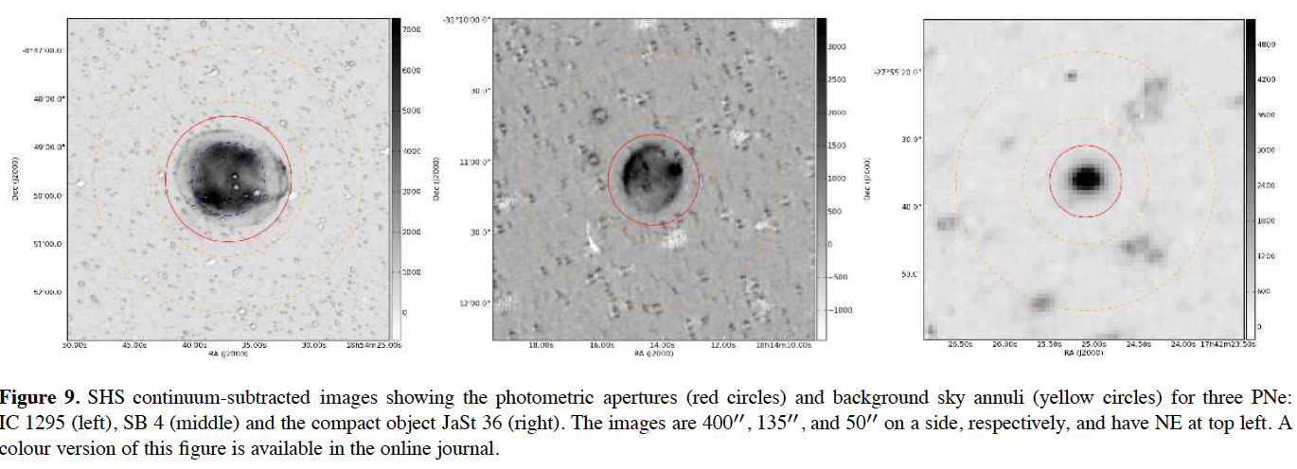
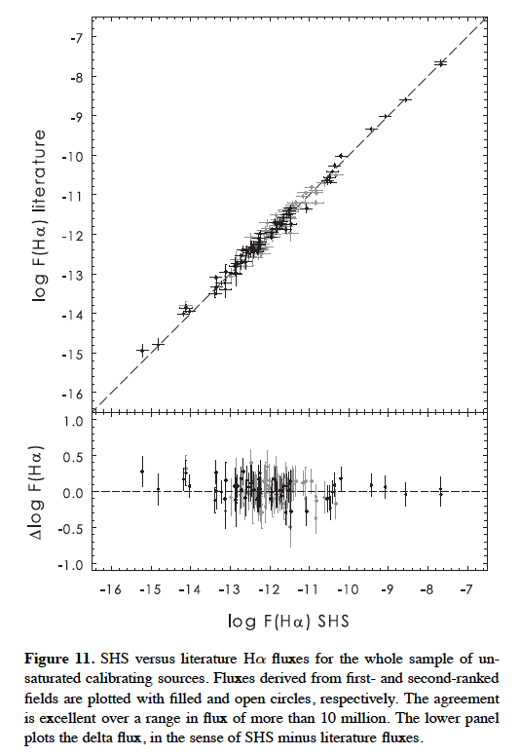
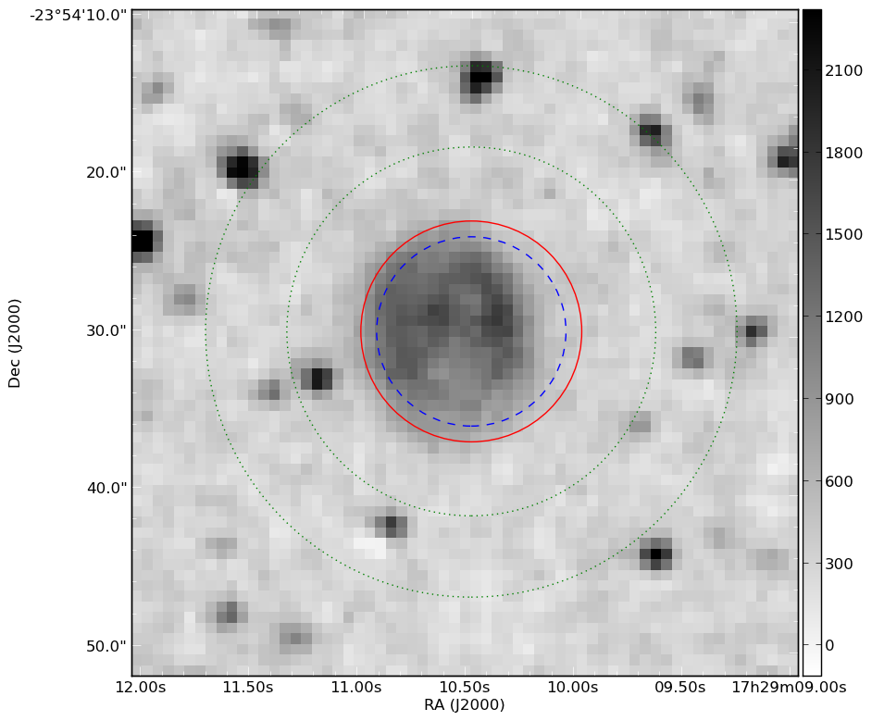
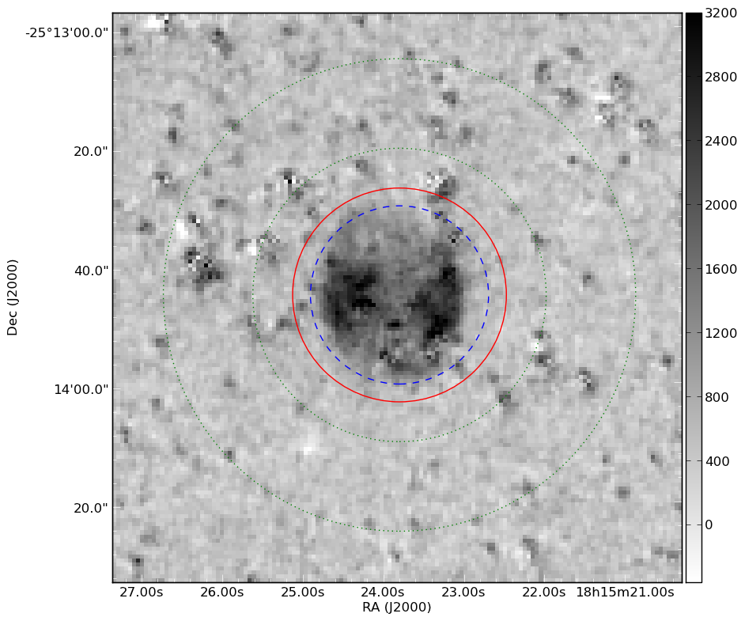
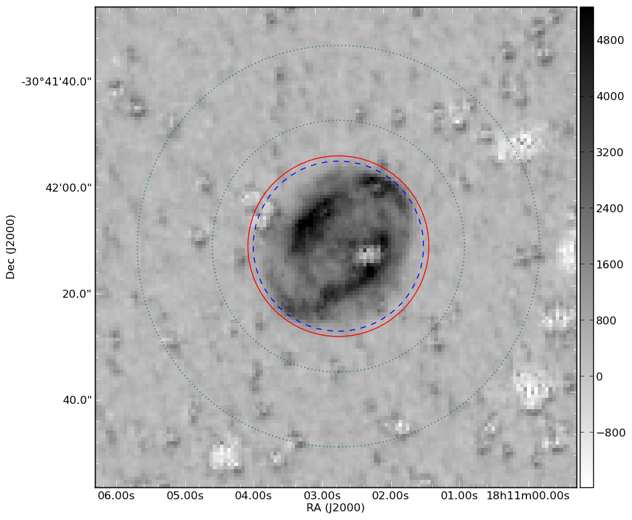
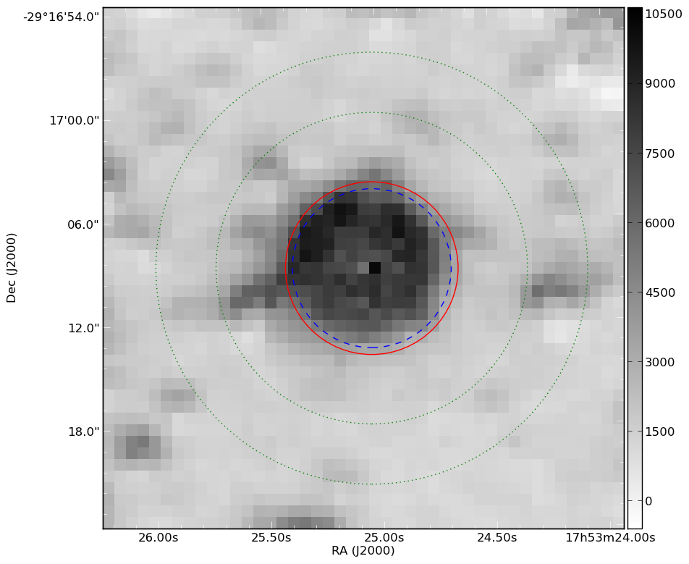
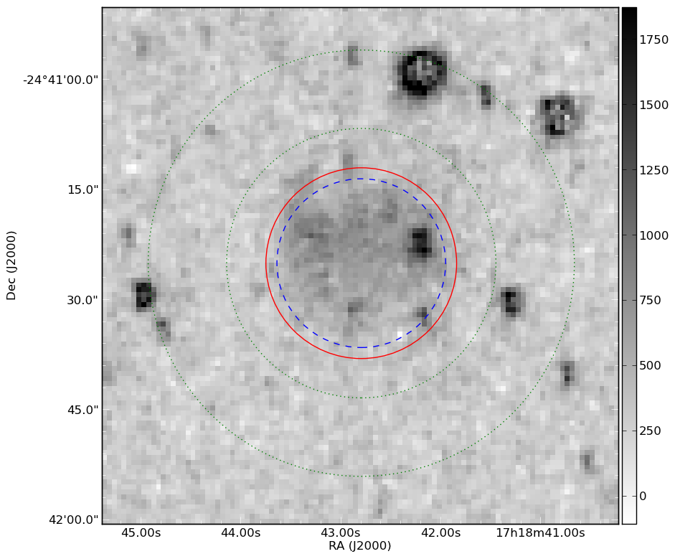
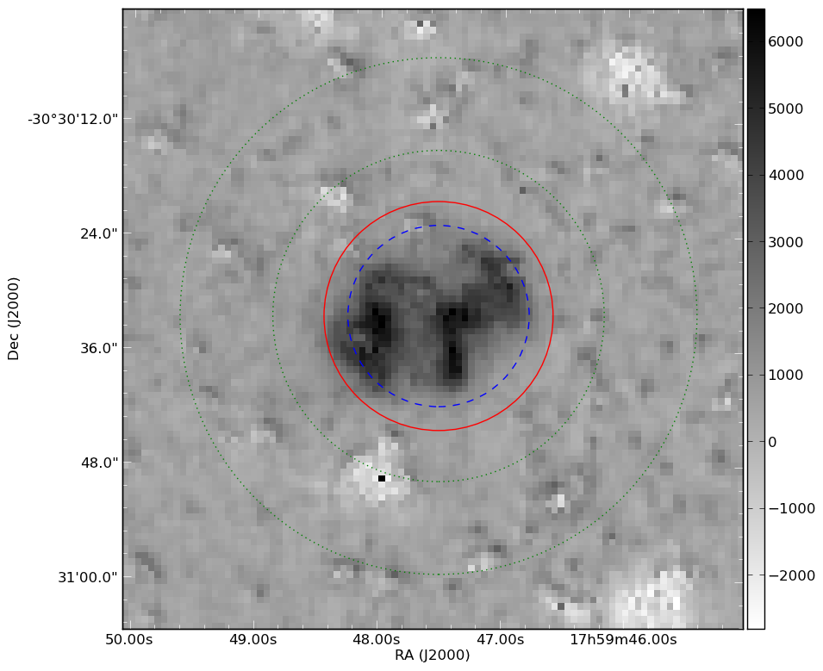
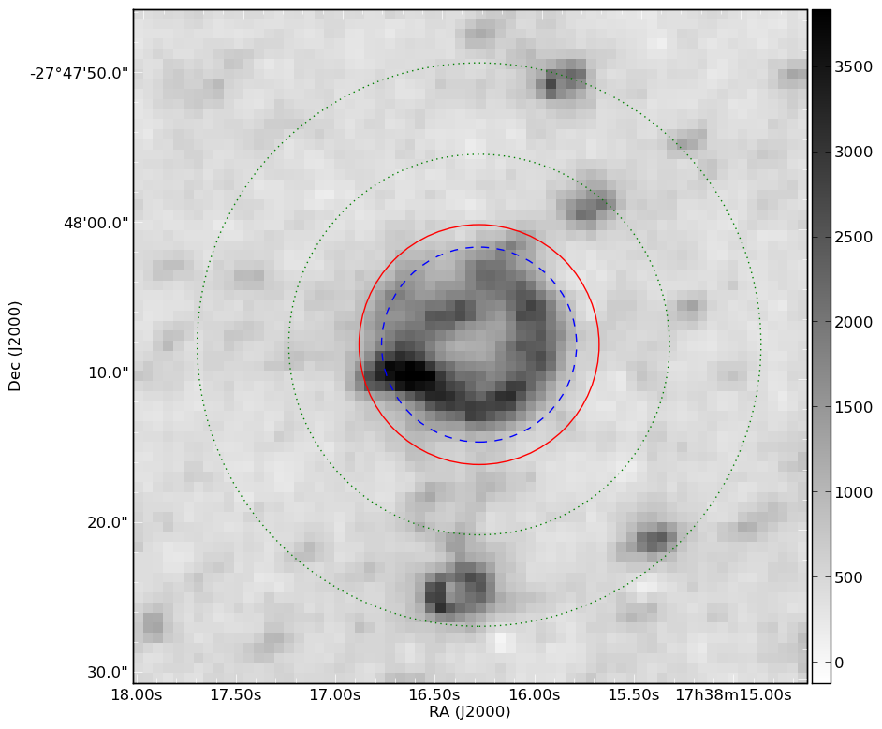
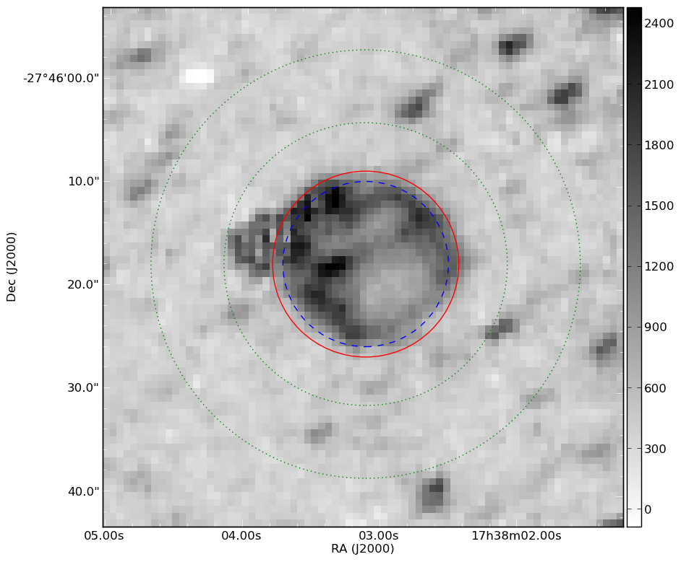
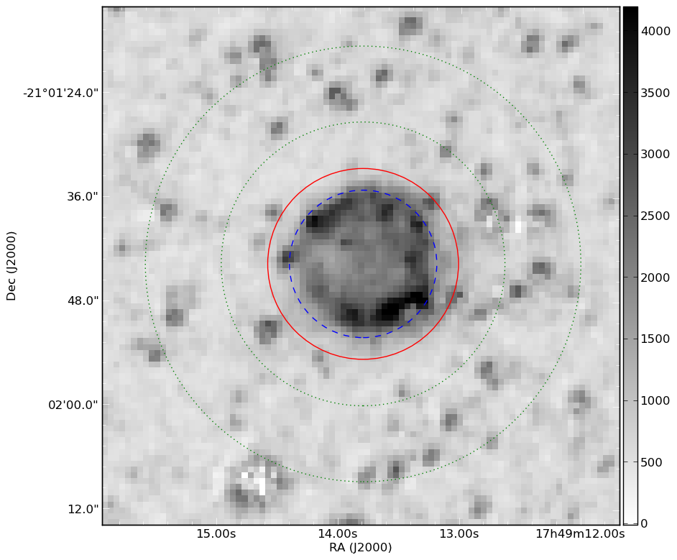
Bulge PN previously determined fluxes for calibration (on-line integrator)
For SHS photographic
data too!
Bulge PN with new our fluxes
We are able to derive accurate F_{halpha} for >200 Galactic PNe for which no previous estimate of F_{halpha} is available (Bojicic et al. in preparation).

