Slide 1
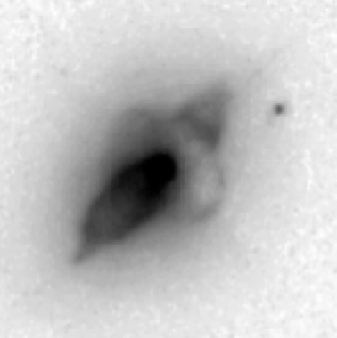
The Prevalence and Implications of Sharp Outer Edge of Disks in Preplanetary Nebulae
Mark Morris (UCLA) and Raghvendra Sahai (JPL)

Slide 2
Many preplanetary nebulae appear to have an optically thick concentration of
dust in or near their equatorial plane, manifested as a dark “waist” in the typically
bipolar nebula. In many cases, these waists can apparently be attributed to unbound
material flowing relatively slowly out of the system. Some, however, may be bound
disks. In either case, the presence of an equatorial dust concentration extending to
fairly large radii is noticeable when it is projected against the background lobe of the
bipolar, partially obscuring only that lobe. In many systems in which the projection
angle is suitable, observations show that the obscuration by the equatorial “disk”
ends abruptly at some radius, where one can see a clear discontinuity in the surface
brightness along the curved outer edge of the disk. That is, there appears to be a
sharp radial cutoff in the dust distribution. In a few cases, the outer edge of the disk
shows an excess brightness, as if it is preferentially illuminated. These sharp outer
edges to the dust distributions have profound implications. For unbound,
outflowing equatorial dust concentrations, the sharp discontinuity would
correspond to an extremely abrupt onset of the heavy mass loss, which severely
constrains the nature of the mass-loss mechanism. For bound disks, on the other
hand, the radial cutoff raises the possibility of a dynamical interaction with a planet
or a companion star. Alternatively, the cutoff might reveal that the mechanism for
forming a bound disk cannot provide the orbiting material with more angular
momentum than a certain critical value. Dynamical studies of the gas associated
with the dust in these systems will be important for sorting out these possibilities.

Slide 3
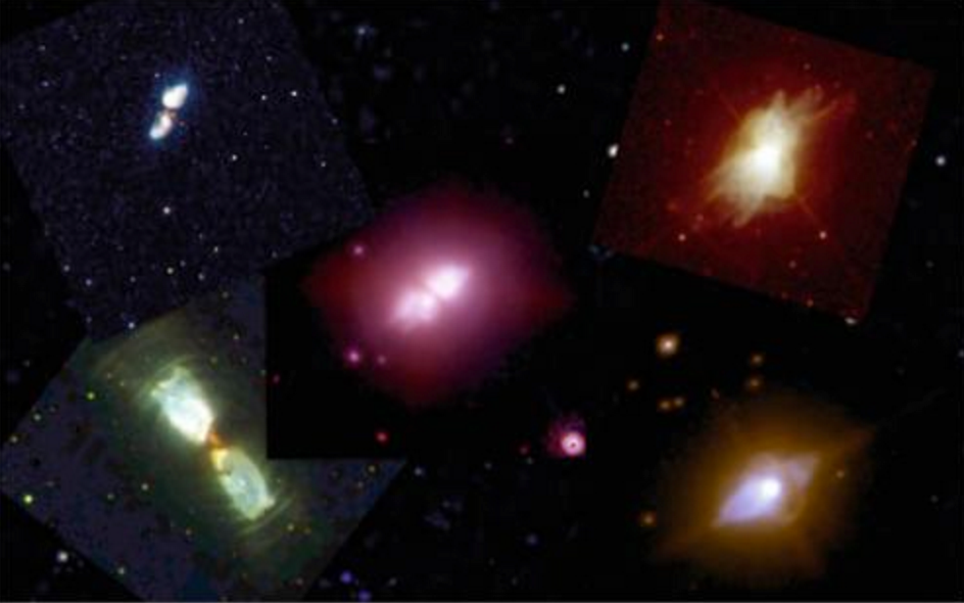
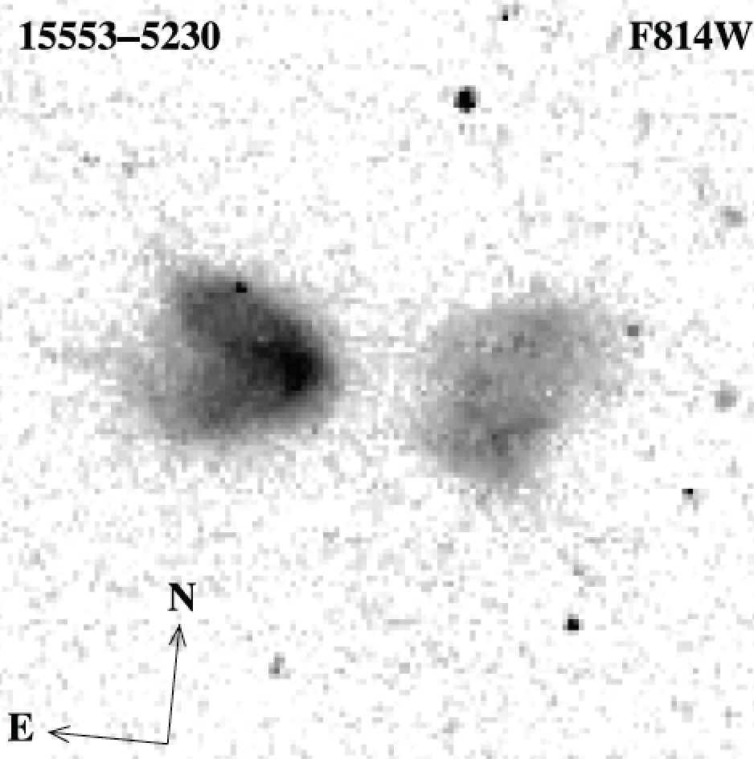
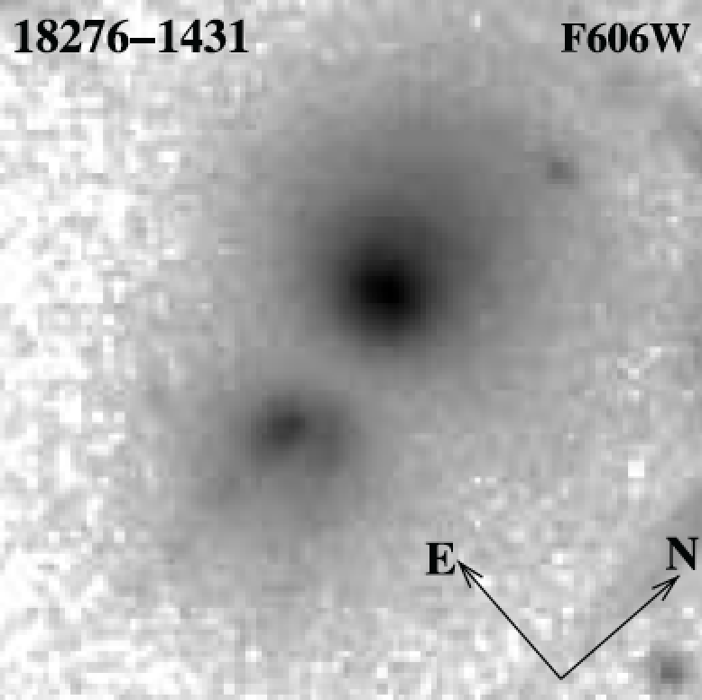
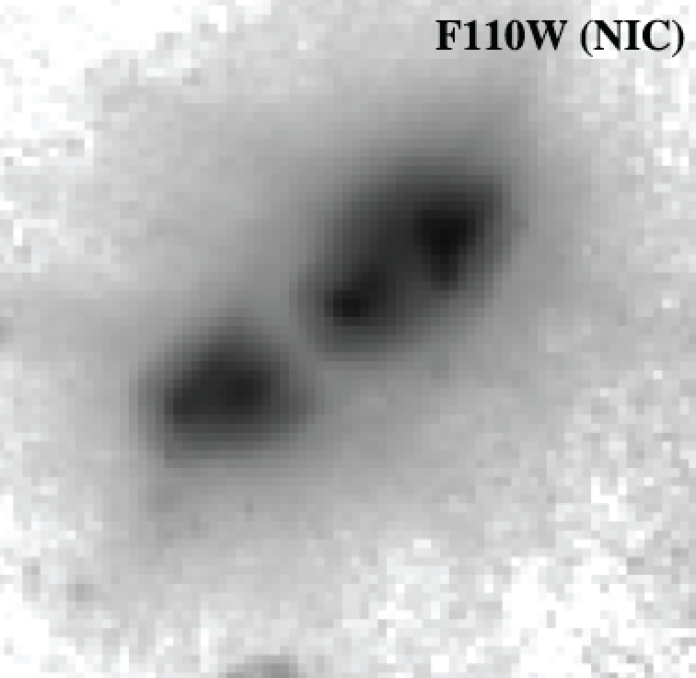
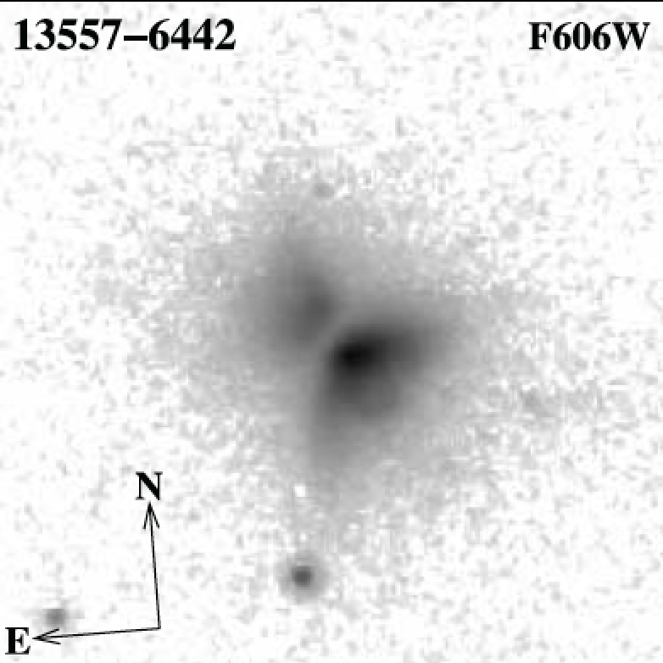
Recognizable preplanetary nebulae are almost always bipolar, with a dark central waist that corresponds to an
optically thick disk-like
equatorial concentration of absorbing dust.
Bipolars and their disks require a close central binary (Morris 1981, 1987; Mastrodemos & Morris 1998, 1999)
Kwok 2013
Sahai et al. 2007
15405-4945

Slide 4
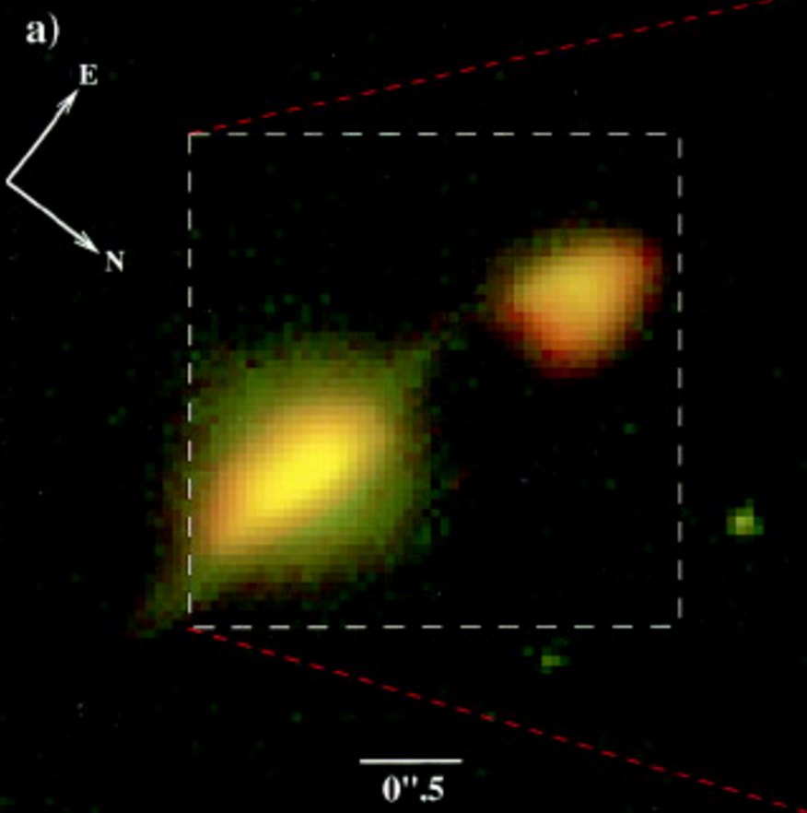
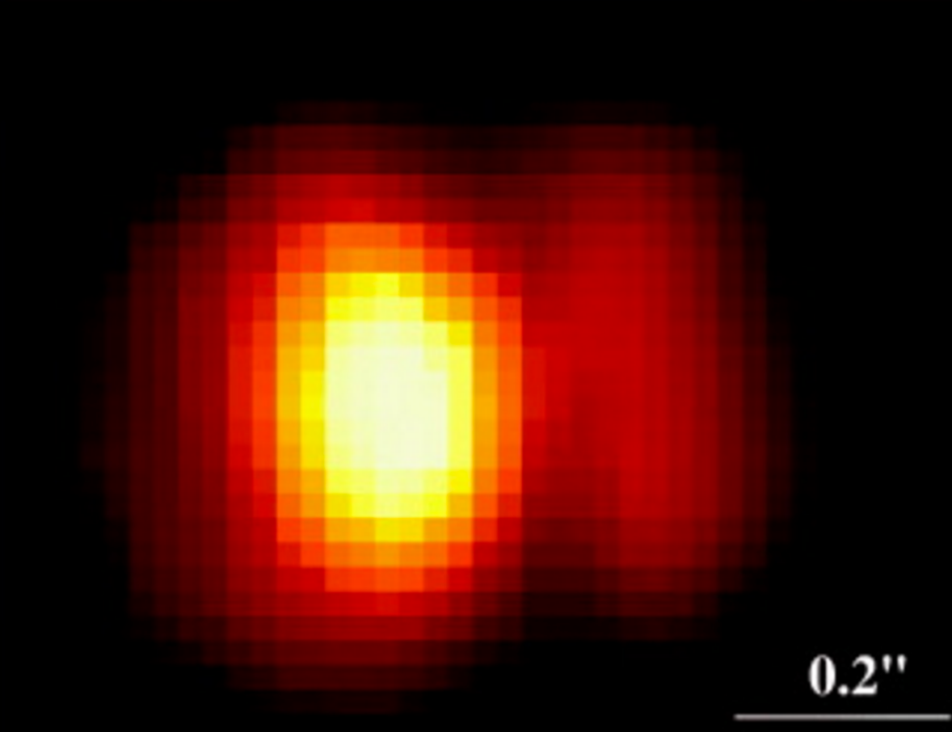
When the symmetry axis is tilted appropriately, the disk can block light from the rear lobe of the nebula.
A large fraction of such systems show a sharp outer boundary to the disk !
IRAS16342-3814
Hen 2-90
Sahai et al. 1999
Sahai & Nyman 2000

Slide 5
Bipolar structure, with opaque disk
having a density discontinuity
at some radius

Slide 6
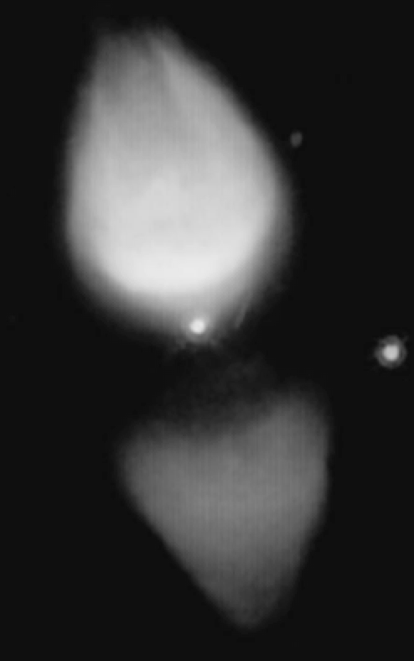

Slide 7
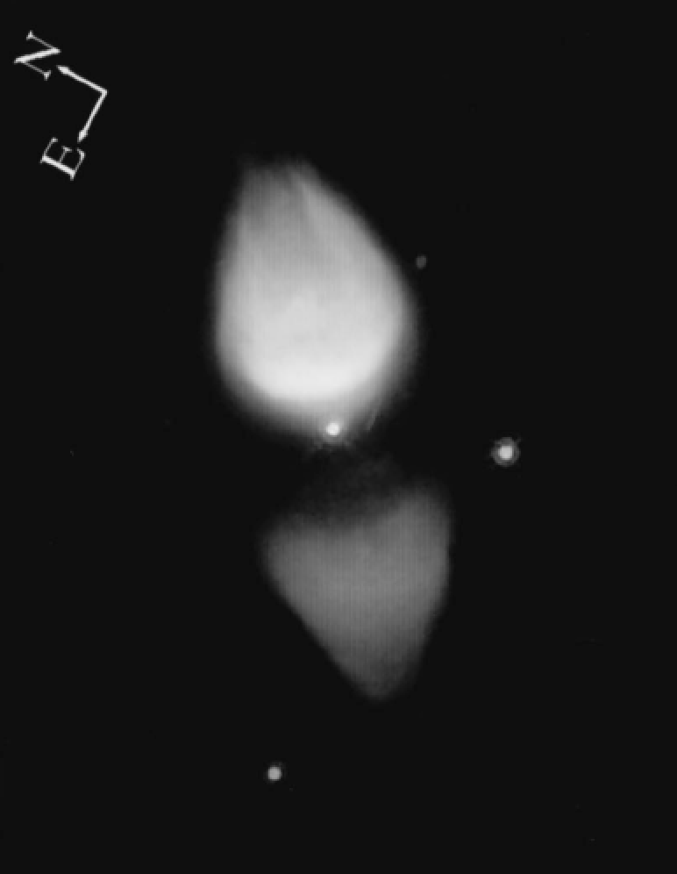
M1-92
Trammell & Goodrich 1996

Slide 8
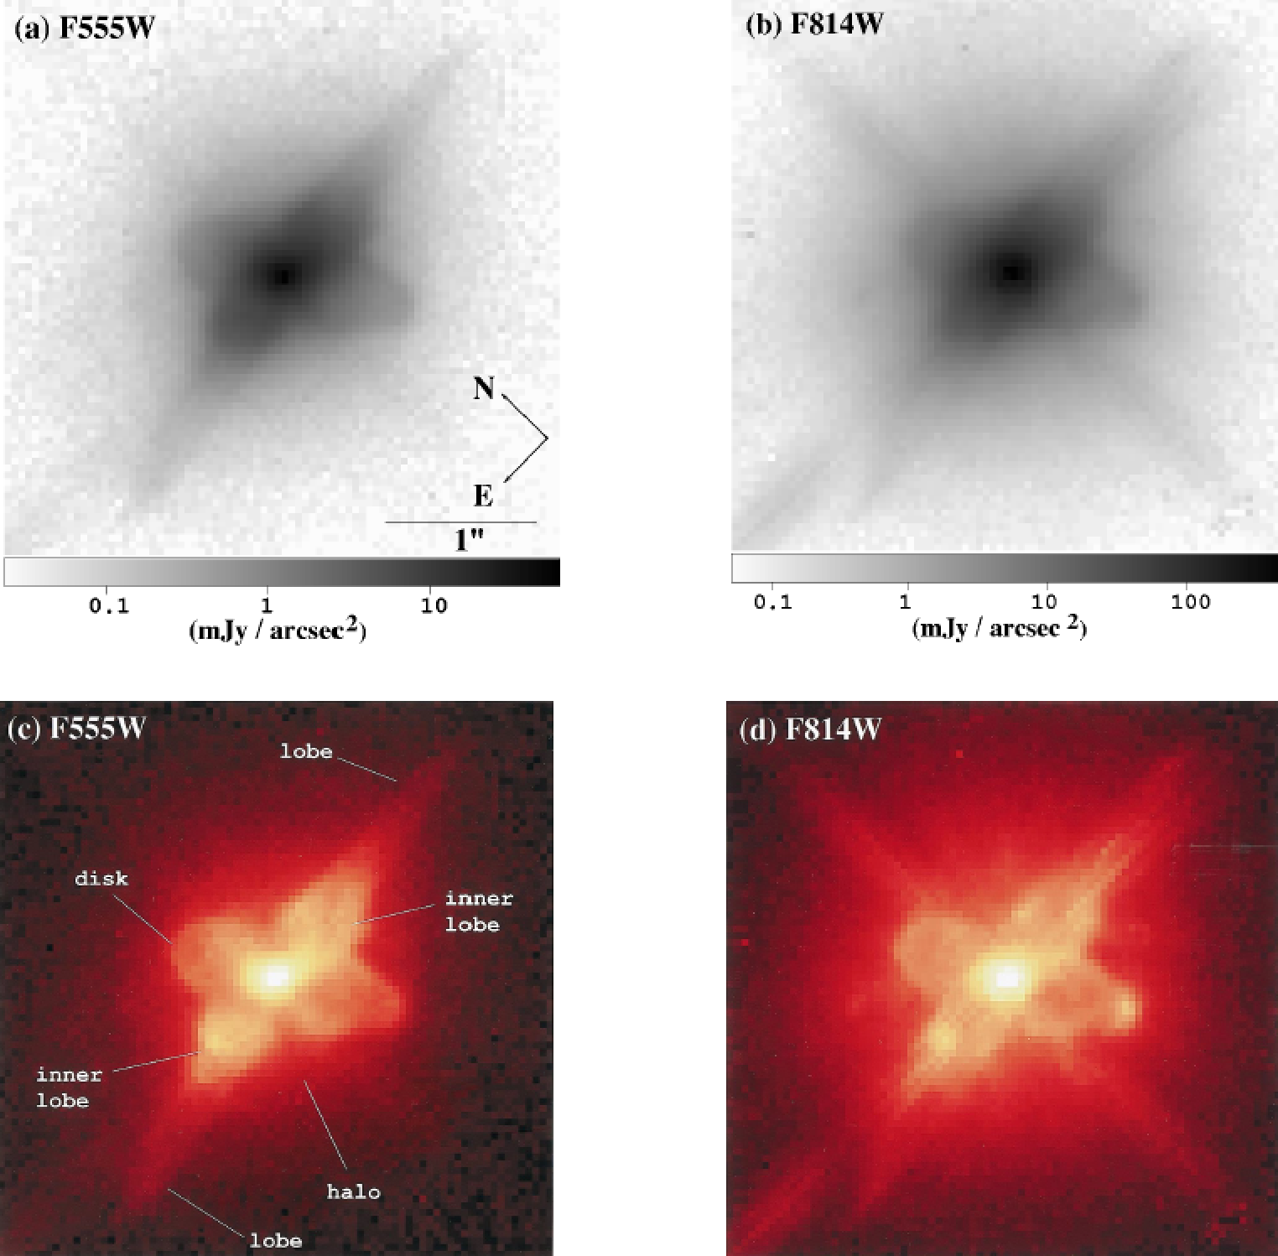
IRAS 04296+3429
(Sahai 1999)
→ Disk with a bright outer rim
Notes:
C-rich with 21-µm dust emission

Slide 9
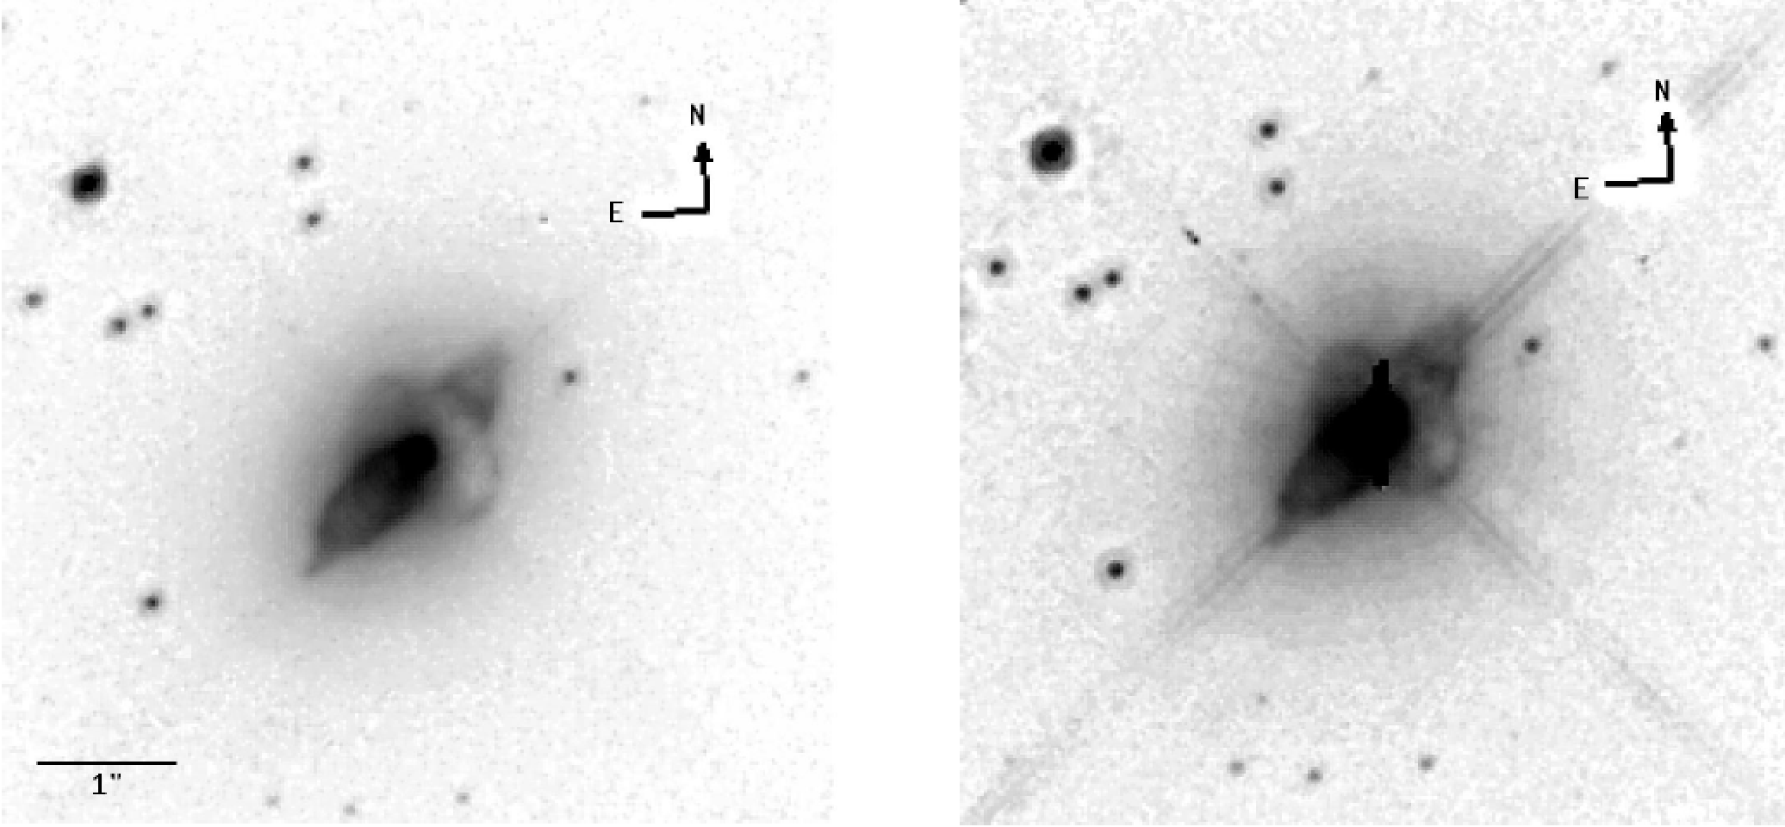
IRAS17106-3046 (Kwok, Hrivnak & Su 2000)
→ Disk with a bright outer rim
F606W
F814W
both unsharp masked

Slide 10
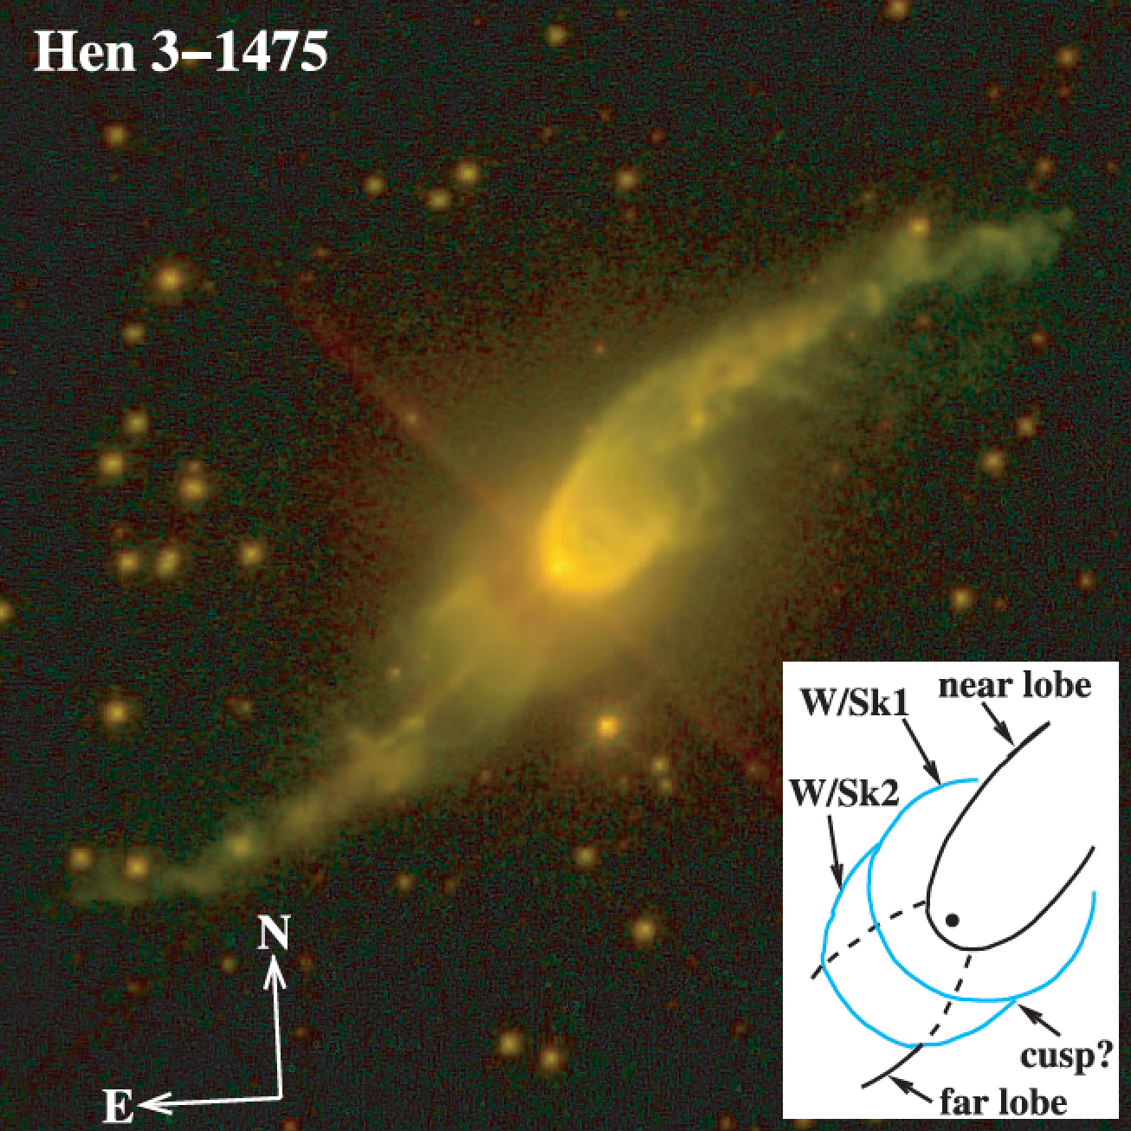
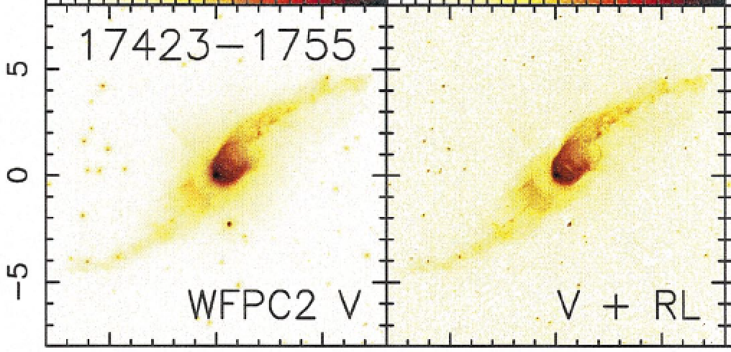
Sahai et al. 2007
Ueta et al. 2000

Slide 11
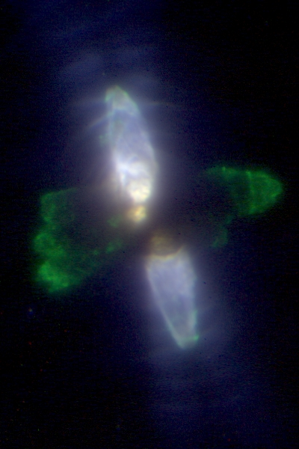
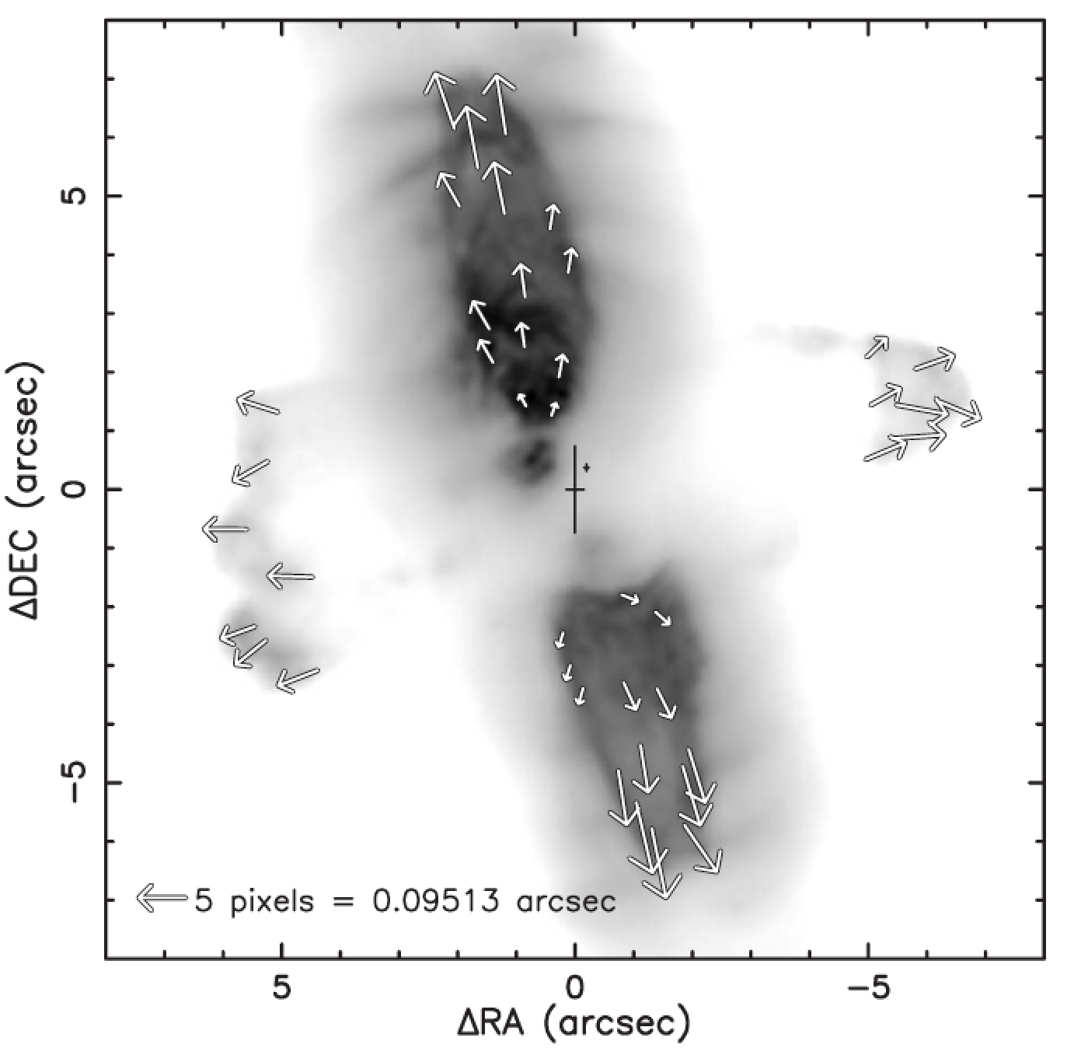
CRL 2688
Sahai et al. 1998
(Ueta et al. 2006)

Slide 12
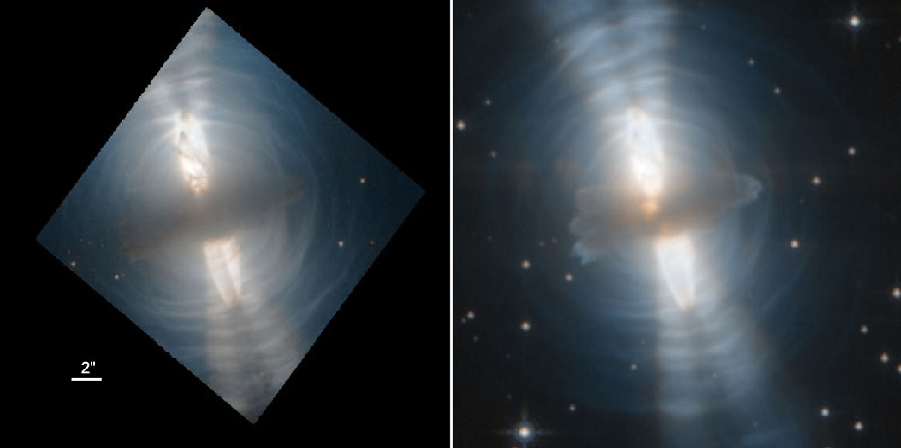
CRL 2688 (Balick et al. 2012)
disk edge = shock
F606W-F814W
F110W-F160W

Slide 13
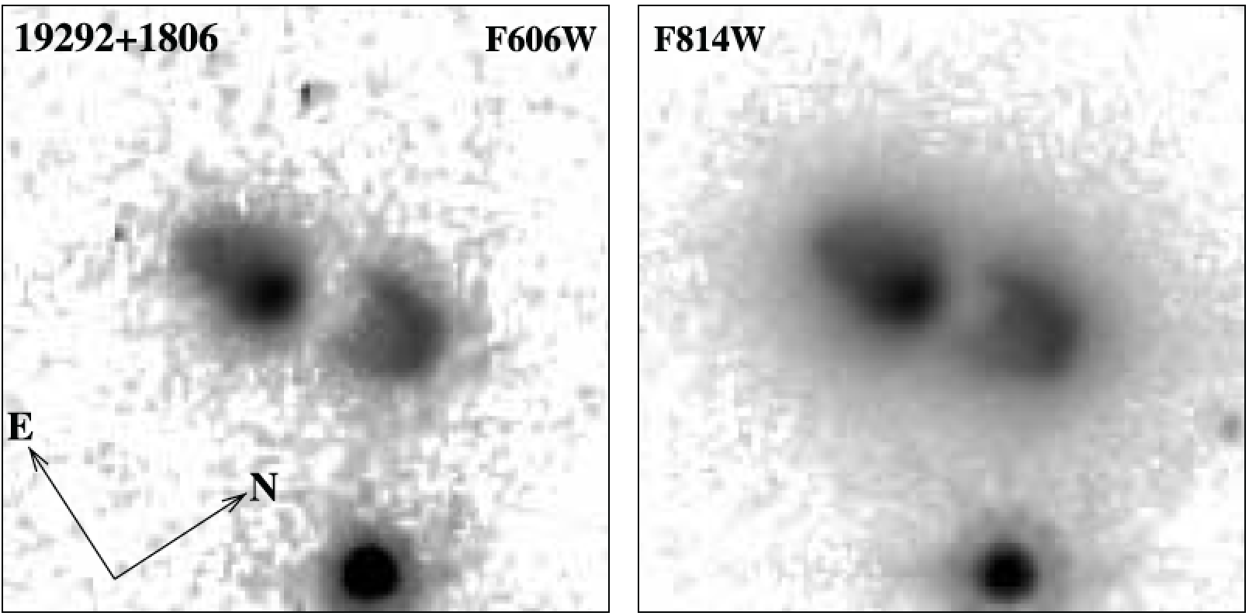
Sahai et al. 2007

Slide 14
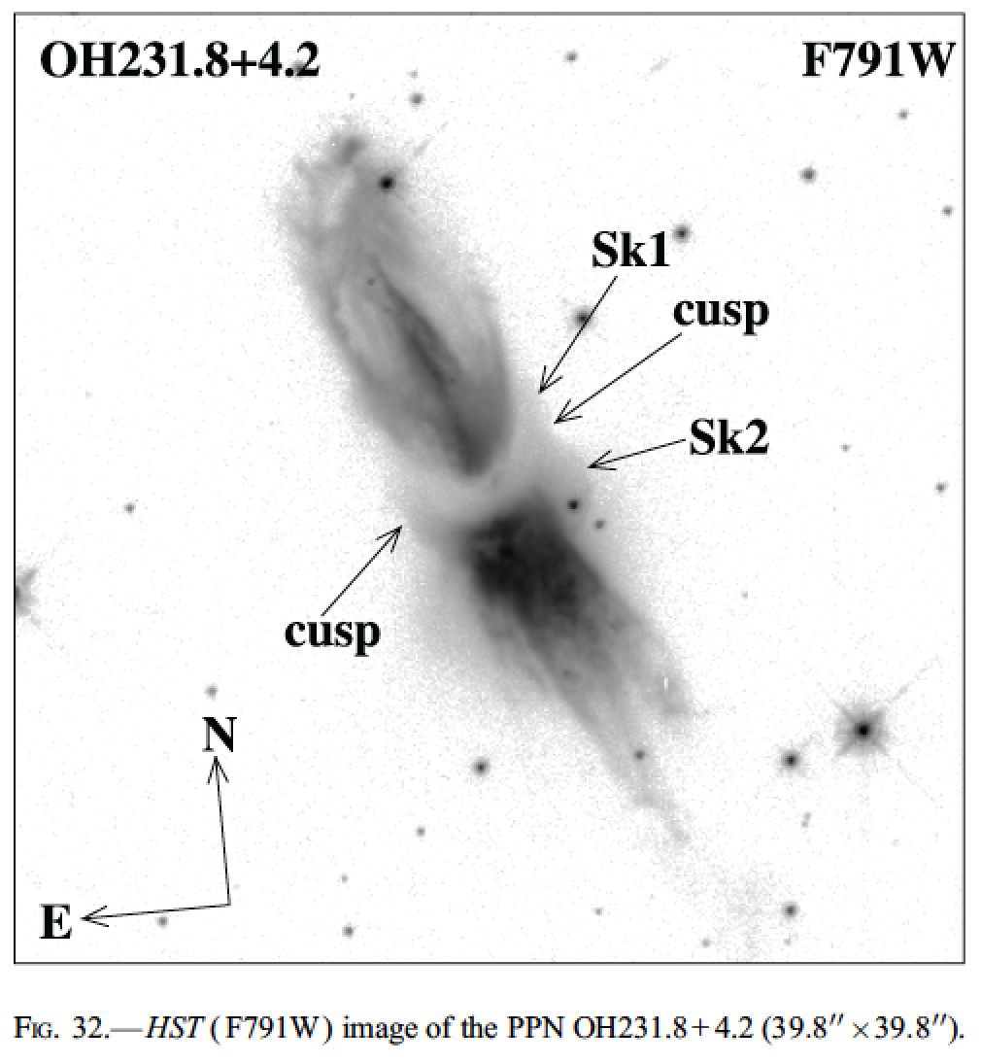
Sahai et al. 2007

Slide 15
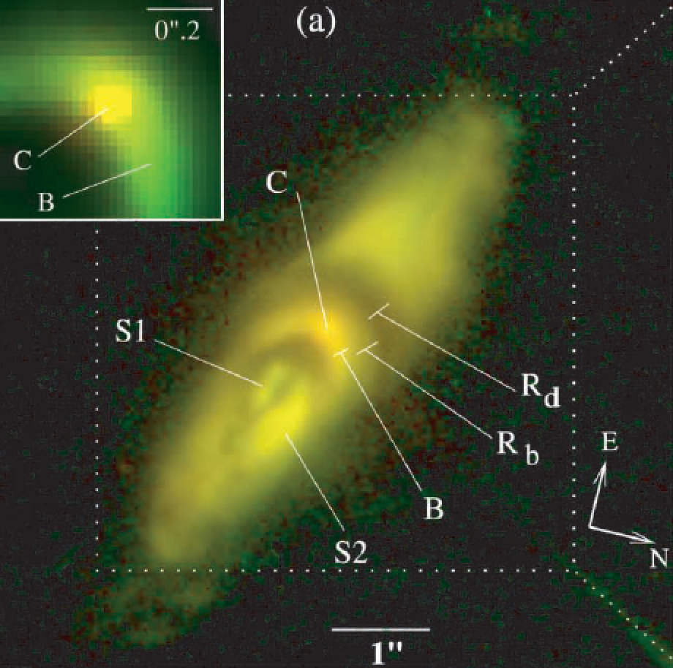
IRAS22036+5306
(Sahai et al. 2003, 2006)
Notes:
A not-so-sharp outer edge

Slide 16
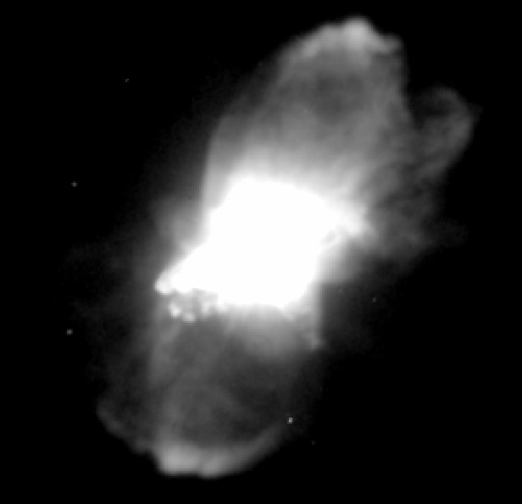
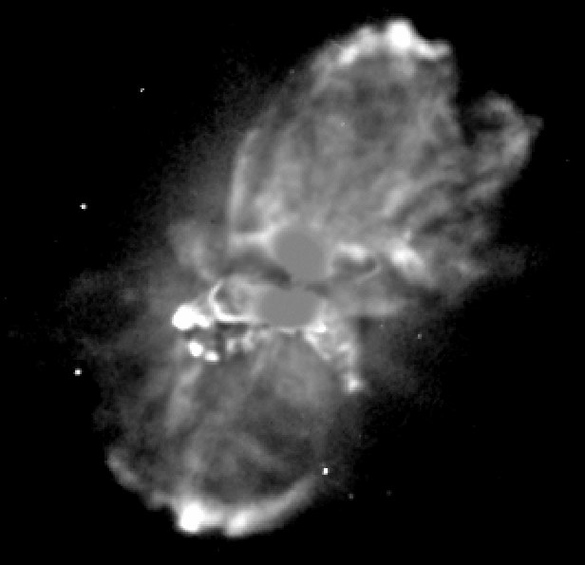
Frosty Leo IRAS 09371+1212
(Sahai et al. 2000)
unsharp masked

Slide 17
Interpretations:
Two categories:
1) bound disk
2) expanding disk
bound disk: requires angular momentum, the source of which can only be a companion….. a close companion
What would the sharp outer disk boundary mean? → A sharp upper limit to the angular momentum provided to outflowing gas
But the disk radii are >> the binary separation required to provide the angular momentum
So incredibly fine-tuning required in all these systems to capture the outflowing gas into marginally bound orbits with a sharp radial limit

Slide 18
Expanding disks:
The sharp outer cutoffs imply a sudden onset of strong equatorial mass loss
Tempting to identify this with the moment of binary merger to a common envelope configuration → the companion’s orbital angular momentum extrudes the disk from the AGB (or red giant) companion as it enters
The high-speed bipolar outflow quickly ensues
Later, the disk becomes the equatorial torus in bipolar planetaries, as the equatorial mass outflow ceases when the core is exposed

