Slide 1


UNDERSTANDING AGB STARS
John Lattanzio & Amanda Karakas
Monash Centre for Astrophysics
Monash University
Melbourne, Australia

Slide 2
Apology!
Sincere apologies for the rushed nature of my talk. If I had been in the audience I would not have been happy. Hence I am not happy on your behalf ☺
This version has been annotated with enough comments to make it readable without me presenting it. I trust you find this version better! Please email me if you would like more info or clarification.
Some annotations are made on the slides, some are in extra (plain white) pages
Best wishes to you all!
John Lattanzio
PS Thanks to Linda, Sun, Mr Lee, Anisia, Jenny and everyone for organising a great meeting!

Slide 3
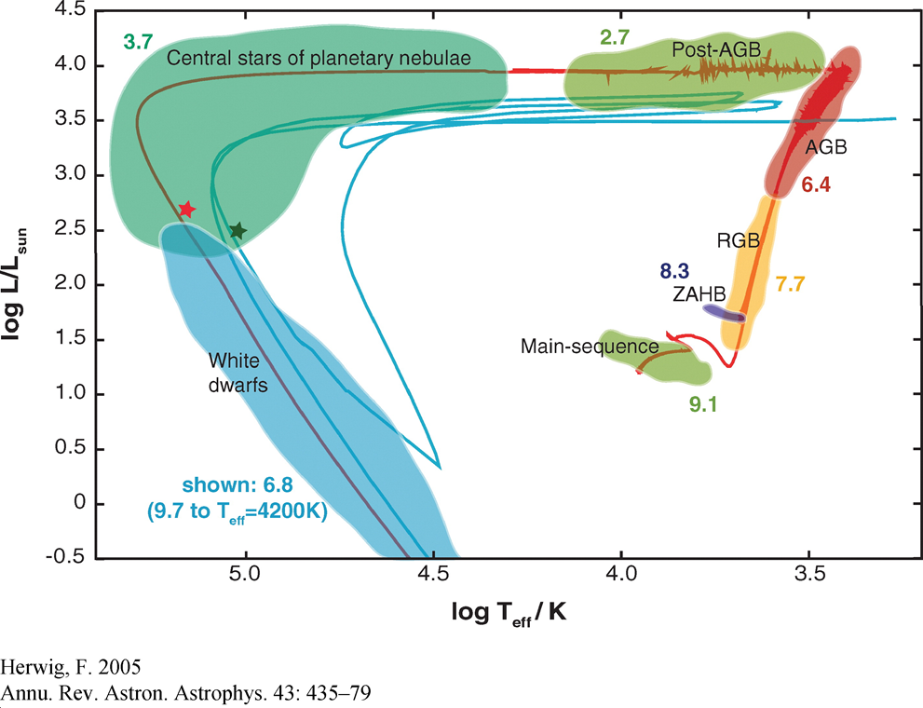
Contents
Summary of AGB evolution
Recent work on Super-AGB stars
Main uncertainties
Final Fates
Dependence on Mass Loss
Conclusions

Slide 4
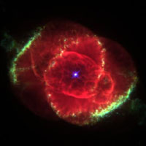
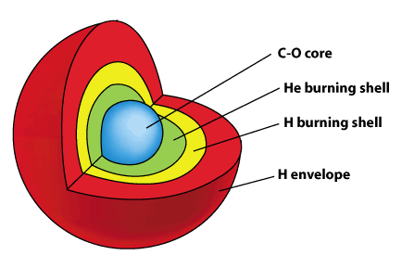
AGB stars are important!
They are common
  Due to shape of IMF
They produce lots of light
  they dominate light of many galaxies
They produce lots of dust
  Estimated that they produced 90% of
  dust in our Galaxy
They are powerhouses of Nucleosynthesis
  Crucial contributors for many elements
  C, F, Mg isotopes, s-process elements

Slide 5
Annotation
The next graph shows the evolution of stars of different masses.
It is taken from the paper by Karakas and Lattanzio (2014) in the top right hand corner.
I have usually placed a picture of the reference on the page where the work is referenced.
We will discuss the stars that pass through the AGB or Super-AGB phase (hereafter SAGB).

Slide 6
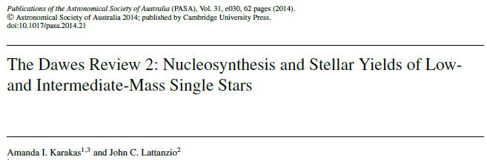
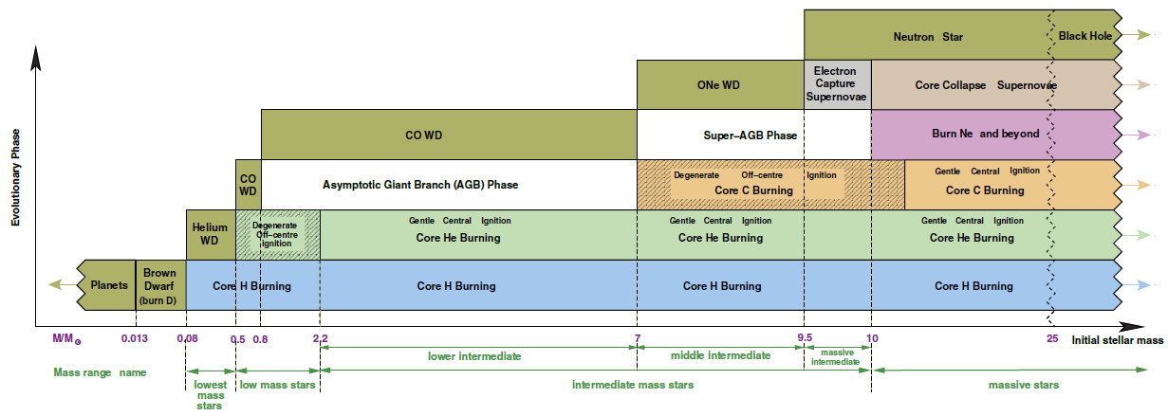
Evolution overview

Slide 7
Evolution overview
We concentrate on this mass range

Slide 8
1. Summary of AGB evolution
Will deal with pre-AGB evolution later
  This is important as “initial conditions” for AGB evolution
AGB follows from end of core He burning phase
Initially Early-AGB
  Second Dredge-Up for intermediate mass stars
Thermally Pulsing AGB
  Most nucleosynthesis occurs here as a result of 3rd dredge-up (TDU)
  May include Hot Bottom Burning (HBB)
Mass-loss
  Returns matter to Galaxy

Slide 9
Annotation
The next plots are useful!
The figure on the left is schematic and NOT to scale. But it illustrates things nicely.
The figure on the right is to scale…on the left half the axis is mass, but on the right half it is radius.
Note that nothing is visible when plotted against radius as it is all lost in the inner dot!

Slide 10
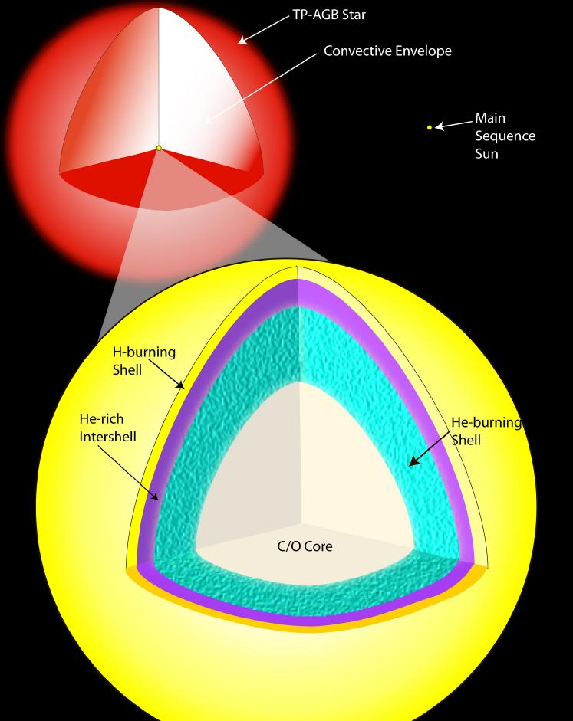
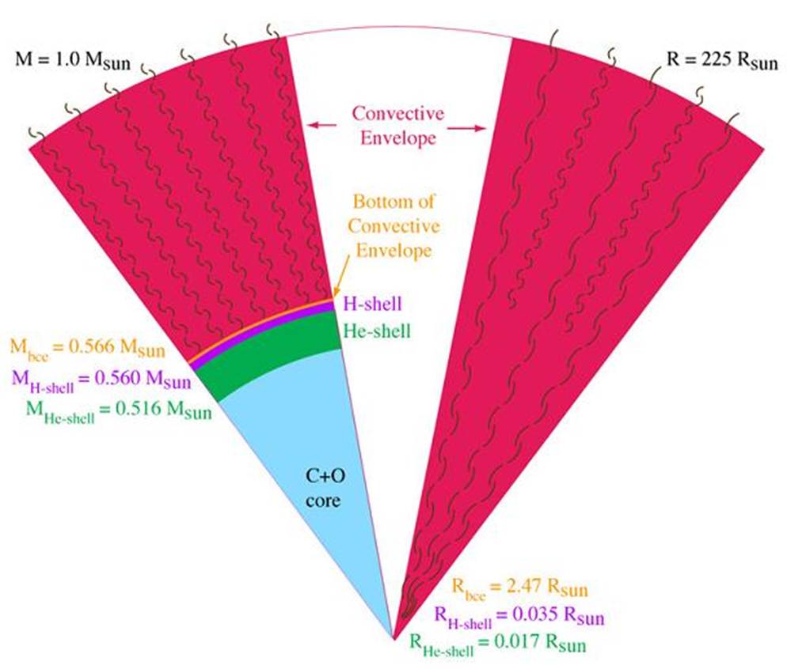

Slide 11
Annotation
The movies can be found at
A convention I used is that the bar that moves across one panel tells you the time that corresponds to the other panel. Sometimes it is a bar, sometimes it is the point on a HR diagram,for example. It shoul dbe not too confusing…I hope!
http://users.monash.edu.au/~johnl/StellarEvolnV1/

Slide 12
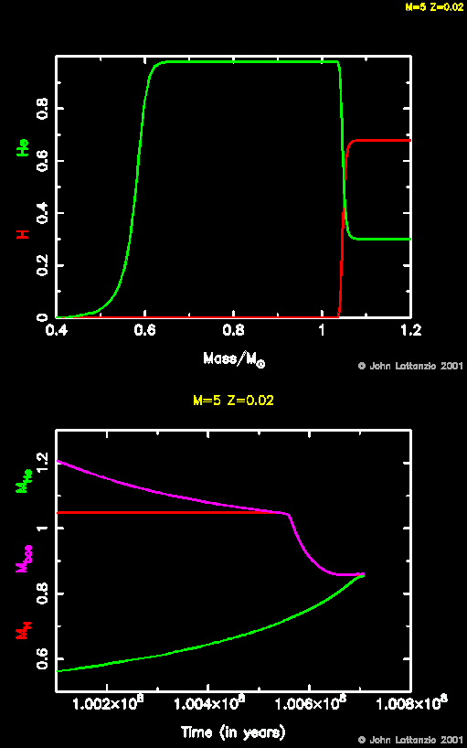
Second Dredge-Up
CO core contracts
Brings lots of He to high T
Very rapid He burning!
Star expands
  H shell is pushed out in radius
  Feels lower T
  Is extinguished (mostly)
Convection extends inward
“Second Dredge-Up”
Mostly He and H-burning ashes

Slide 13
Annotation
In the next movie note that the lines are coloured to indicate which part of the star they correspond to.
Note that the star adopts a very well-defined core-shell structure during this movie!

Slide 14
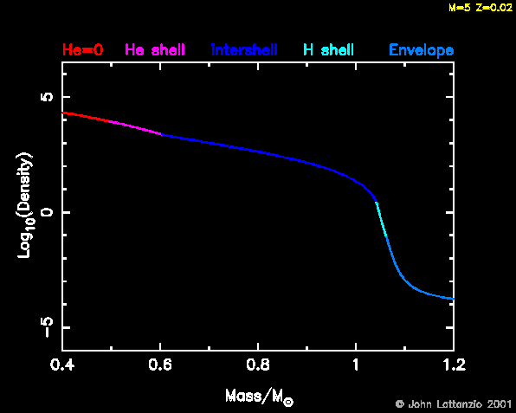
Second Dredge-Up: Toward an AGB structure

Slide 15
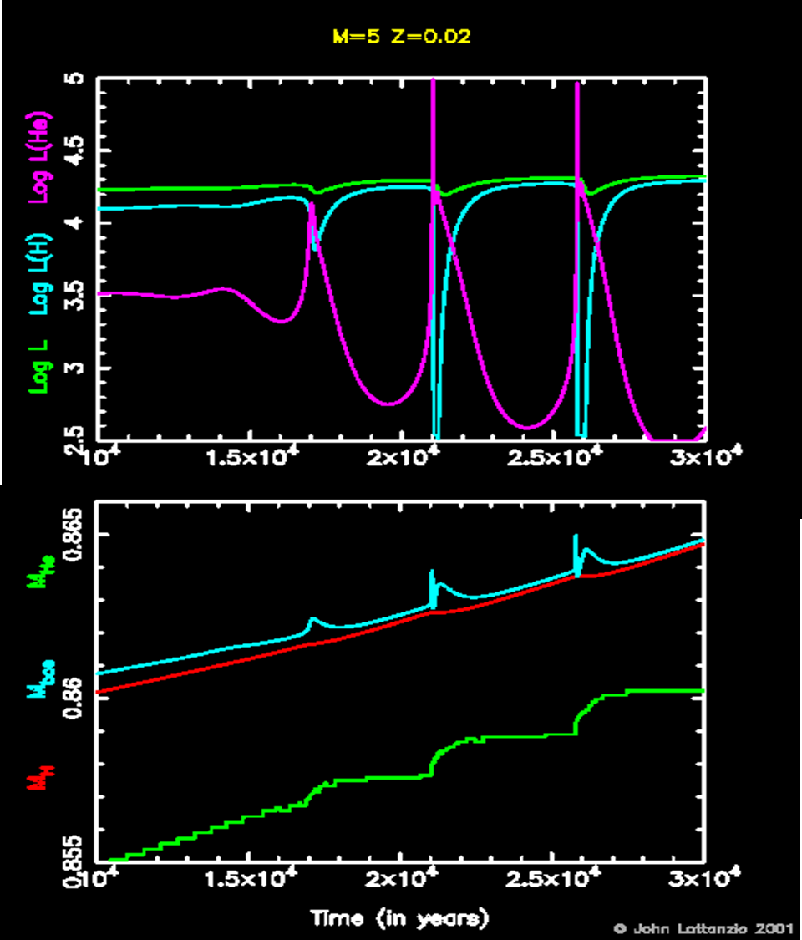
Thermal Instability
The He shell is thermally unstable
It periodically “flashes”
Known as
  Shell flashes
  Thermal Pulses
Due to delayed thermal response
of a thin shell

Slide 16
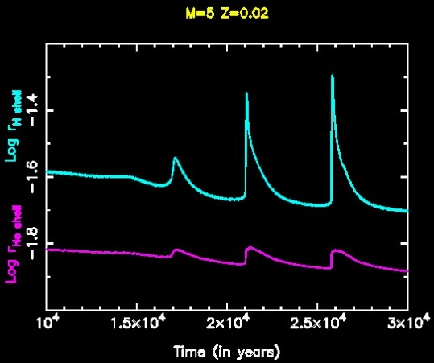
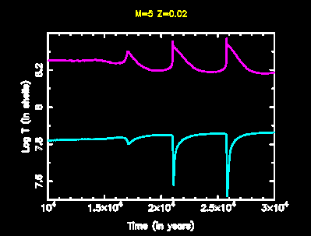
Energy drives expansion
He shell dumps energy
  Causes expansion of the star

Slide 17
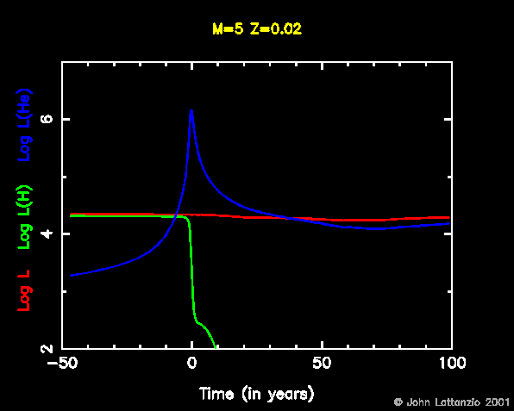
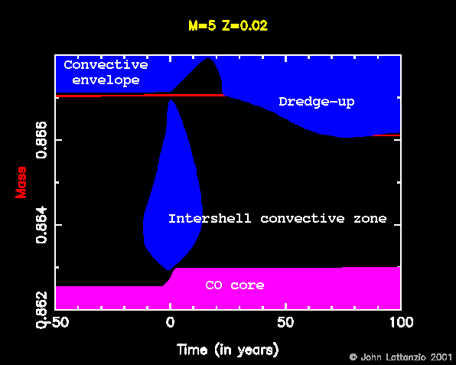

Slide 18
Annotation
The next movi is another attempt at showing the time evolution during a thermal pulse

Slide 19
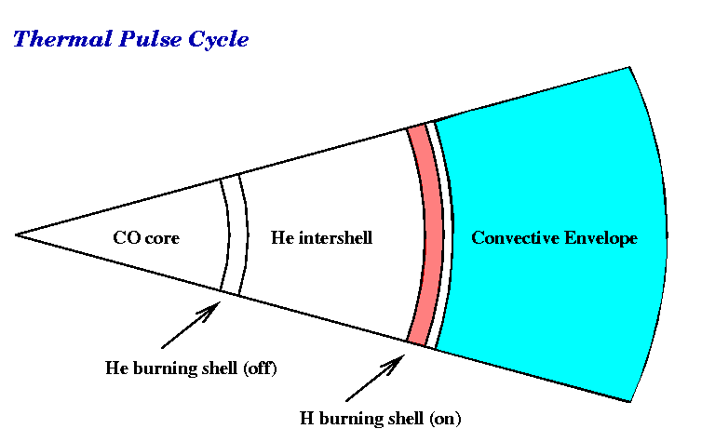
AGB slice and pulse evolution

Slide 20
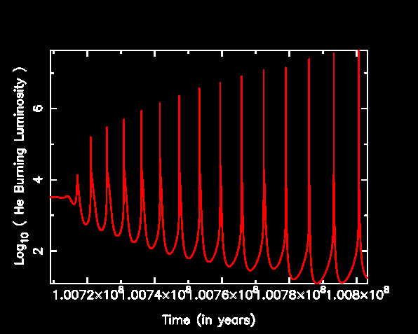
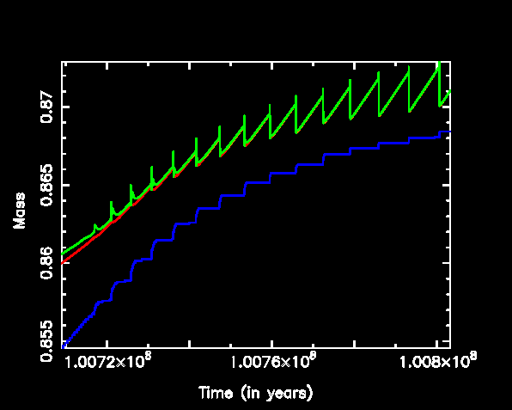
Many pulses can occur

Slide 21
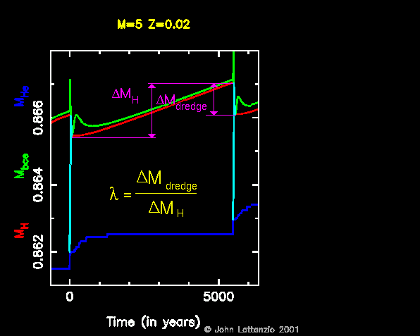
Dredge-Up Parameter: λ

Slide 22
Annotation
The next animated slides shows how the C13 source operates

Slide 23
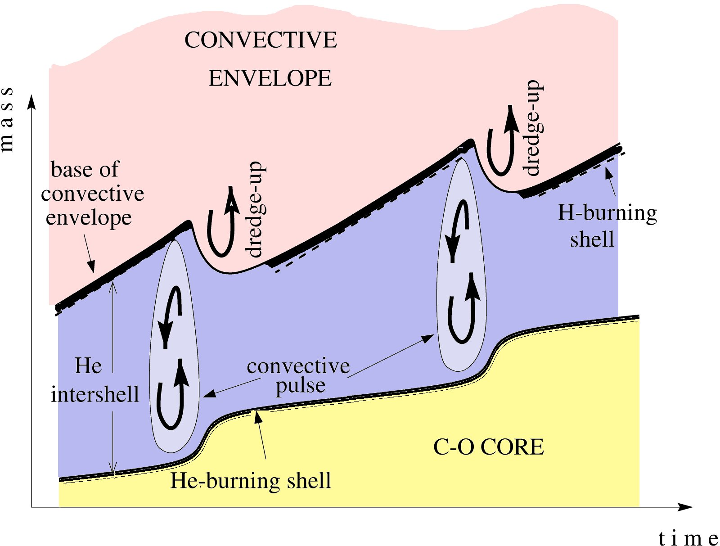
Neutron Sources: ¹³C
Needs low T ~ 1x10⁸K
Operates at low M
proton diffusion
¹²C(p,γ)¹³N(β⁺ν)¹³C
25% ¹²C 75% ⁴He

Slide 24

Neutron Sources: ¹³C
Needs low T ~ 1x10⁸K
Operates at low M
proton diffusion
¹³C s-elts
¹³C
Contraction and heating
¹³C(α,n)¹⁶O & Fe+n=s

Slide 25
Annotation
The next animated slide shows how the Ne22 source operates

Slide 26
Neutron Sources: ²²Ne
Higher T ~ 3x10⁸K
Operates at high M
2% ¹⁴N (was CNO)
25% ¹²C 75% ⁴He
Hot He Burning:
¹⁴N(α,γ)¹⁸F(β⁺ν)¹⁸O(α,γ)²²Ne
²²Ne(α,n)²⁵Mg

Slide 27
Annotation
Next is a quantitative calculation
Look for the appearance of neutrons near the bottom of the plot
  You can see those from C13 during the interpulse
  See the little pocket of C13…which turns into g, a dummy particle representing the s-process elements
The cross-hatched region represents convection
When the pulse-occurs you see the intershell convective region
  Now you can see the activity of the Ne22 source
Note that we have a time-dependent mixing algorithm so the abundance of neutrons is not homogeneous in the convective region

Slide 28
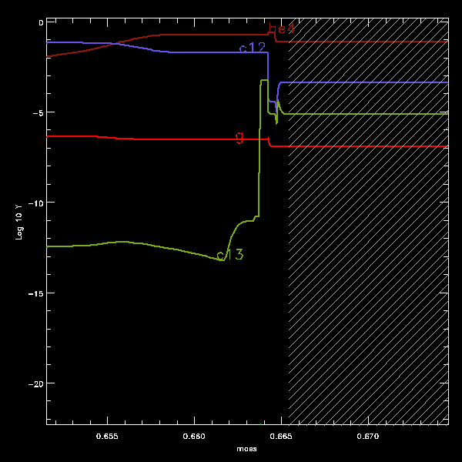
Quantitative Calculation
g = s-process
convection
²²Ne neutrons
¹³C neutrons

Slide 29
Annotation
Next we get a rough summary of the different characteristics of the two neutron sources
The conditions of each are very different, as summarised on the next slide
Hence the s-processing is different because of branching in the s-process pathways …
  The path, and hence final abundances, depend on the pathway which is determined by the neutron density

Slide 30
Neutron Exposure
(at solar metallicity)
Neutron source
¹³C(α,γ)¹⁶O
²²Ne(α,n)²⁵Mg
Neutron density vs t
Max neutron density
10⁸ n/cm³
10¹³ n/cm³
Timescale
10,000 yr
10 yr
Neutron exposure
0.3 mbarn⁻¹
0.02 mbarn⁻¹
Stars
Low mass:
M=1-3M
Intermediate mass:
M = 3-8M

Slide 31
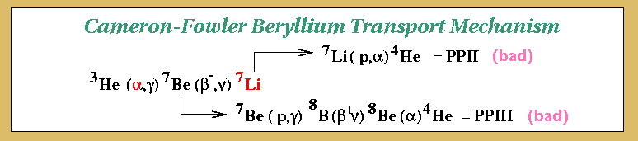
Making Li
This was predicted by Cameron and Fowler
Need to move the ⁷Be
  Convection moves it from hot bottom of envelope
  Li formed in the cooler regions
Eventually Li is destroyed as it is mixed again to the hot regions
Li-rich phase is temporary
  It relies on production dominating destruction

Slide 32
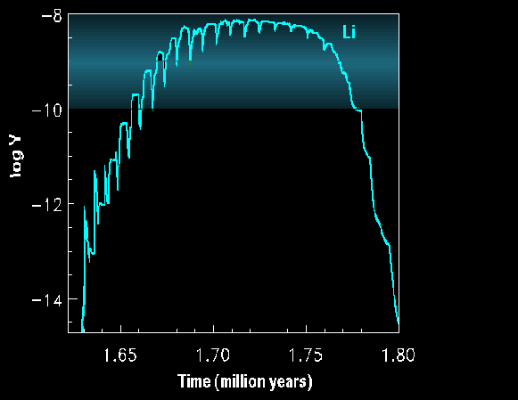
Matches Observations
The shaded region is roughly
what we observe in the Li-rich
AGB stars in the Magellanic
Clouds.
I think the calculation was
for a 6Msun model…
The details are lost in the mists
of time…

Slide 33
Annotation
The next plot shows the abundance of Ne22 in the intershell convective region ass a function of mass and composition
This is a function of time (or pulse number) which does not seem to be shown in the plot! So this might be the last pulse or some average. I don’t remember.
The paper to see is http://adsabs.harvard.edu/abs/2003PASA...20..393K

Slide 34
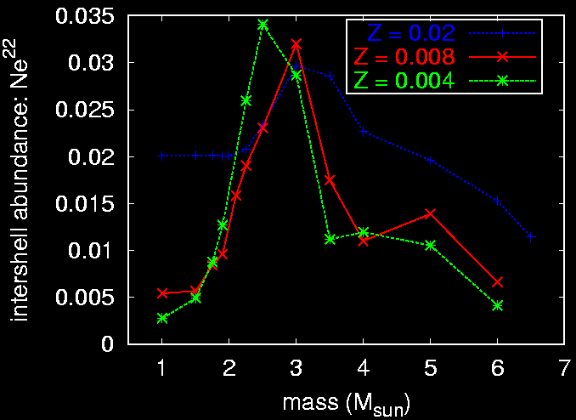
Making ²²Ne in the convective shell : ¹⁴N + 2α = ²²Ne
²²Ne  ²⁵Mg and ²⁶Mg

Slide 35
Similarly, can make other things
²⁵Mg
  Made in the convective shell from ²²Ne
  ²²Ne(α,n)²⁵Mg
²⁶Mg
  Made in the convective shell from ²²Ne
  ²²Ne(α,γ)²⁶Mg
²³Na and ¹⁹F
  Requires both the convective shell and H shell

Slide 36
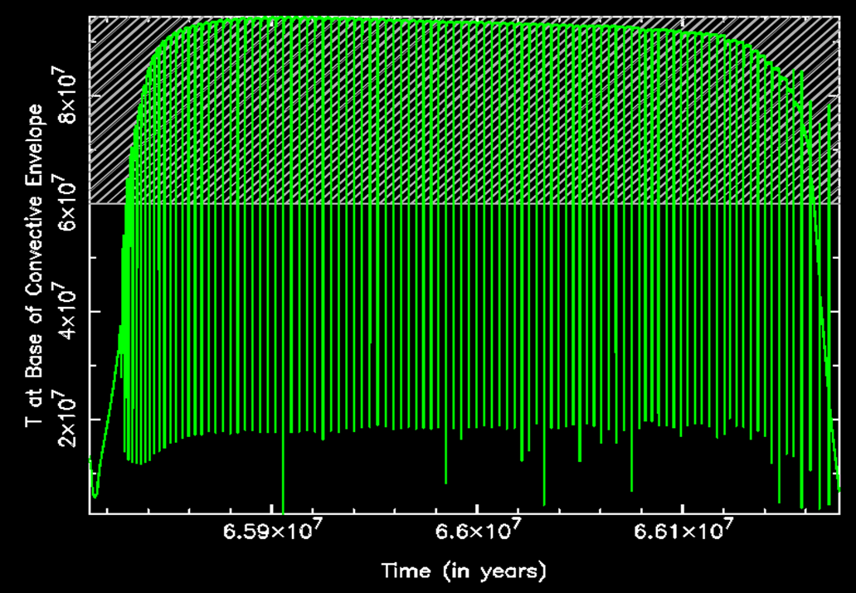
Hot Bottom Burning: HBB
For massive stars the deep convective envelope reaches to the top of the H-shell
So the envelope has a “hot bottom”
And nuclear burning occurs there…
Hence HBB!
M> 4M or so, depending on
the composition

Slide 37
Annotation
Incidentally...some of the plots I show use mole fraction (Y) rather than mass fraction.
Mole fractions (Y) do not add to unity. Ask the chemists….
Mass fractions (X) do add to unity.
To convert between note that Y=X/A for species with atomic mass A

Slide 38
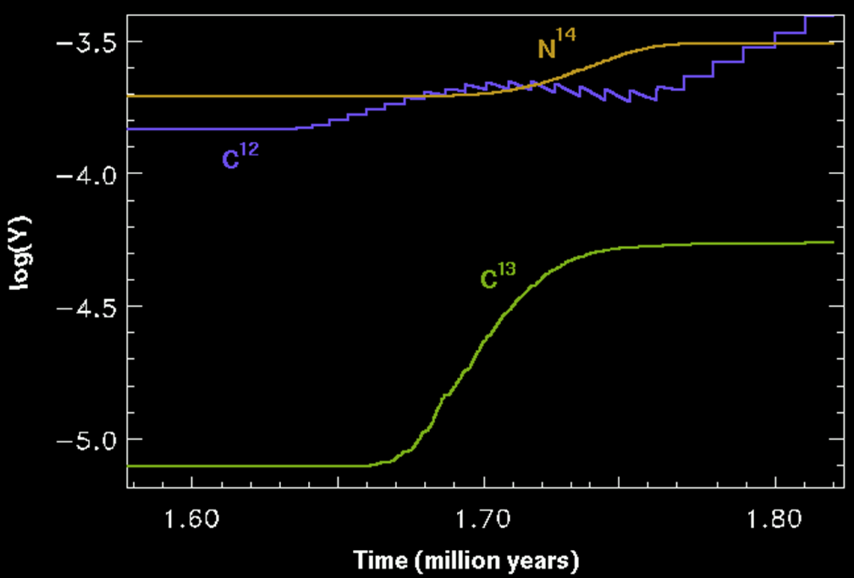
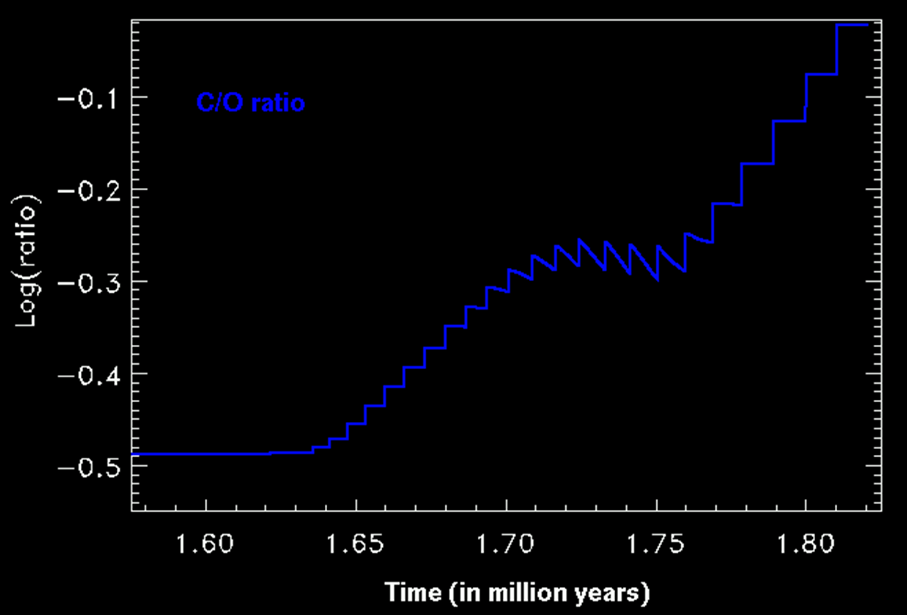
Consequences of HBB
H burns into He
  Negligible! Huge envelope!
PP Chains…
  Just make He
CNO Cycles
  Make He but also…
  CNO into ¹⁴N
C stars? Prevented!

Slide 39
Variation in HBB
Minimum mass for HBB decreases with decreasing Z or [Fe/H]
  Because low metallicity stars are hotter…
Do not forget the metallicity dependence of HBB.
HBB prevents the formation of a C-rich envelope at solar metallicity
But can still become C-rich for models with Z <= 0.008.
  Due to very low O abundance
  And not all C burns into N…
  This point is often forgotten for some reason.

Slide 40
Annotation
A complete calculation gets very complicated very quickly…
See next slide ☺

Slide 41
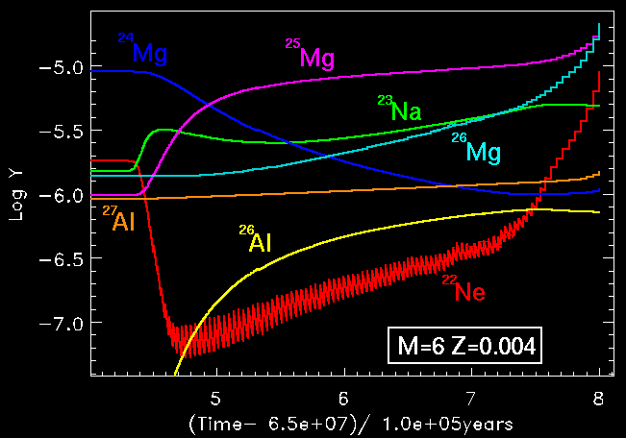
A more complete example…

Slide 42
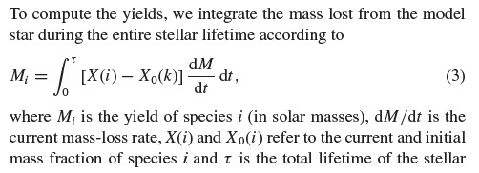
Typical Yields
We used to use synthetic evolution, or population synthesis
It still has a role to play
But now can use supercomputers to run details for many stars
Yield of an isotope is the amount returned to the ISM over the life of the star

Slide 43
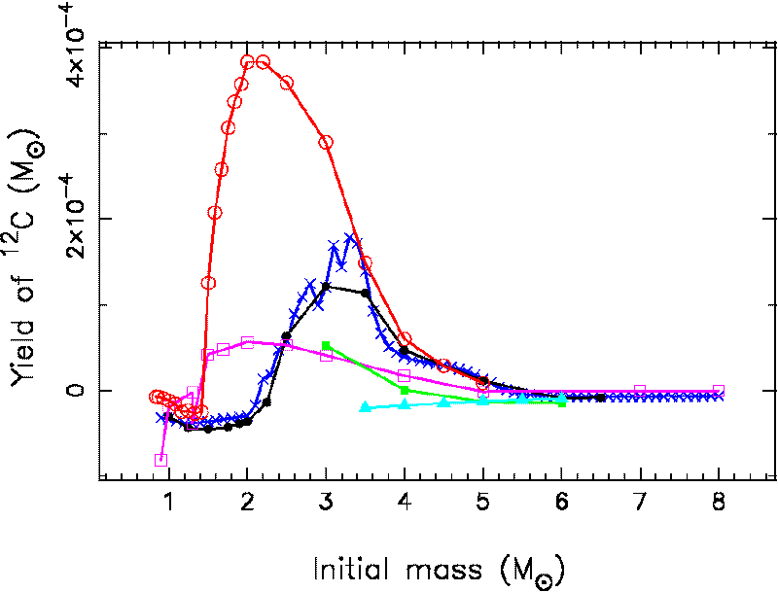
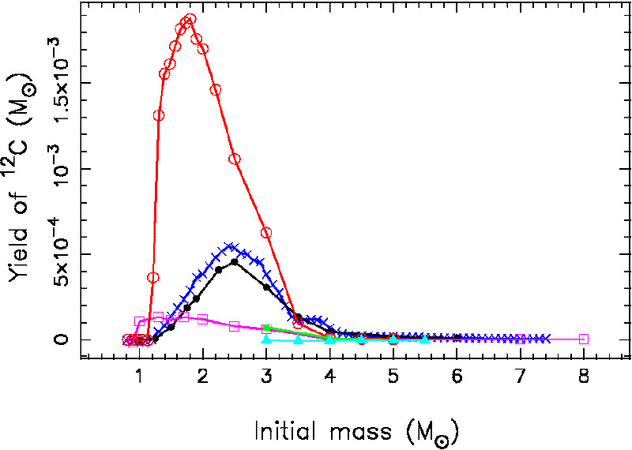
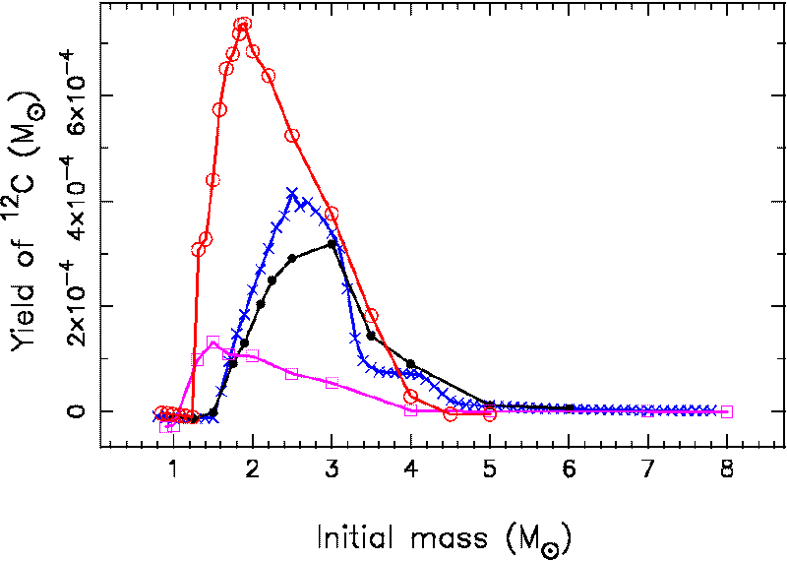
Yield of ¹²C
Z = 0.008
Z = 0.004
Z = 0.02
Legend:
Black: Karakas models
Blue: Izzard
Red: Marigo (2001)
Pink: van den Hoek & Groenewegen
From Karakas (2010)
Hot Bottom Burning
Third Dredge-Up

Slide 44
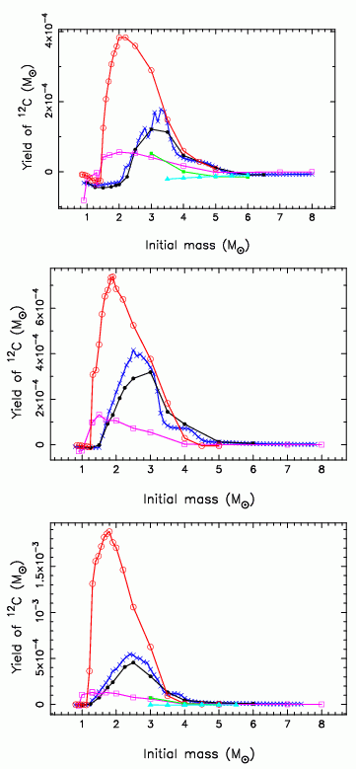
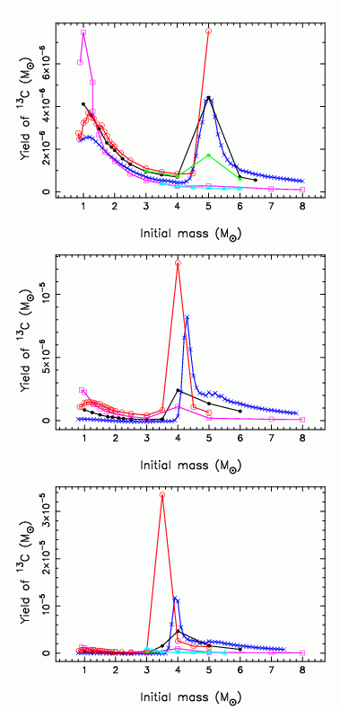
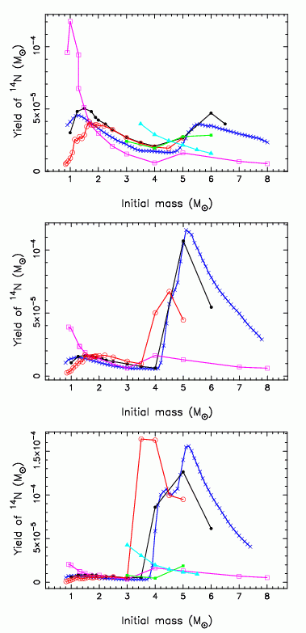
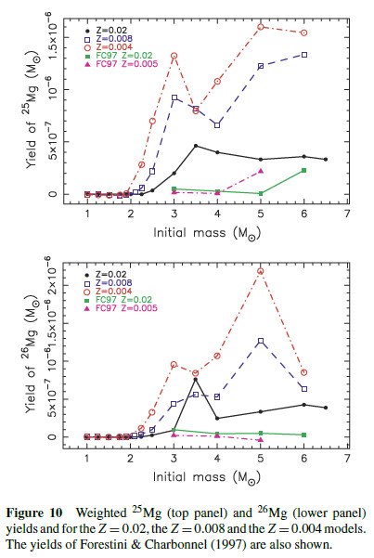
¹²C ¹³C ¹⁴N ^{25,26}Mg
Karakas (2010)
Z=0.02
Z=0.02
Z=0.02
Z=0.008
Z=0.008
Z=0.008
Z=0.004
Z=0.004
Z=0.004

Slide 45
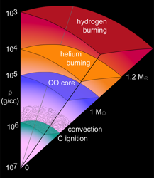
2. Super-AGB Stars
Higher masses than AGB stars
Ignite Carbon in core
  M > 6M? Or 8?
  Depends on
    Composition
    How you do the earlier mixing!
But they do not ignite beyond C
  M < 10M?
  Depends on
    Composition
    How you do the earlier mixing!
Burns C
  Possibly incomplete
  Goes on to join AGB
  Thermal pulses result
  Very HOT HBB takes place

Slide 46
Annotation
In the next plots
  HBS is the H burning shell
  HeBS is the He burning shell

Slide 47
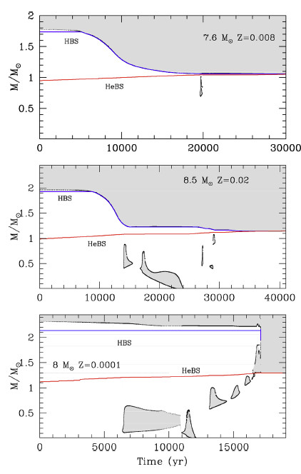
Core Carbon Burning in SAGB Stars
Details depend on many unknowns
Can get many different behaviours
Negligible burning
Burning shells move to core
Burning shells advance and mixing
joins convective envelope…
“dredge-out”

Slide 48
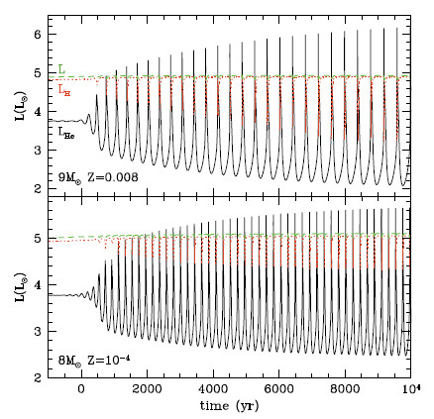
Thermal Pulses in SAGB Stars
Pulses are not very strong
Very short time between
the pulses (“interpulse period”)
Hence there are many hundreds to thousands of pulses on the (S)AGB…

Slide 49
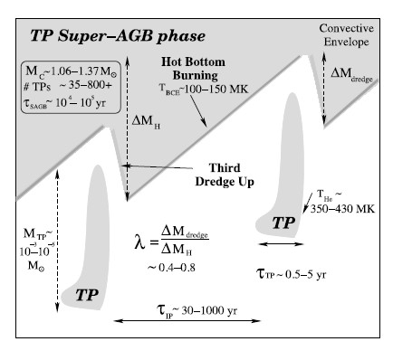
Thermal Pulses in SAGB Stars
Intershell zone is also very small
  10⁻³M to 10⁻⁵M
Hence dredge-up is not as important
as HBB

Slide 50
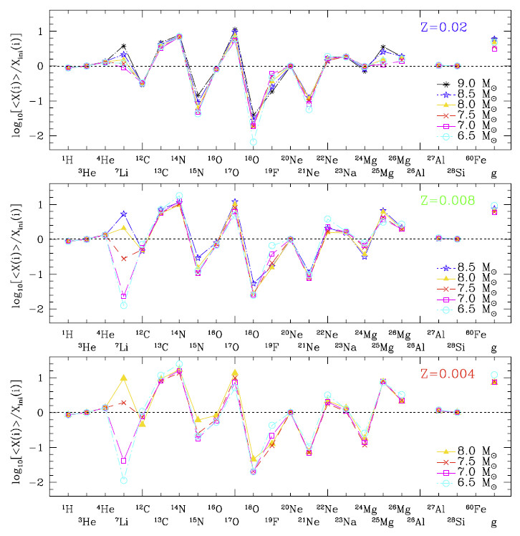
Yields are mostly the result of H-burning

Slide 51
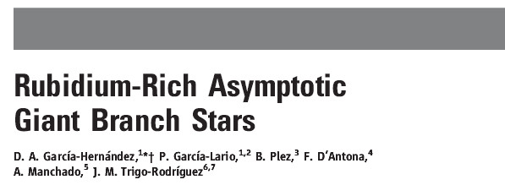
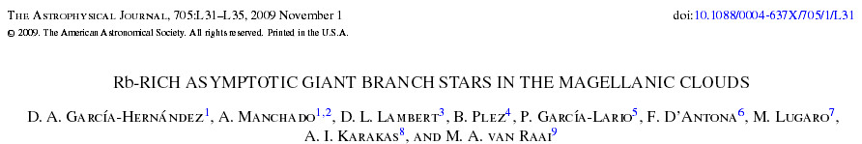
Rb in Massive AGB Stars
Observations show large excess in Rb
in bright AGB stars
  Typically [Rb/Fe] = 0.5 to 2.5
  They are O-rich so presumably HBB
  has acted
  Hence they are likely massive AGB or even SAGB stars
  To get Rb you need ²²Ne as neutron source
  Good confirmation of theory! (Qualitatively)

Slide 52
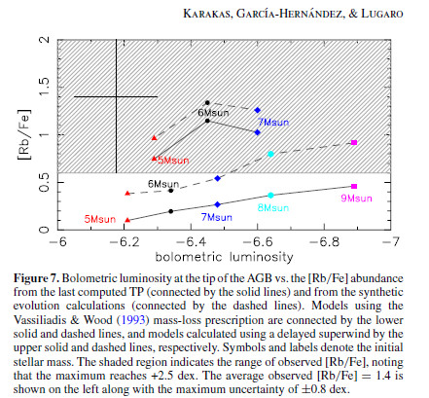
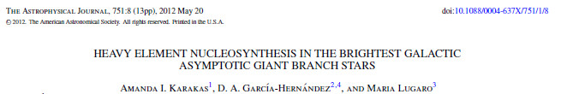
Rb in Massive AGB Stars
And the models?
[Rb/Fe] increases with Mass or decreasing [Fe/H]
But seems limited to about 1.0
  Unless you delay the superwind phase….
  Maybe alter the ²²Ne(α,n)²⁵Mg rate
  Then you can get [Rb/Fe] ~ 0 to 1.5

Slide 53
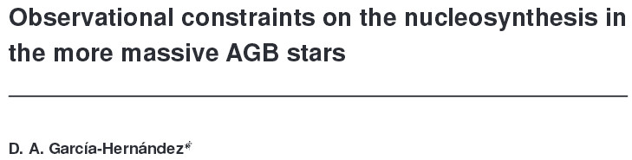
Rb in Massive AGB Stars
But…
If you use dynamical atmosphere models…
The observations are reduced to [Rb/Fe] ~ 0.0 to 1.0 – THIS MATCHES!
  ie matches both normal and delayed superwind
NB: Unlikely to be SAGB stars due to large envelope dilution…

Slide 54
3. Main Uncertainties
Deep-mixing on the FGB
Deep-mixing on the AGB?
FDU and LF Bump
Core He Burning
Convective Boundaries
  Third Dredge-Up
  C¹³ pocket
  O in the ISCZ (Inter-shell Convection zone or Pulse-driven convective zone)
Opacities for variable envelope composition
Convection Theory Used
Convergence Problems – Envelope Ejection?
Mass-loss
  Crucial
  See later

Slide 55
Annotation
The next few animated slides illustrate the changes of Li on the first giant branch

Slide 56
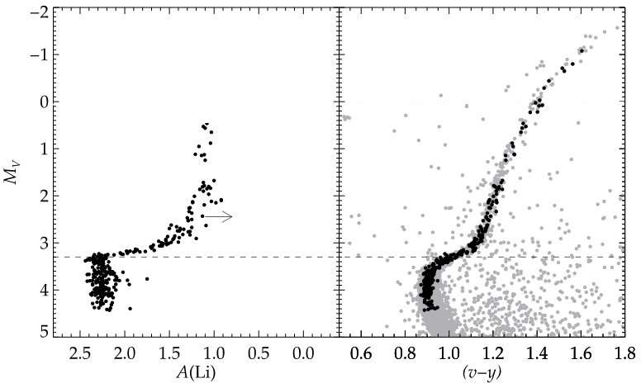
3.1 Deep Mixing on the First Giant Branch
At FDU we see abundance changes
  ¹²C & ⁷Li down
  ¹³C & ¹⁴N up
Lind et al (2009)

Slide 57
Deep Mixing on the First Giant Branch
At FDU we see abundance changes
  ¹²C & ⁷Li down
  ¹³C & ¹⁴N up
Lind et al (2009)

Slide 58
Deep Mixing on the First Giant Branch
At FDU we see abundance changes
  ¹²C & ⁷Li down
  ¹³C & ¹⁴N up
But later we see more abundance changes, of the same kind!
  ¹²C & ⁷Li down
  ¹³C & ¹⁴N up
Lind et al (2009)

Slide 59
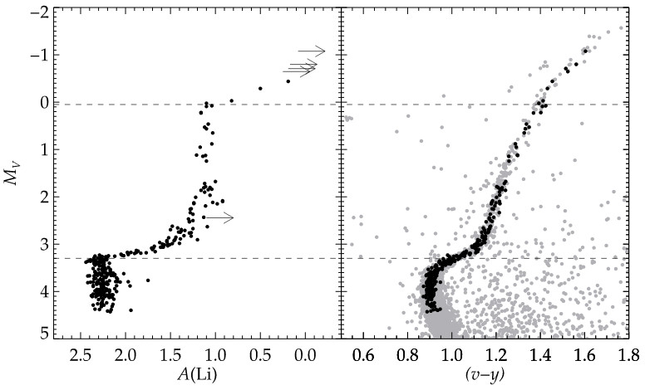
Deep Mixing on the First Giant Branch
At FDU we see abundance changes
  ¹²C & ⁷Li down
  ¹³C & ¹⁴N up
“Deep-mixing” or “extra-mixing”
But later we see more abundance changes, of the same kind!
  ¹²C & ⁷Li down
  ¹³C & ¹⁴N up
Lind et al (2009)

Slide 60
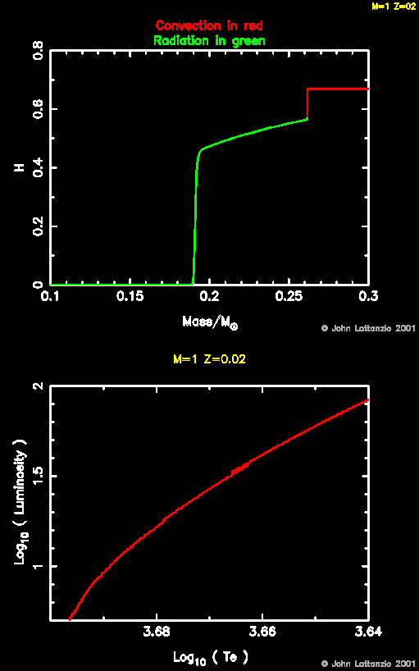
Deep Mixing on FGB
Happens when H-shell reaches the abundance discontinuity left behind after FDU
Thought to inhibit mixing
The star retraces its path n the HRD
This creates the “bump” in the Luminosity Function (LF)
Extra-mixing then occurs

Slide 61
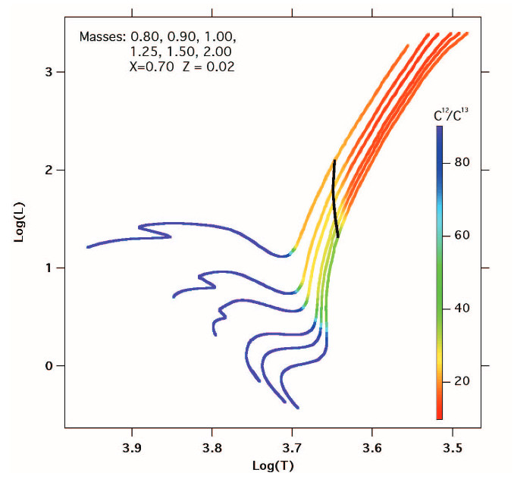
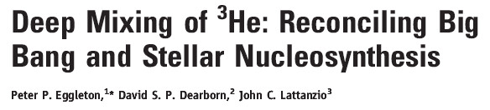
What is the cause of “extra-mixing”?
Rotation?
  Seems not to work – not enough mixing
Thermohaline mixing?
  Works!
  Solves cosmological ³He problem also
  Has many attractive features
  Requires correct value of parameter ☺
  3D hydro does not endorse this value ☹
  NB: 3D hydro is not 100% reliable yet…

Slide 62
3.2 Extra-Mixing on the AGB?
This has been postulated by many authors
Basic problem:
  We cannot match observed C/O and ¹²C/¹³C values
  TDU adds ¹²C
  By the time we get C/O agreeing with observations the ¹²C/¹³C values are too large
Add some extra-mixing to burn 12C into 13C and lower ¹²C/¹³C values

Slide 63

Extra-Mixing on the AGB?
The models that don’t work ignored the effects of extra-mixing on the RGB…
So they started with the incorrect values at the end of the RGB
What if we start with the observed envelope values?

Slide 64

The observations

Slide 65


Slide 66


Slide 67

This model started
with α-enhanced
compositions more
appropriate to
stars in globular
Clusters.

Slide 68


Slide 69


Slide 70


Slide 71


3.3 First Dredge-Up and the LF Bump
Abundance changes at FDU seem to match data
But the luminosity at which it occurs does not!
Neither does the depth of FDU – which determines the luminosity of the LF bump
Neither does the luminosity of the LF bump (related to FDU!)
Both are worse at lower [Fe/H]

Slide 72

3.4 Core He Burning
This has been a problem for ages
Most people ignore it!
It involves:
  Semiconvection
  Overshoot
How to model it??
Here is the same star
modelled with
different codes!!!

Slide 73

3.4 Core He Burning
Here are two examples…
The boundary of convection determined
by a strict application of the Schwarzschild
condition
2) The result from using a diffusion equation
with an exponentially decreasing velocity
beyond the formal Schwarzschild edge (see
the discussion of this in section 3.5)
Note the large differences!

Slide 74

Core He Burning
3D hydro offers hope…
Simon Campbell is working
on this with various
collaborators:
  Arnett
  Mocak
  Etc
Note the gravity waves above
the formal convective core, which
start to cause mixing…
For details see
http://adsabs.harvard.edu/abs/2015arXiv151204774C

Slide 75

3D Calculation
A movie from Simon
Campbell et al

Slide 76
Annotation
The Schwarzschild criterion is a local criterion, which defines a point where the buoyancy is neutral.
It does not include, for example, the momentum of any blobs that approach the boundary.
Since a blob accelerating toward the boundary will reach the neutral point with a finite momentum, it will “overshoot” beyond that border.
But how far???

Slide 77

3.5 Convective Boundaries
Convective borders are trouble…
Usually mixing is done with diffusion equation
  But mixing is advective…not diffusive! Remember!

Slide 78


Typical Overshoot Method
Use diffusion equation
Add some decrease in D into the radiative region

Slide 79

Convective Boundaries
This helps with third dredge-up
Also creates ¹³C pocket
  Required for s-processing
  Required ¹⁹F production
But it is hiding physics…

Slide 80

¹³C Pocket
This remains a problem…how does it form?
Many mechanisms suggested, none proven
Simulated by using some partial mixing of arbitrary kind…
Try to constrain with observations of s-process

Slide 81

Overshoot at ISCZ
Mixes material from the C-O core into the ISCZ
  And hence surface following TDU
Enhances ISCZ in O
Herwig et al 1999

Slide 82

Overshoot at ISCZ
Resulting abundances match H-deficient central stars of PN – PG1159
  Enhanced in C and O and He
  Also Ne and F
  Quantitatively matches models with
  overshoot at bottom of ISCZ
  X(He) ~ 0.30 – 0.85
  X(C) ~ 0.15 – 0.60
  X(O) ~ 0.02 – 0.20
  X(Ne) ~ 0.02
Also matches AGB abunds better
Karakas et al 2010

Slide 83

Convective Borders Summary
It’s not simple
It’s not one-dimensional
It’s not static
It’s not mixing-length
But it is very hard to calculate…

Slide 84


3.6 Envelope Opacities
Third dredge-up of C can produce large C enhancements
Hot bottom burning of C into N can produce large N enhancements
Hence:
We need low temperature opacities for variations in C and N

Slide 85

Online tool: AESOPUS

Slide 86
Annotation
AESOPUS now allows us to get opacities for many mixtures, with detailed atomic physics.
Note how dramatically the chemistry, and the opacity, change with the value of C/O

Slide 87


AESOPUS results

Slide 88


Envelope Opacity Effects
When C > O the opacity increases
Radius increases
Temperature decreases
Mass-loss increases!
Evolution altered…
Better fit to NEMP stars also
See later for details
NEMP = Nitrogen enhanced metal poor stars

Slide 89

3.7 Convection Theory
Most calculations use the Mixing-Length Theory
But there are others!
The most common competitor is
Full Spectrum of Turbulence (FST)
  Integrates over all mixing-lengths – no preferred scale

Slide 90
Annotation
The next plot shows some comparisons between
  FST = Full Spectrum of Turbulence theory
  MLT = Mixing-Length Theory (with specified mixing length of α time the pressure scale height)
The resulting abundances in AGB stars with HBB may in fact fit globular clusters better than does the MLT

Slide 91



Main Differences
Brighter
Shorter

Slide 92

Main Differences
Seems to fit Globular Clusters better?
HBB is very sensitive to the convection theory
Less Na and Mg
Less Dredge-up

Slide 93

3.8 Convergence Problems – Envelope Ejection?
Since 1980s…
We get convergence problems near the end of the evolution
Especially for more massive stars
Usually not admitted ☺
Wood and Faulkner (1986): PN ejection?
Revisited recently

Slide 94

Convergence Problems
Just above core
Where convection is inefficient
L > L_{Edd}
P_{gas} → 0
R increases rapidly
β = ratio of gas to total pressure
= 1 fpr all gas pressure
= 0 for all radiation pressure

Slide 95


Cause? Effect?
Seems to be a genuine iron peak in opacity
Has been found in massive star models also
What effect does it have?
Is envelope bound?
Need hydro to study
Not done yet ☹

Slide 96


3.9 Mass Loss
Controls the evolution and death of the star
Controls extent of nucleosynthesis
Determines the initial-final mass relation

Slide 97


Mass-loss controls the evolution

Slide 98

4. Final Fates
Most AGB stars end as CO white dwarfs
What about SAGB? Much less certain…

Slide 99

SAGB Final Fates
Burn C & O into O & Ne – so most end as One WD
Some as CO(Ne) WDs….and some as electron capture supernovae?

Slide 100
Critical Masses
M_{n} = minimum mass
for a neutron star
M_{mass} = minimum mass
for massive star evolution;
i.e. a core-collapse SN
M_{up} = minimum mass
for C-ignition

Slide 101


SAGB Final Fate
Depends critically on
  core evolution during C-burning
    And the usual problems with determining the
    borders of mixing…
  Second dredge-up/out

Slide 102

SAGB Core Mass
Second dredge-up occurs as star joins (S)AGB
This reduces the core mass
Fate depends on size of this new core mass
  Is it larger than Chandrasekhar mass?
    Neutron star (ECSN?)
  Is it smaller than Chandrasekhar mass?
    O-Ne WD
Chandrasekhar Mass

Slide 103
Annotation
The Kippenhahn diagrams on the next page show the three main cases of C ignition
The shaded regions correspond to convection

Slide 104

SAGB Final Fate
ONe shell
C-ignition fails to proceed
  CO core
  O-Ne shell
  CO(Ne) WD
  Narrow mass range ~ 0.2 M
C-flame penetrates to the core
  O-Ne WD
C-flame meets envelope
  “Dredge-out”
    Iben,Ritossa,Garcia-Berro 1994-99
  Fate depends on size of new core
CO core

Slide 105
Annotation
The next plot shows an estimate of the fate of the stars according to mass and composition
CO(Ne) are the C and O and Ne hybrid white dwarfs
ECSN are electron capture supernovae

Slide 106

SAGB Final Fate
CO(Ne) range very narrow
ECSN range very narrow

Slide 107


Initial-Final Mass-Relation (IFMR)
Final Mass
Final Mass
Initial Mass
Initial Mass

Slide 108
5. Mass loss
For stellar models we need to know a mass-loss rate (MLR)
Needs to be a function of things we know!
MLR formulae assume steady and symmetric winds
Reality may not be like that…

Slide 109

Observed Mass Loss
Observations show mass-loss is largely spherical
  But often episodic

Slide 110


Observed Mass Loss
Observations show mass-loss is usually clumpy
Sometimes it is far from spherical ☹

Slide 111


Observed Mass Loss
Typical MLR ~ 10⁻⁷ to 10⁻⁵ M/y
Typical velocities ~ 5 – 30 km/s
Mechanism believed driven by
radiation on grains enhanced by
pulsation. This is known as the:
“pulsation enhanced dust-driven
wind scenario”
  Photon hits grain
  Transfers momentum to grain
  Grain collides with gas
  Transfers momentum to gas
  Gas collisionally drives other gas

Slide 112
What are the grains?
In C-stars: C/O > 1
In M-stars: C/O < 1
Lots of CO
Excess C left over
This make amorphous C grains
These are used for mass-loss
Here we make CO
Have O left over
No C grains…
Assumed Mg-Fe silicate grains
But these grains form outside the high radiation zone
Not enough coupling to work!

Slide 113



Grain Sizes
Höfner showed that large grains might be the solution…
This needs r > 0.1 μm
Recently Observed!
r ~ 0.3 μm close to star!

Slide 114

Common Mass-Loss Formulae: Remiers (1975)
Based on
  K and M giants
  G, K and M Supergiants
One free parameter

Slide 115




Common Mass-Loss Formulae: VW93
Vasilliadis and Wood (1993)
  Fit of MLR vs pulsation period for AGB stars
  Limited by radiation limit:
  Superwind must be delayed at high masses

Slide 116

Common Mass-Loss Formulae: Blocker (1995)
Based on Reimers
Again, one free parameter (from Reimers part)

Slide 117


Delaying the Superwind at 5 M
Normal VW formula
Superwind delayed until P=750days
(and shifted 10⁵y for clarity)
Huge difference to lifetime

Slide 118


Effect of varying MLR - evolution
Blöcker with different values of η
Huge difference to lifetimes

Slide 119


Effect of varying MLR - evolution
Most common rates compared
for Z=0.02 and 8.5M
Huge difference to lifetimes

Slide 120

Effect of varying MLR - abundances
Blöcker with different values of η
Huge difference to abundances

Slide 121


Effect of varying MLR - abundances
Most common rates compared for Z=0.008 and 1.5M
Huge difference to abundance yields

Slide 122

Effect of varying MLR - yields
Most common rates compared for Z=0.02 and 8.5M
Huge difference to some yields

Slide 123

Effect of varying MLR - yields
Most common rates compared for Z=0.008 and 1.5M
Huge difference to
some yields

Slide 124


New MLR from Schröder and Cuntz (2005)
Reimers plus two additional terms

Slide 125
Annotation
To test their formulae, S&C modelled well studied binary stars and tried to find consistent solutions with their mass loss formulae.

Slide 126



Tests of SC (2005)
Cross = observed, tracks = theory

Slide 127

Tests of SC (2005)
Agrees very well!

Slide 128
Annotation
The next plot shows the results for the 5 binary stars they considered.
The only formula that fits within the uncertainties for all 5 is the new S&C formula (purple dot).
We should all be using the S&C formula (at least prior to the AGB…)

Slide 129

Tests of SC (2005)
Stop using Reimers!

Slide 130
Annotation
Comparisons were also made with the AGB luminosity function
Again the S&C formula does very well
ie the purple line (S&C2005) matches the blackline (data)
Then try other galaxies with resolved stellar populations (See following slide)

Slide 131


Tests of SC (2005)

Slide 132

Tests of SC (2005)
Use nearby Galaxies
Obviously, with resolved stellar populations

Slide 133

Reimers (1975)
Reimers does not fit the
AGB luminosity function…

Slide 134

S & C (2005)
S&C2005 does fit the
AGB luminosity function…

Slide 135
Stop using Reimers!

Slide 136
Annotation
Next we look at tests of the Vassiliadis and Wood formula.
This was derived for AGB stars and is only relevant for that phase.
Tests are performed on two Magellanic Clouds clusters
  NGC1978
  NGC419

Slide 137

Tests of VW (1993)
Both clusters have two well studied stars
  A mid-IR source observed with ISOCAM
  A near-IR source
Use pulsation models to determine mass
  Both linear pulsation models and non-linear pulsation models
Compare with VW formula (and mass from isochrones)
Cluster Data | NGC1978 (LMC) | NGC419 (SMC)
[Fe/H] | -0.4 | -0.7
Z | 0.008 | 0.004
Age from isochrones | 1.9 - 2.2 Gyr | 1.2 - 1.6 Gyr
TP-AGB mass from isochrones (M) | 1.54 – 1.62 | 1.67 – 1.97

Slide 138
Tests of VW (1993)
AGB star masses (M) | NGC1978 (LMC) | NGC419 (SMC)
TP-AGB mass from isochrones | 1.54 – 1.62 | 1.67 – 1.97
Mass from linear pulsation models – lower AGB star | 1.55 | 1.87
Mass from non-linear pulsation models – lower AGB star | 1.43 | 1.70
Mass from non-linear pulsation models – upper AGB star | 1.32 | 1.40
All results consistent
Lower AGB star mass matches isochrones value for start of TP-AGB
Higher AGB stars has less mass than lower AGB star
  As expected due to ML on the AGB

Slide 139
Tests of VW (1993)
Look also at the magnitude of the termination of AGB
Compare observed with VW93 and Blöcker(1995)
Tip of AGB | NGC1978 (LMC) | NGC419 (SMC)
Observed | -5.06 | -5.33
VW (1993) prediction | -5.07 | -5.14
Blöcker (1995) prediction | -4.18 | -4.25
VW (1993) looks pretty good!

Slide 140

Tests of VW (1993)

Slide 141

VW (1993) looks pretty good!

Slide 142
Surveys: the Future!
Future looks promising
  Large instruments
  Massive automated observational programs
Resolved stellar populations offer much hope
  Eg at present we have little direct evidence of MLR in low [Fe/H] systems
  This is crucial if we want to model the early evolution of the Galaxy…

Slide 143

Low Metallicity Populations

Slide 144
Annotation
In the next slide we want to compare the luminosity functions for the models (red) versus the data (black).
On the left we have the original Bowen and Wilson formula.
On the right a modified formula from Bedijn. This fits much better.
It would be nice to repeat this with the VW1993 formula or the SC2005 formula.

Slide 145


Bowen-Wilson (1991) MLR
Modified Bedijn (1988) MLR

Slide 146

Recent models – from first principles…

Slide 147


Recent models – looking good!

Slide 148

Recent models – looking good!

Slide 149
6 Conclusion
I have just made myself very depressed…
Seems we know very little accurately
But we know a lot qualitatively
Hydrodynamical things are the main holdup…
As has been true for decades
But progress is becoming possible
Mass-Loss workers are doing a great job!

