Slide 1
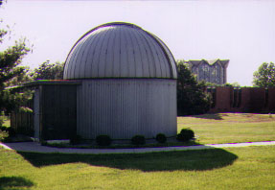
Pulsational Variability in Proto-Planetary Nebulae and Other Post-AGB Objects
(Measuring the Pulse of Dying Stars)
Bruce J. Hrivnak (Valparaiso University)
Post-AGB
Pulsation
Results
(Binarity – another topic)
(11th Pacific Rim Conf., Hong Kong 2015-12-15)

Slide 2
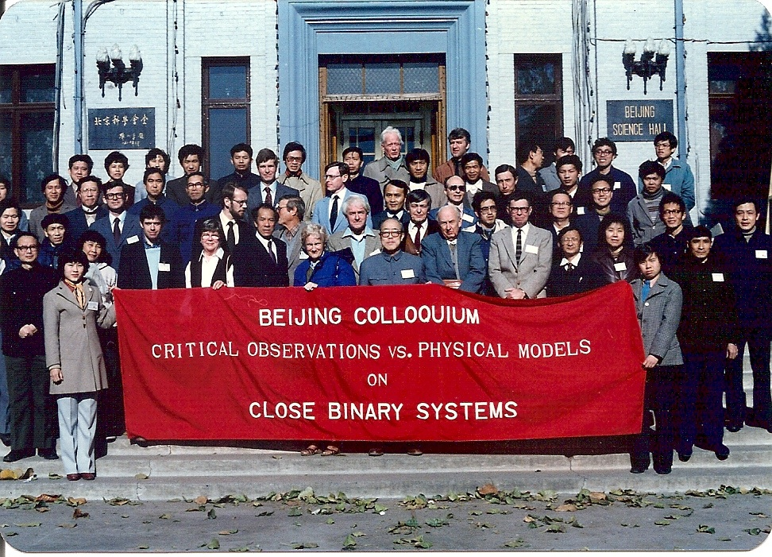
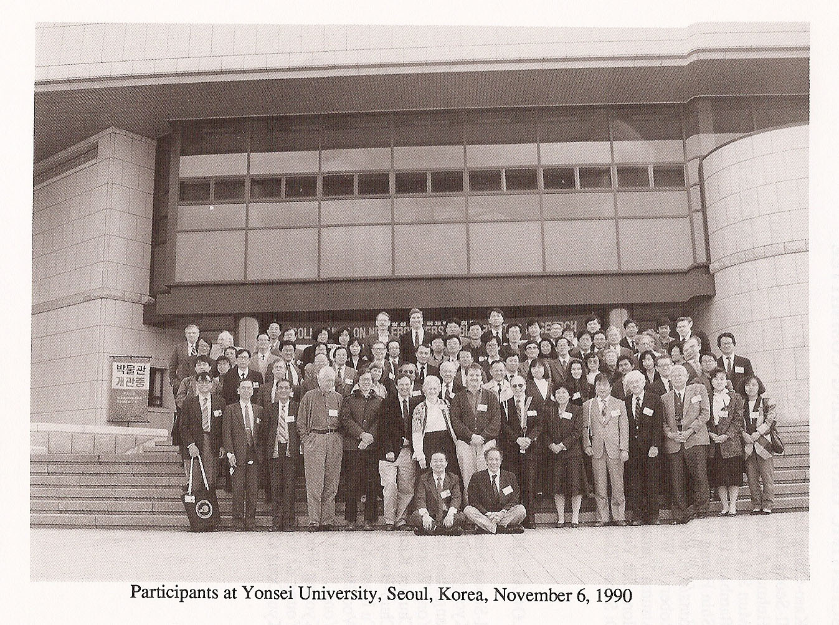
Nostalgic journey: Pacific Rim Conferences 1 & 2

Slide 3
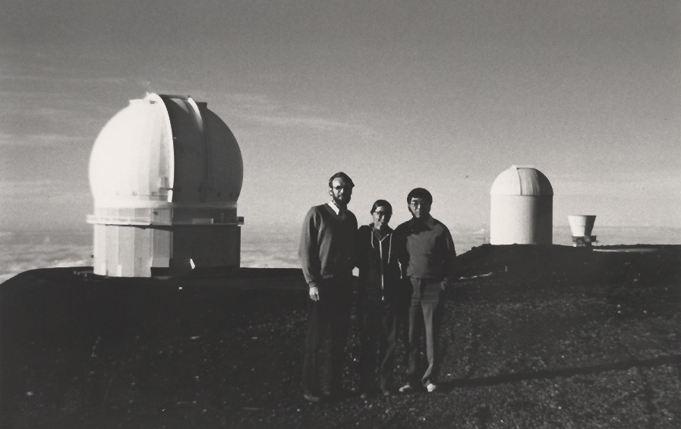
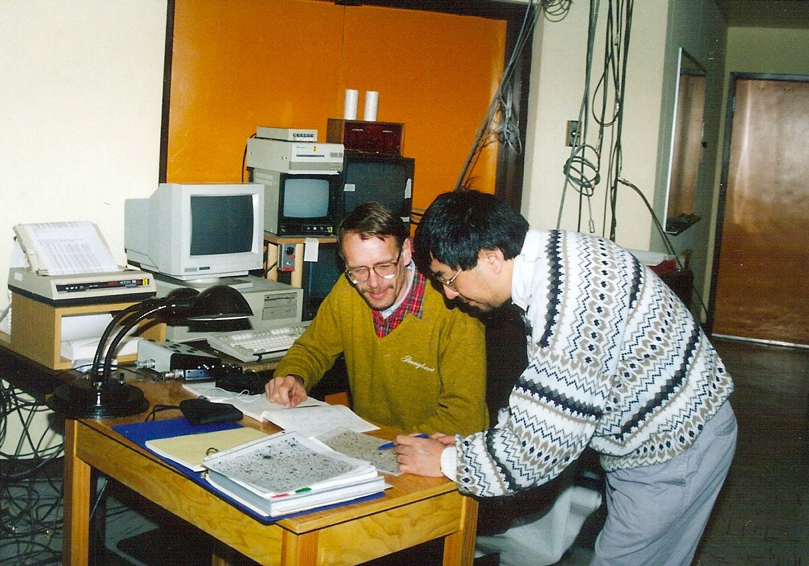
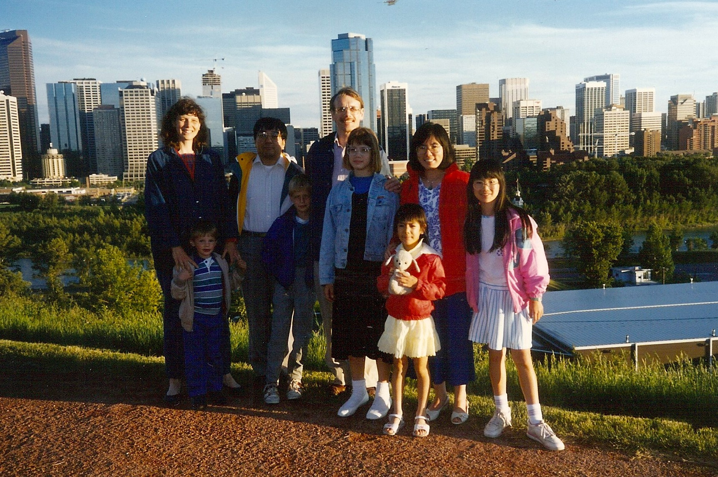
Nostalgic journey: Early research with Sun Kwok (1984 - )
Identifying PPN candidates
CFHT 1984
CTIO 1992
Calgary 1991

Slide 4
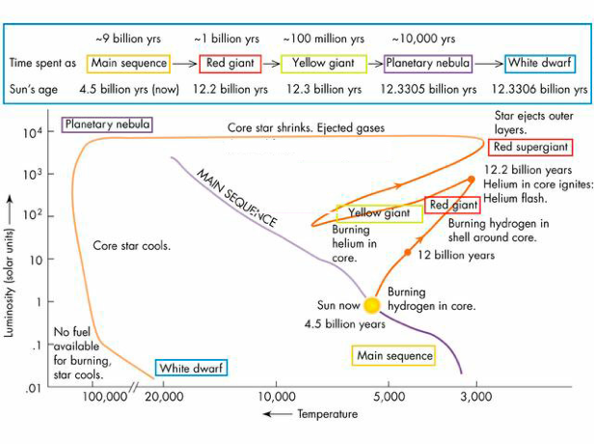
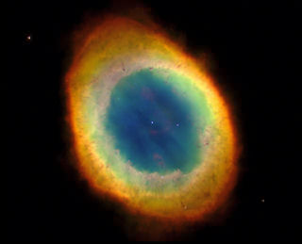
Background: Evolution of stars like the sun
Expected properties of PPNe?
- AGB → PN
L = 5-10 x 10³ L
- T_{eff} = 5,000-30,000 K
- Exp. gas envelope,
detached but close
- Cool dust
T_{d} = 300 → 150 K
- Chemical signs of
AGB nucleosynthesis
Proto-planetary nebula
~1,000 yrs
L
Temp (surface)

Slide 5
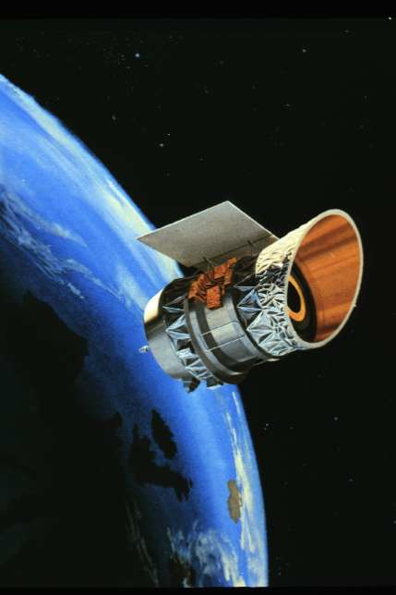
Proto-Planetary Nebulae: Finding Them
Discovery: Rather recent (since late 1980s) Difficulties?
Short lifetime: few thousand years (10³yr/10⁹yr ~ 15 min/75 yr)
Partial obscuration by ejected circumstellar gas, dust
Hard to tell from normal stars in visible light
Key to Discovery:
Circumstellar dust is cool, radiates in infrared
IRAS satellite, all-sky survey (1983)
S. Kwok quickly recognized the opportunity that IRAS afforded to identify and study these transitional objects:
Select candidates based on IR colors
Visible counterparts were found for many of these (→ IRAS names)

Slide 6
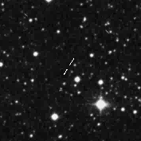
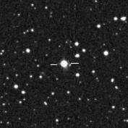
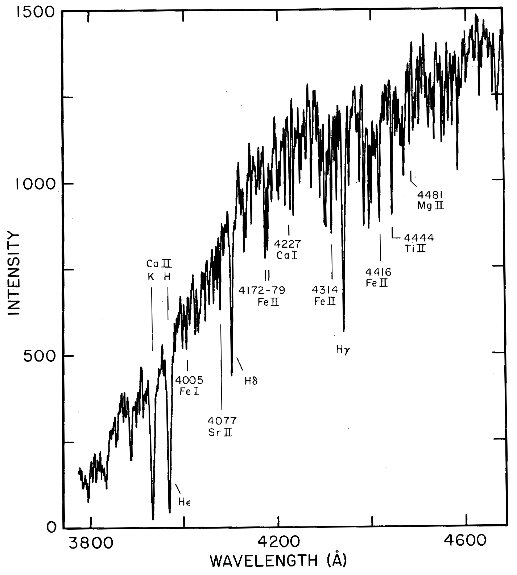
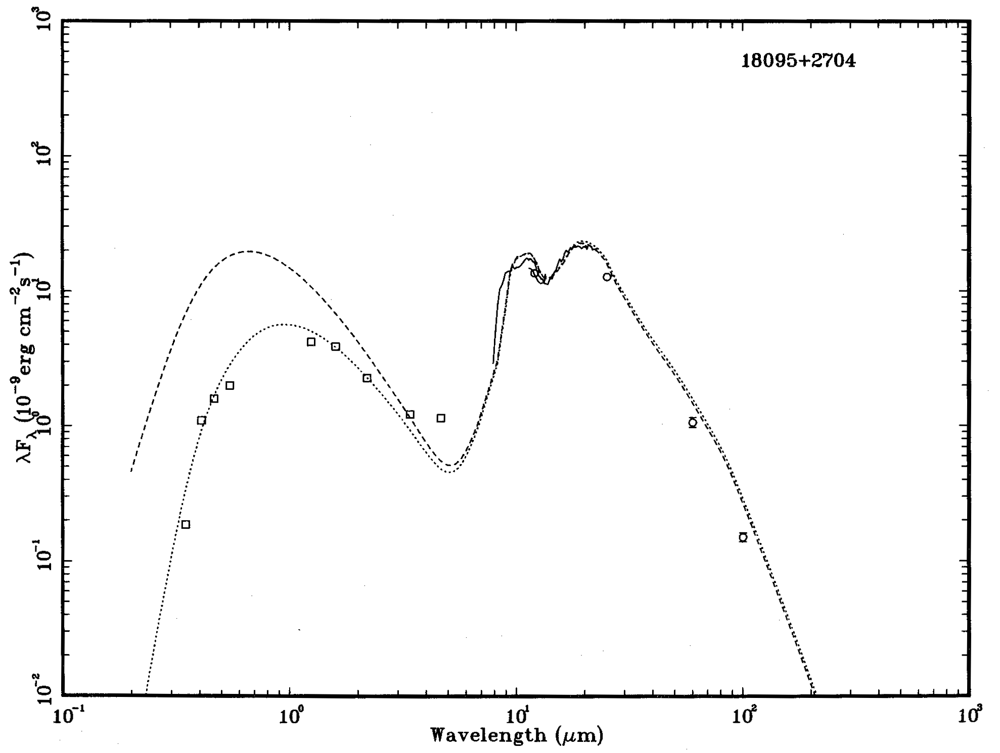
Beginning the Search: Identifying Candidates
IRAS 19477+2401
IRAS 18095+2704
F3 I
visible/near-IR:
photosphere
|
mid-IR:
cool dust
|

Slide 7
Studies of Central Star and Circumstellar Envelope
Star:
Chemical composition (Van Winckel et al.; Reddy et al.)
S-process elements overabundant (AGB nucleosynthesis)
Variability (Arkhipova et al.; Hrivnak et al.) – discuss today
Circumstellar Envelope:
Chemical composition
Gas
Dust
Shape of nebula (HST images, Sahai, … Balick)
Shaping of the nebula
Kinematics (Bajurrabal, …)

Slide 8
Pulsation in PPNe – Light Curve Studies
Motivation:
Pulsational light variability known to occur in AGB stars
It is a driver of mass loss and contributes to dust formation
Can yield info on mass loss, physical properties (M, L), and evolution in PPNe phase. Compare & combined with models.
Study of variability of PPNe began in part to search for binarity.

Slide 9
Pulsation in other Post-AGB Stars
RV Tau: LC: Alternately deep and shallow minima
SpT: F – K; P: 30 – 150 d (or twice that long)
Amplitude range: → 3 mag
Post-AGB/Post-RGB: LC: Type II Cepheids, SRV
P: 50 – 120 d; Ampl. range: 0.1 – 1.5 mag
Studies by Kiss et al. (2007) and Van Winckel et al. (2009) of post-AGB and post-RGB stars in binary systems.
Recently identified in LMC (van Aarle et al. 2011, # ~ 50 var.) SMC-LMC (Kamath et al.)
RCB: LC: drops of → 8 mag; Rare; H-poor, C-rich, dust ejections
Pulsation : P~40 day, Ampl~0.4 mag (seen between eruptions)

Slide 10
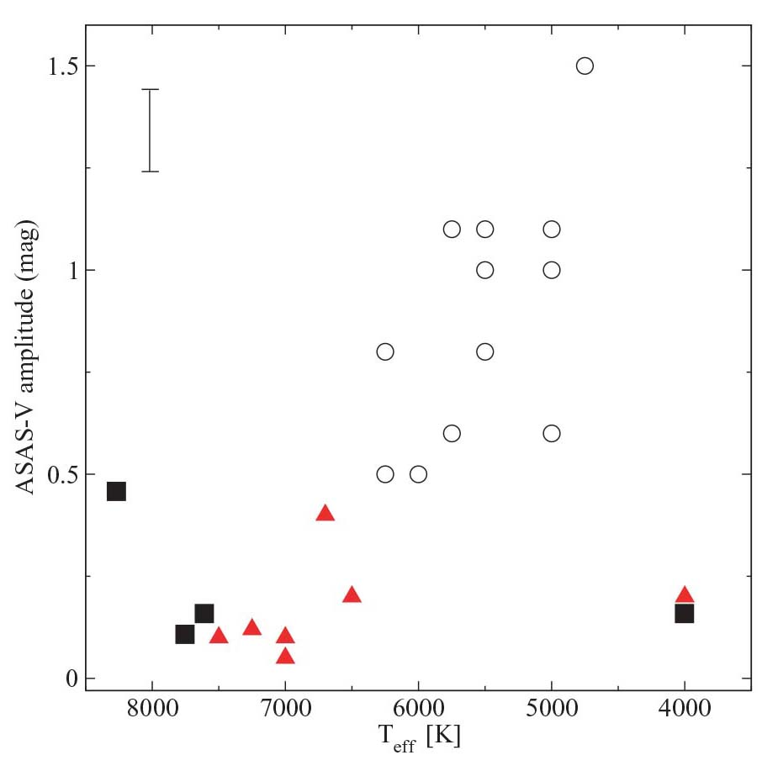
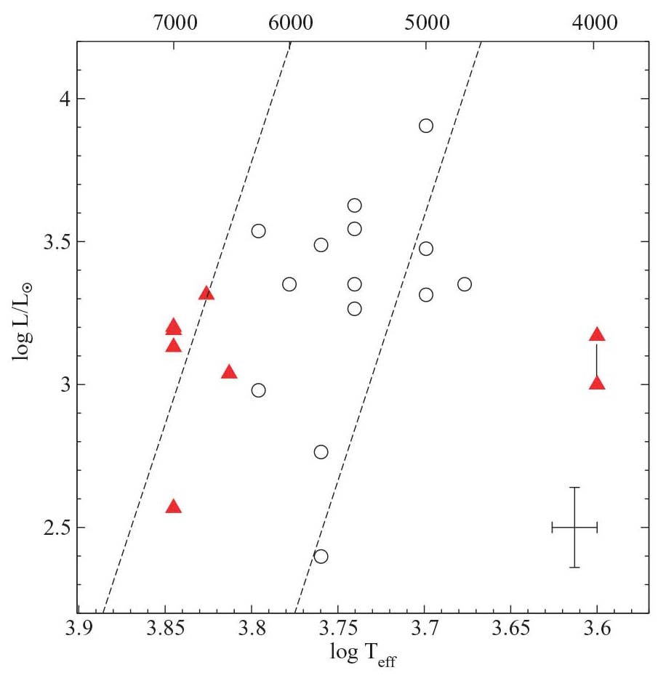
Pulsation in other Post-AGB Stars
Post-AGB: Kiss et al. (2007)
Ampl – T_{eff} relations
L – T_{eff} relations
= multi-P

Slide 11
Pulsation in PPNe – Light Curve Studies
Arkhipova et al. (Sternberg Inst., Moscow)
Long-term study: 1991 – present (~ 25 yrs)
Photoelectric ptm, 0.6-m telescope, Crimea
Published light curves for ~15 PPNe and candidates
Valparaiso study:
Long-term study: 1994 – present (~ 20 yrs)
CCD ptm, 0.4-m telescope on Valparaiso campus & more recently SARA KPNO (0.9-m) & CTIO (0.6-m)
50 PPNe and candidates, V = 8-14 mag
Complementary studies

Slide 12
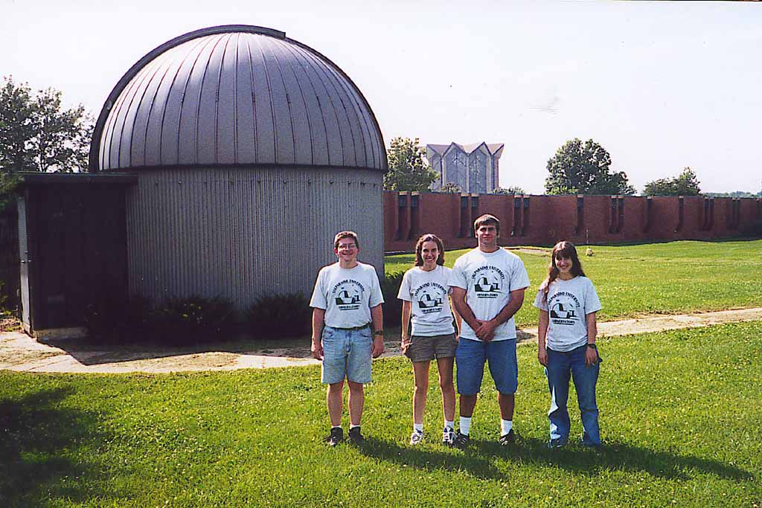
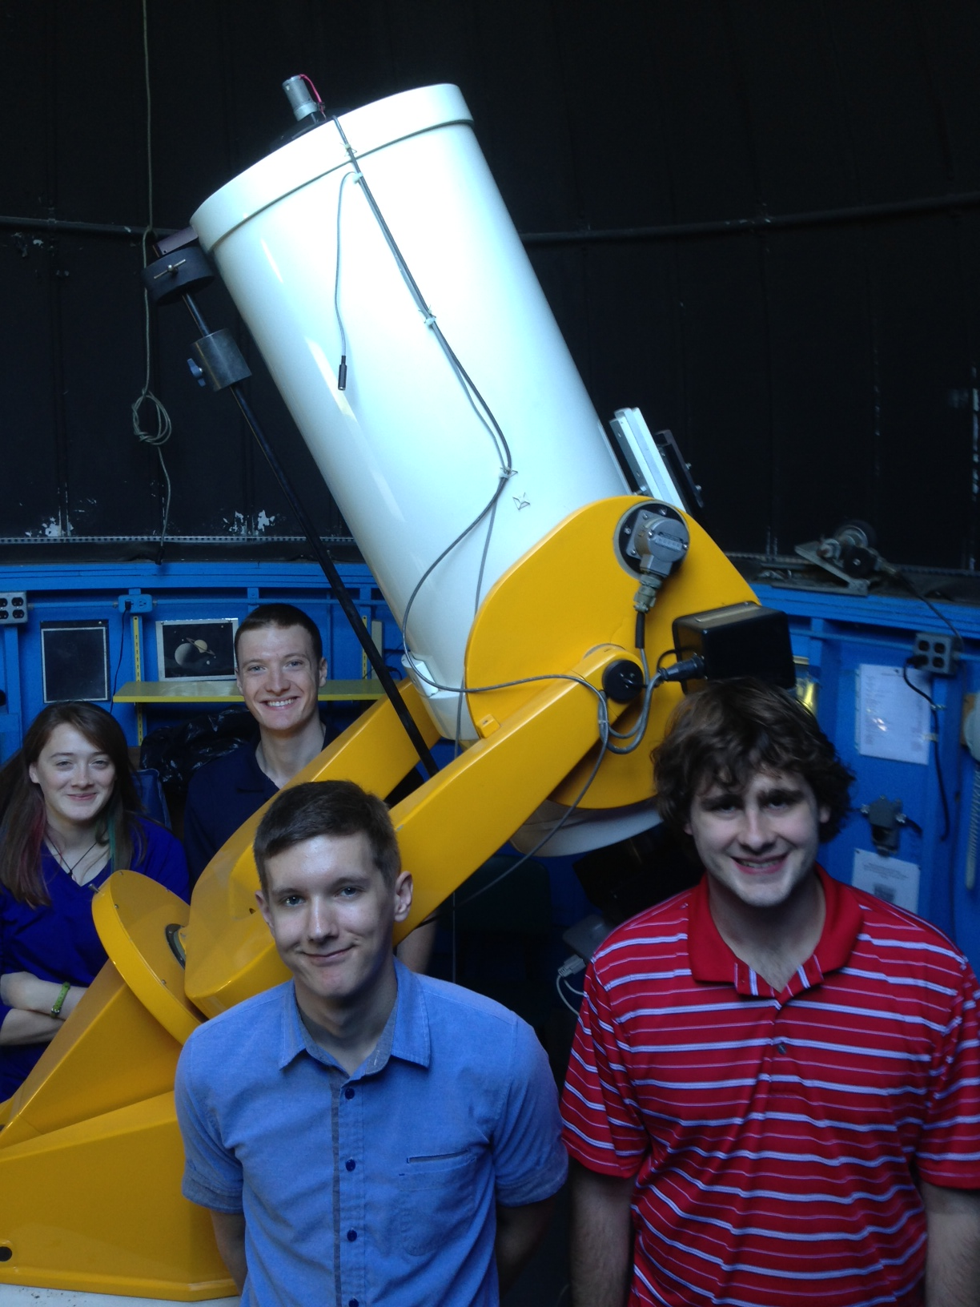
Pulsation in PPNe – Light Curve Studies
Much of this research carried out at VU Campus Observatory:
Photometric monitoring program
Small telescope, but dedicated access year round required
Ideal program to involve undergraduate students in research

Slide 13
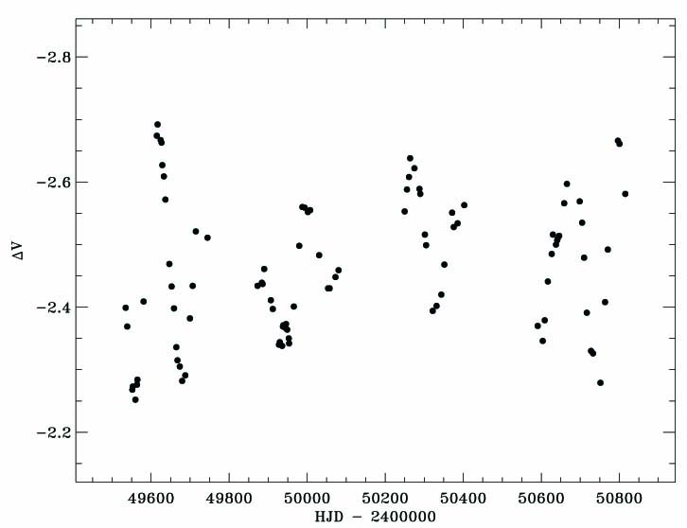
Light and Color Curves (14 yr) – C-rich PPNe
Sample Light Curve – changing amplitude
1994
1997

Slide 14
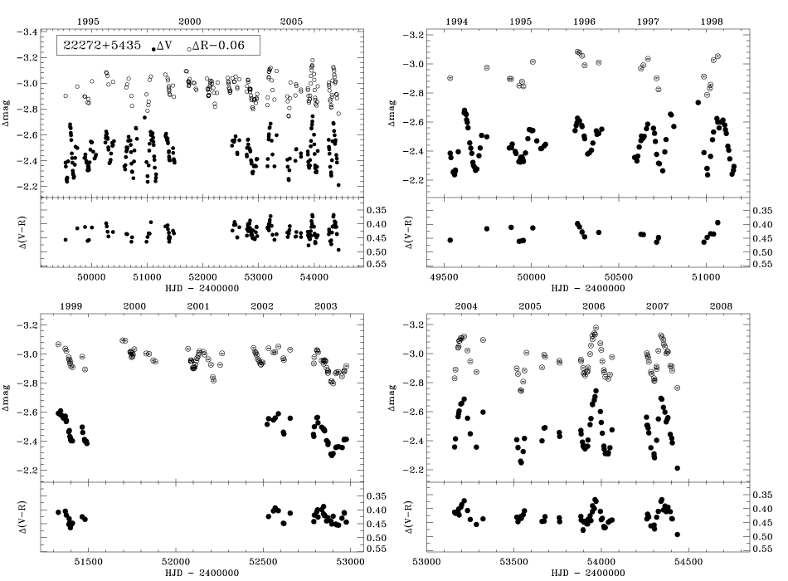
Light and Color Curves (14 yr) – C-rich PPNe (ex. 1)
ΔR
ΔV
Entire data set
5-yr intervals
Δ(V-R)
ΔR
ΔV
- V filter problem -
Δ(V-R)

Slide 15
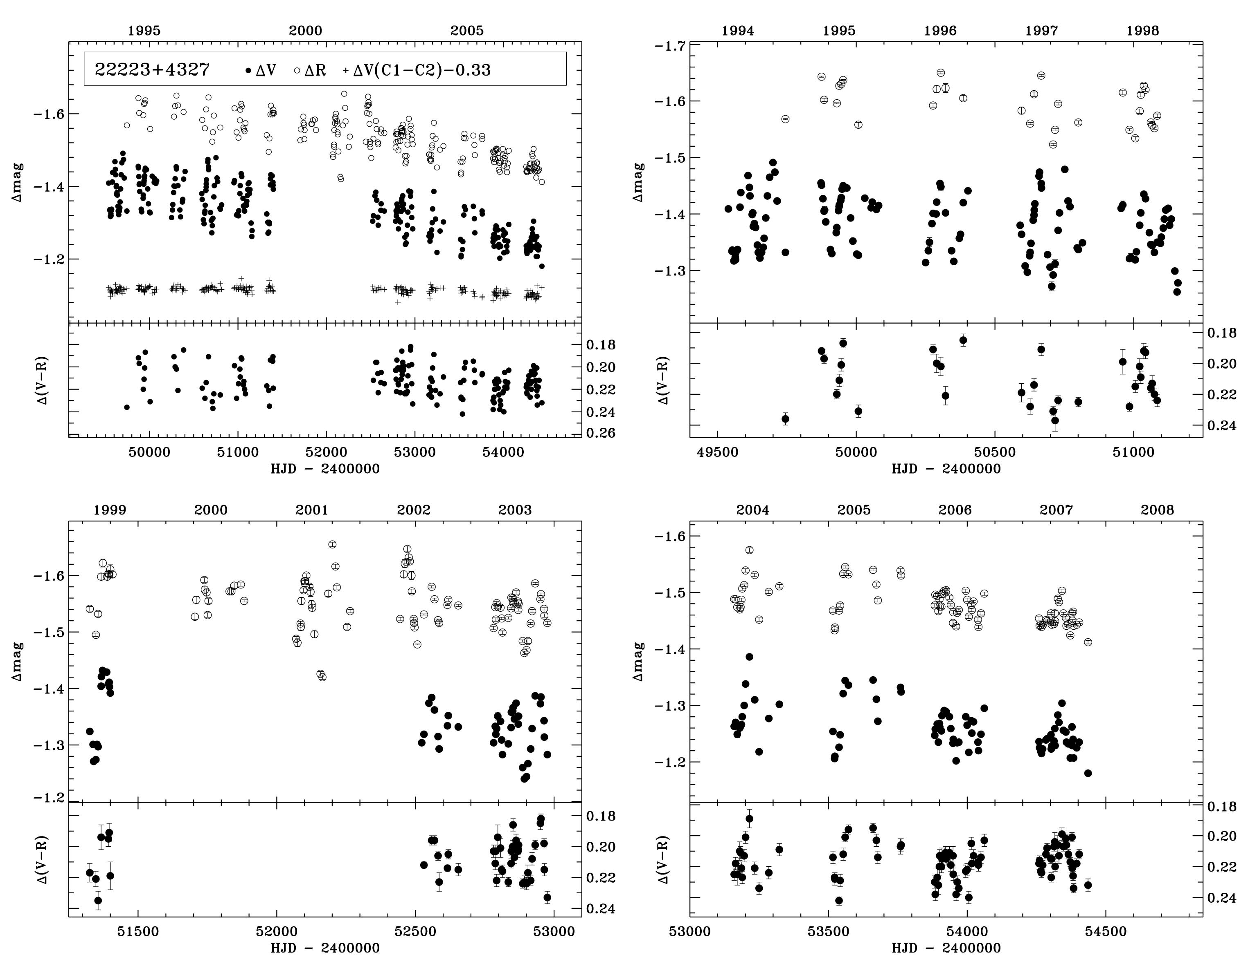
Light and Color Curves (14 yr) – C-rich PPNe (ex. 2)
ΔR
ΔV
Entire data set
5-yr intervals
Δ(V-R)
ΔR
- V filter problem -
ΔV
Δ(V-R)

Slide 16
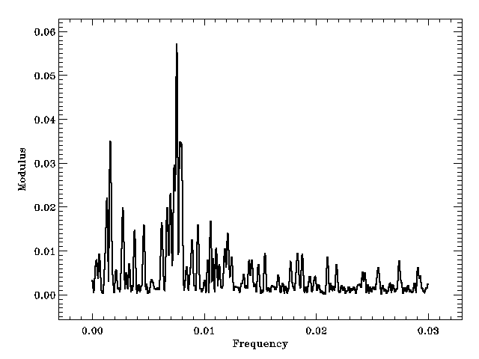
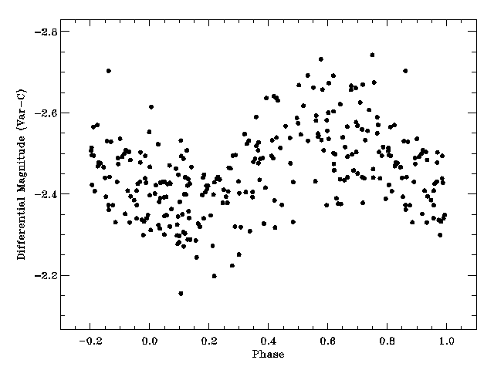
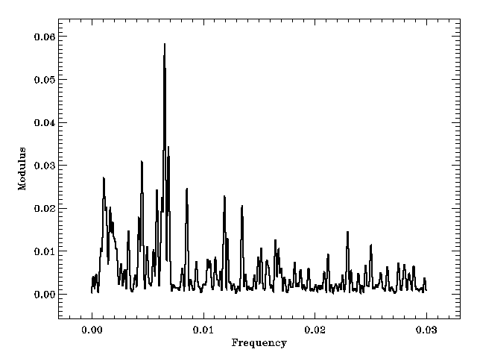
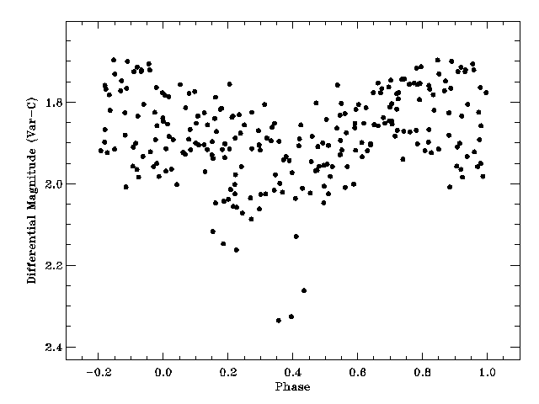
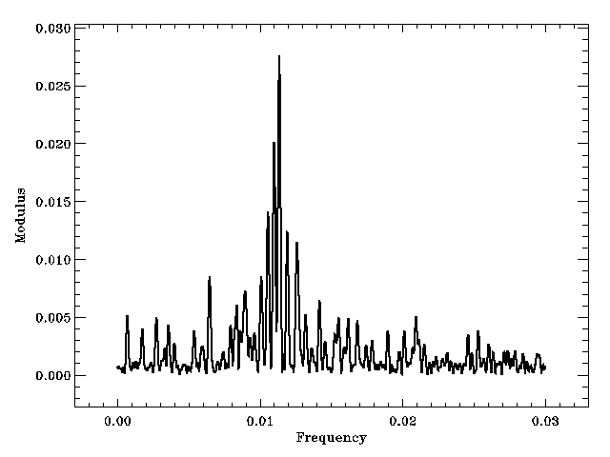
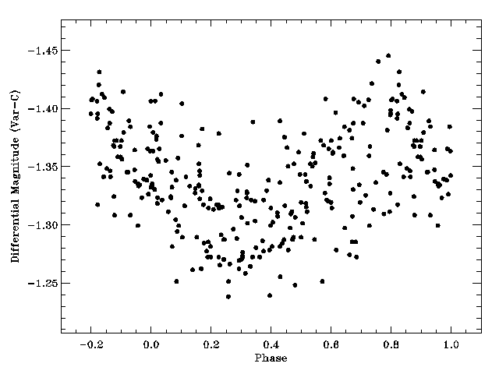
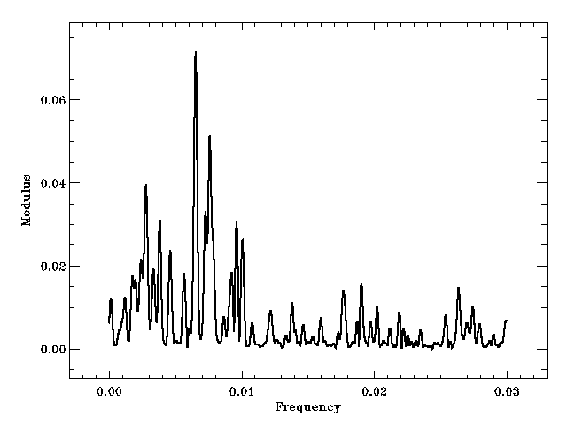
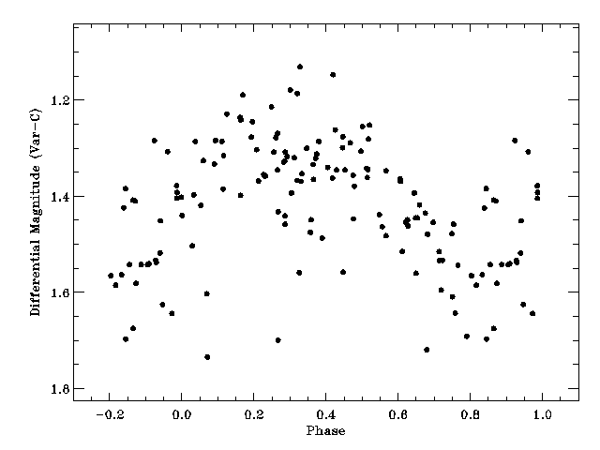
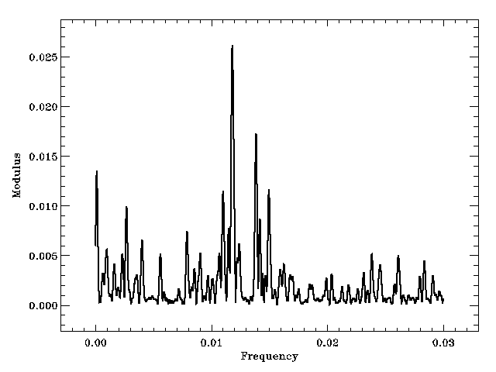
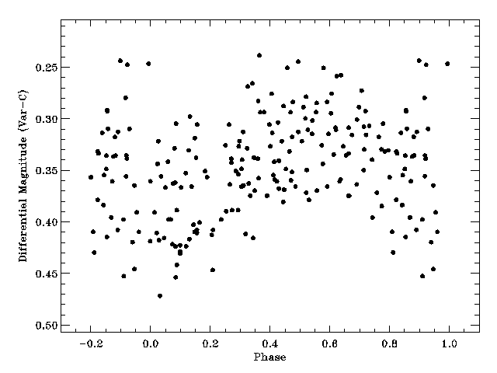
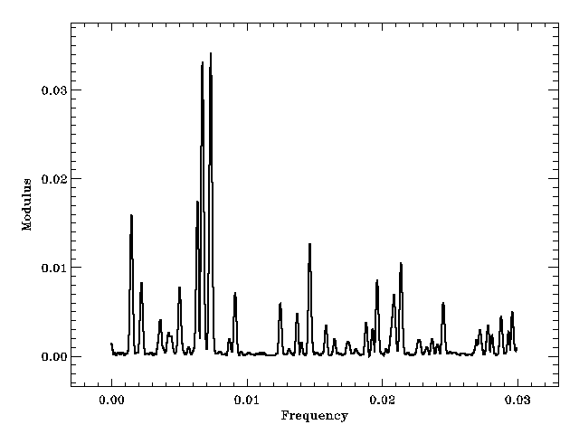
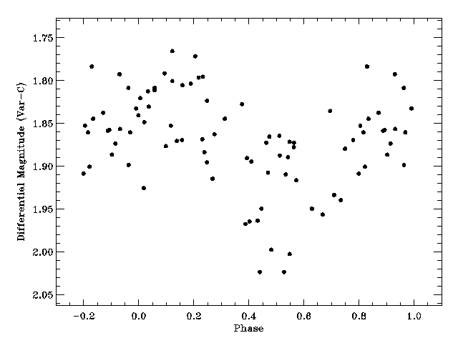
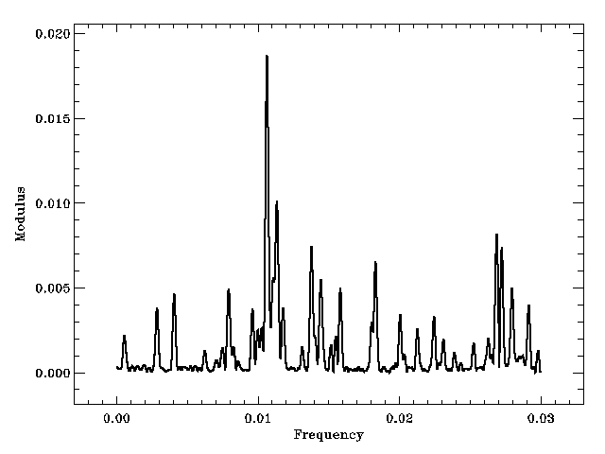
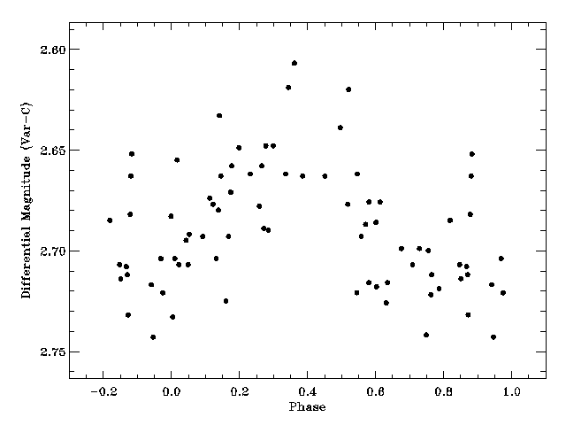
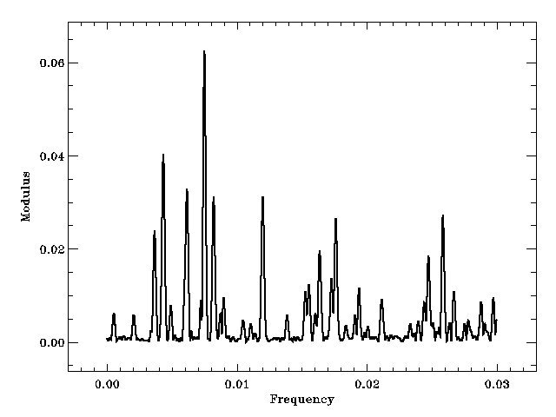
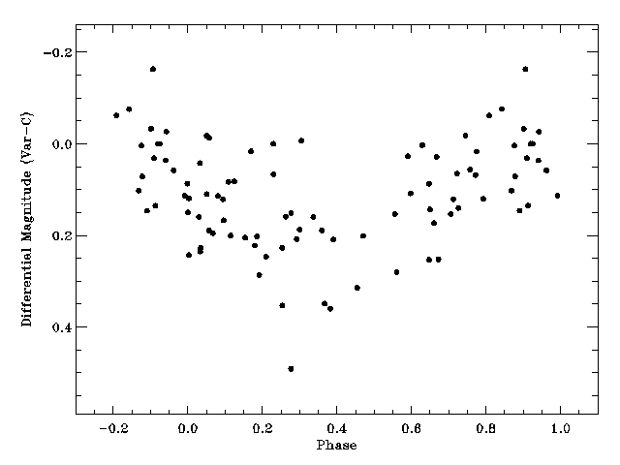
Light Curves, C-rich PPNe - Period Determination
P = 130 d
G5
P = 89 d
G0
P = 85 d
G2
P = 94 d
G2
P = 153 d
G8
P = 153 d
G8
P = 136 d
(148 d)
G5
P = 133 d
G8
P analysis – Period04 & CLEAN

Slide 17
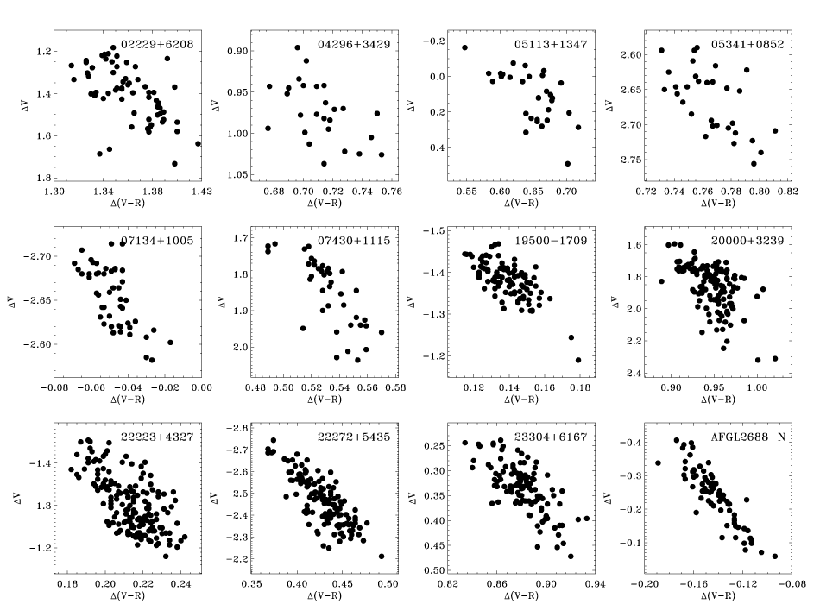
Light Curves (C-rich) - redder when fainter ΔV vs Δ(V-R)
Δ(V-R)
ΔV
Brightness change due to Teff change

Slide 18
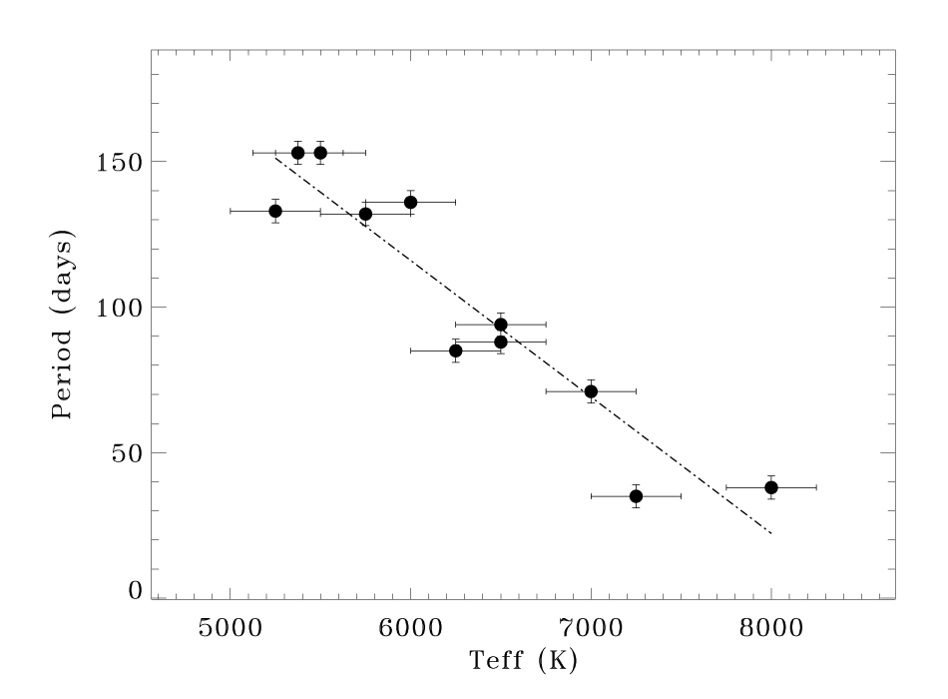
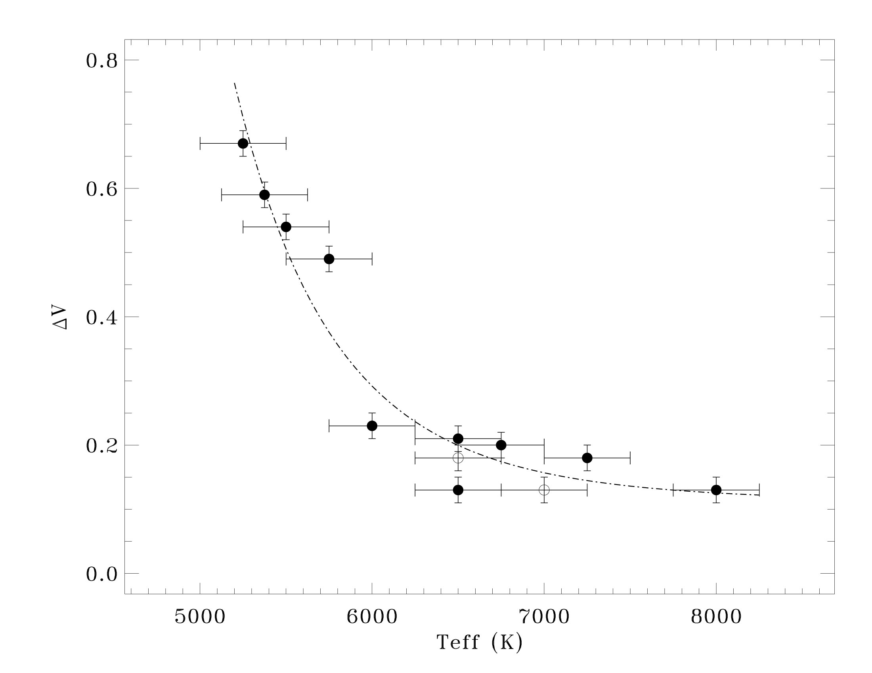
Pulsation in C-rich Central Star – Correlations
P
ΔV
(LC ampl.)
(ΔP/ΔT_{eff} = -0.047d/K)
T_{eff}
T_{eff}
Results: (Statistical trends with 12 carbon-rich objects)
- Shows on average how an individual PPN evolves with time
- Known: T_{eff} → increases with time as star evolves
- P decreases with T_{eff} → P decreases with time
- LC ampl. decreases with T_{eff} → it decreases with time

Slide 19
Light Curve Studies – Pulsation in PPNe PPNe
Initial results (12 C-rich):
All PPNe vary in light due to pulsation
ΔV ~ 0.15 – 0.60 mag
All are redder when fainter
P = 35 – 155 d, F-G (T_{eff} = 5000-8000 K)
P decreases with increasing T_{eff}, and thus P decreases with time
Amplitude decreases with T_{eff} and thus with time
Can we observe evolution in real time?
Using model evolution rates after decreased mass loss → ΔT_{eff}/Δt coupled with our ΔP/ΔT_{eff} → ΔP/Δt ~ -0.2 d/yr
Potentially important constraint for this evolutionary phase
Return to this later with a larger sample
Hrivnak et al. (2010)

Slide 20
Light Curve Studies – Pulsation in PPNe - Extension
More recent and in-progress extensions of this study:
O-rich PPNe (#=4 thus far)
Fainter Milky Way PPNe, (O- & C-rich) (#=9, VU + SARA, in progress)
Hotter PPNe (O- & C-rich) (#=8, VU, in progress)
PPNe from Magellanic Clouds (C-rich) (#=22, OGLE data)
Including contemporaneous V_{R} data (#=2 completed, 5 in progress)

Slide 21
Light Curve Studies – Pulsation in PPNe - Extension
More recent and in-progress extensions of this study:
O-rich PPNe (#=4 thus far)
Fainter Milky Way PPNe, (O- & C-rich) (#=9, VU + SARA, in progress)
Hotter PPNe (O- & C-rich) (#=8, VU, in progress)
PPNe from Magellanic Clouds (C-rich) (#=22, OGLE data)
Including contemporaneous V_{R} data (#=2 completed, 5 in progress)

Slide 22
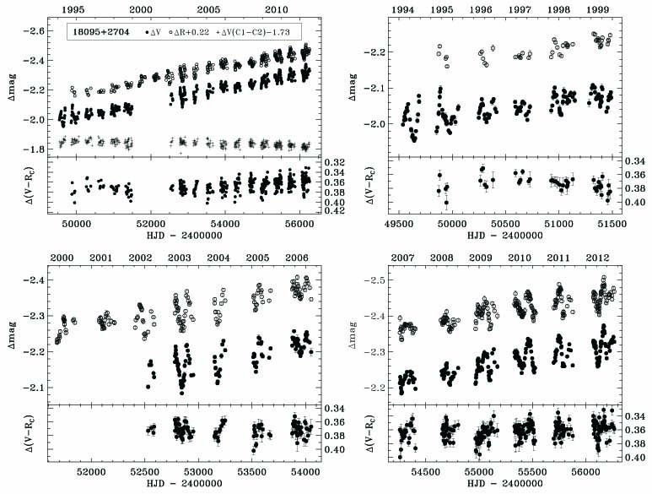
Light and Color Curves – O-rich PPNe
ΔR
ΔV
Entire data set
6-yr intervals
Δ(V-R)
ΔR
ΔV
Δ(V-R)

Slide 23
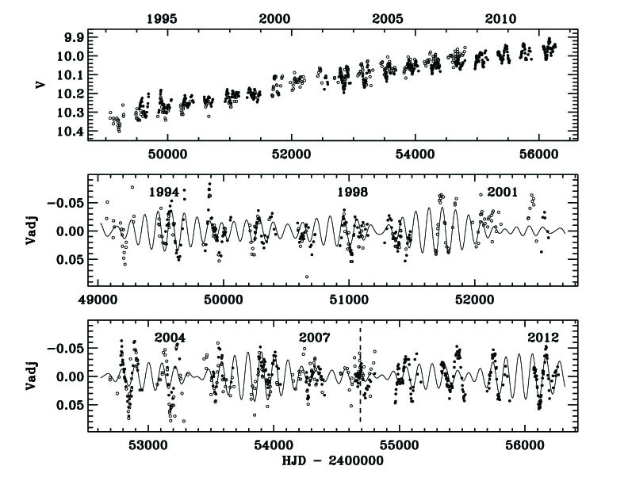
Pulsational Light Curves (20 yr) – O-rich PPNe
Fitted with 4 P: P₁=113, P₂=98, P₃=103, P₃=108 d; inc. Arkhipova et al.

Slide 24
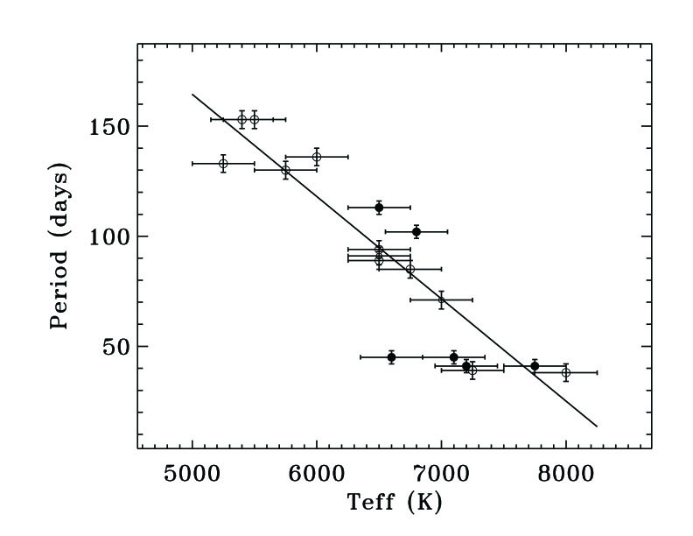
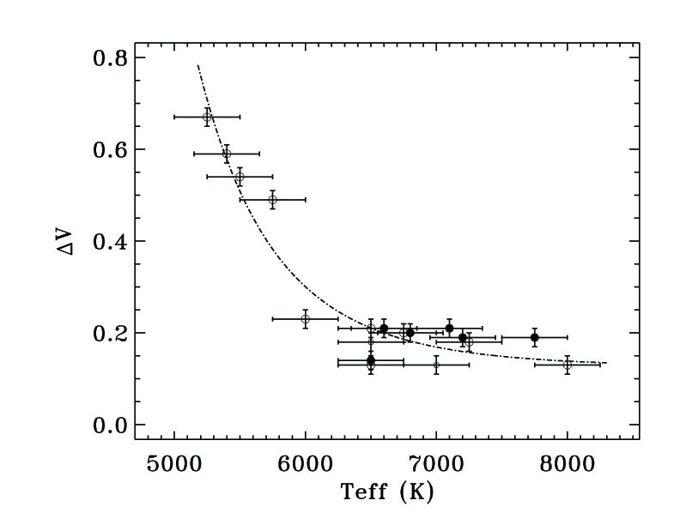
Pulsation in the Central Star – O-rich / Results
Study of 4 O-rich PPNe:
P = 113, 101, 58, 43 days (with multiple P; P₂ = P₁±10%)
Amplitudes ΔV = 0.14-0.21 mag
Redder when fainter
P not inconsistent with C-rich, but perhaps a bit steeper ΔP/Δt_{eff}
Amplitudes consistent with C-rich sample
(small sample of O-rich objects)
P
ΔV
o
o
(MaximumLC ampl.)
o
o
o
o
T_{eff}
T_{eff}
(Hrivnak et al. (2015a)
T_{eff}

Slide 25
Light Curve Studies – Pulsation in PPNe - Extension
More recent and in-progress extensions of this study:
O-rich PPNe (#=4 thus far)
Fainter Milky Way PPNe, (O- & C-rich) (#=9, VU + SARA, in progress)
Hotter PPNe (O- & C-rich) (#=8, VU, in progress)
PPNe from Magellanic Clouds (C-rich) (#=22, OGLE data)
Including contemporaneous V_{R} data (#=2 completed, 5 in progress)

Slide 26
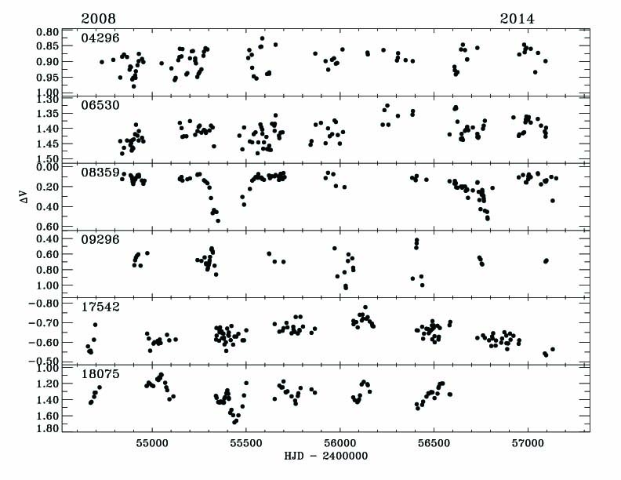
Pulsational Light Curves (7 yr) – Fainter PPNe

Slide 27
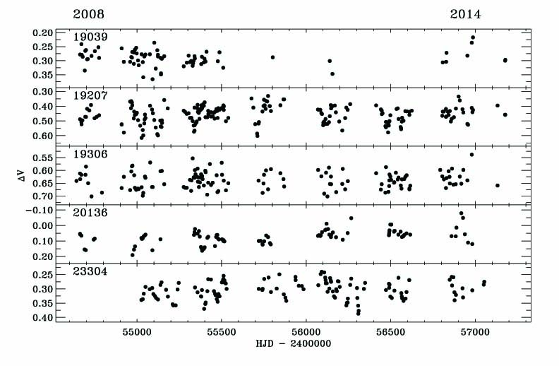
Pulsational Light Curves (7 yr) – Fainter PPNe

Slide 28
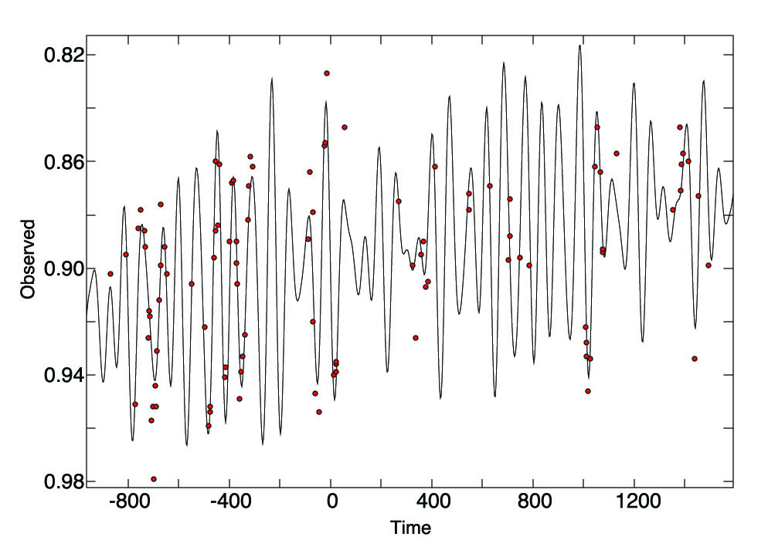
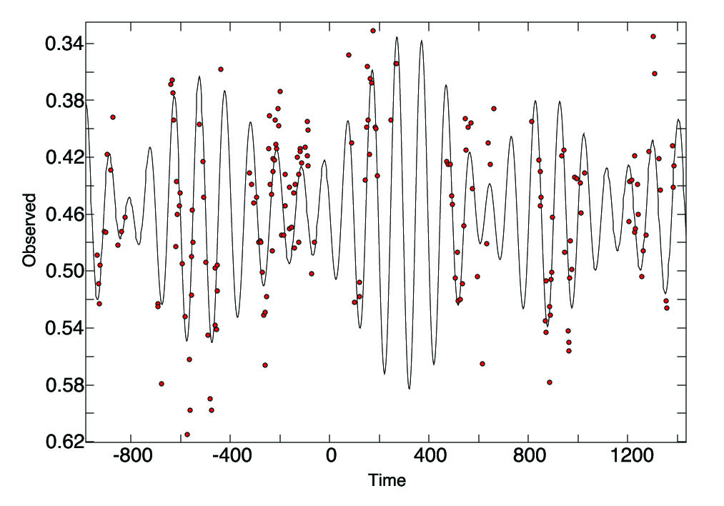
Pulsational Light Curves (7 yr) – Fainter MWG PPNe
Fainter PPNe from the Milky Way Galaxy
#=9, both O-rich and C-rich, all observed from VUO + SARA
V = 13 – 15 mag
P found for 6 of 9; P = 25 – 135 d (with multiple P)
presently in progress
2008
2011
2014
2008
2011
2014
Fitted with 4 P: P₁= 71 d
Fitted with 4 P: P₁=96

Slide 29
Light Curve Studies – Pulsation in PPNe - Extension
More recent and in-progress extensions of this study:
O-rich PPNe (#=4 thus far)
Fainter Milky Way PPNe, (O- & C-rich) (#=9, VU + SARA, in progress)
Hotter PPNe (O- & C-rich) (#=8, VU, in progress)
PPNe from Magellanic Clouds (C-rich) (#=22, OGLE data)
Including contemporaneous V_{R} data (#=2 completed, 5 in progress)

Slide 30
Pulsational Light Curves – Hotter PPNe
Hotter PPNe of B spectral type, both O- & C-rich
8 objects from our list of PPN candidates
VU Observatory 1994-2007 + some recent
Variations on a short timescale (< few days)
Amplitude 0.15 – 0.21 mag
presently in progress
Variations on individual days
Variations over 50 days

Slide 31
Light Curve Studies – Pulsation in PPNe - Extension
More recent and in-progress extensions of this study:
O-rich PPNe (#=4 thus far)
Fainter Milky Way PPNe, (O- & C-rich) (#=9, VU + SARA, in progress)
Hotter PPNe (O- & C-rich) (#=8, VU, in progress)
PPNe from Magellanic Clouds (C-rich) (#=22, OGLE data)
Including contemporaneous V_{R} data (#=2 completed, 5 in progress)

Slide 32
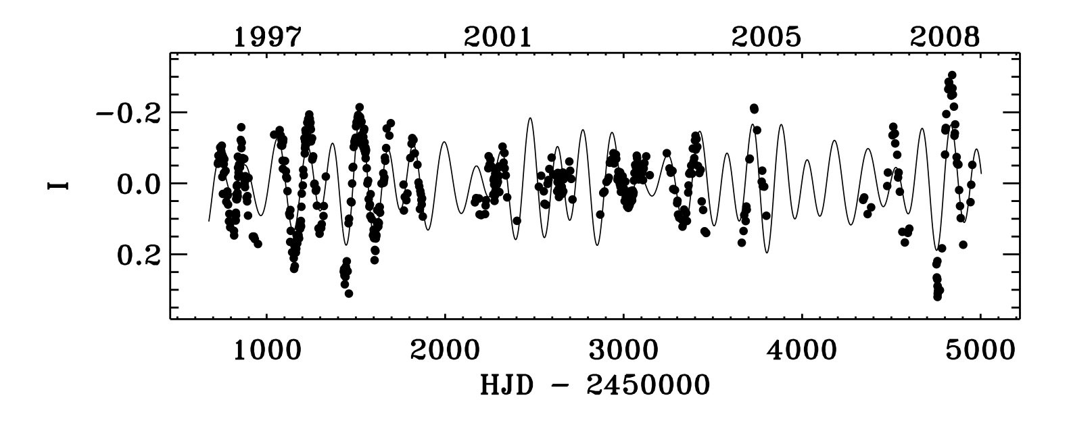
Pulsational Light Curves (12 yr) – MC C-rich PPNe
Including some PPNe from Magellanic Clouds
22 C-rich objects selected from our Spitzer mid-IR spectra
OGLE II & OGLE III data
P found for 8 of 22, F-G, P = 49 – 157 d (with multiple P)
Hotter PPNe varied on shorter time scale, no periods found
Fitted with 3 P: P₁=157, P₂=138, P₃=239

Slide 33
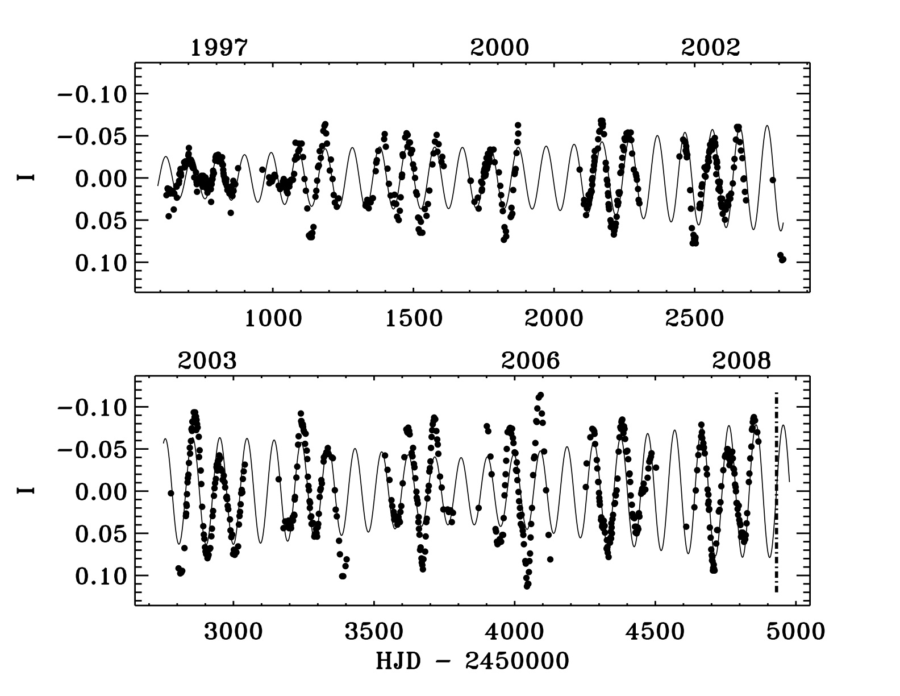
Pulsational Light Curves (12 yr) – MC C-rich PPNe
Fitted with 3 P: P₁=96, P₂=100, P₃=94

Slide 34
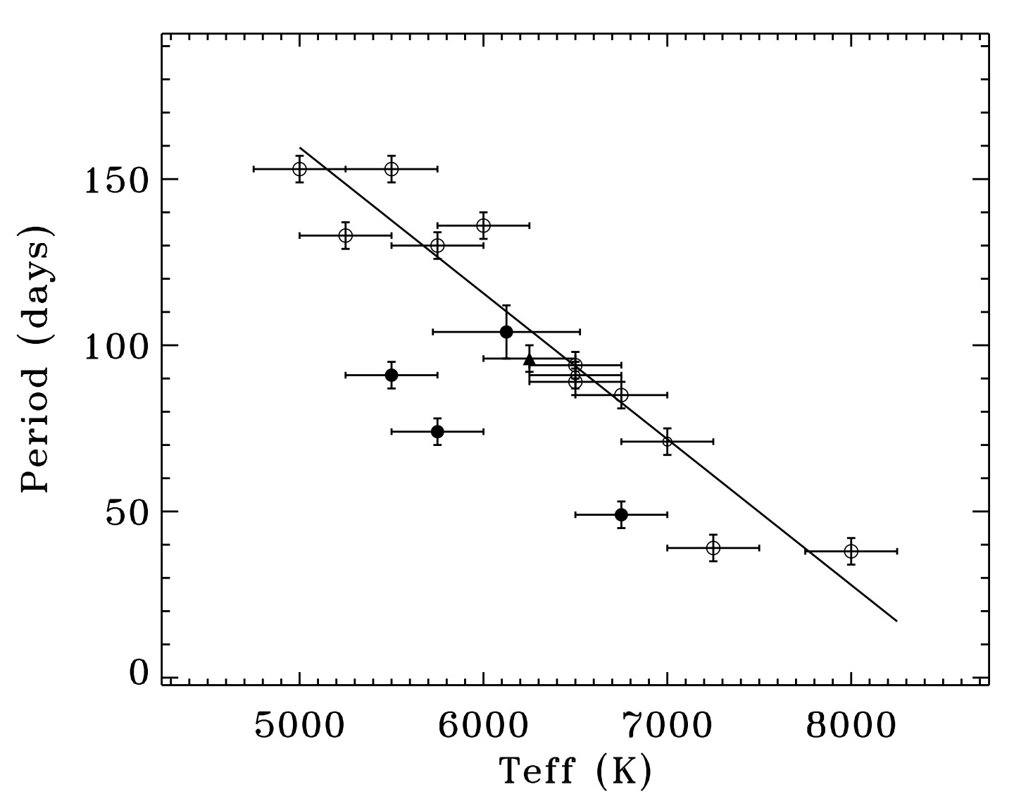
Pulsation in C-rich Central Star - MC
P
MC
MWG
ΔV
(LC ampl.)
T_{eff}
P
- Compared with Milky Way Galaxy
- P decreases with T_{eff} – but displaced to lower T/smaller P, LMC, low Z - metallicity effect?
- LC ampl. decreases with T_{eff} – agreement
Hrivnak et al. (2015b)

Slide 35
Light Curve Studies – Pulsation in PPNe - Extension
More recent and in-progress extensions of this study:
O-rich PPNe (#=4 thus far)
Fainter Milky Way PPNe, (O- & C-rich) (#=9, VU + SARA, in progress)
Hotter PPNe (O- & C-rich) (#=8, VU, in progress)
PPNe from Magellanic Clouds (C-rich) (#=22, OGLE data)
Including contemporaneous V_{R} data (2 completed, 5 in progress)

Slide 36
Contemporaneous Pulsational Velocity Curves
Brighter PPNe from the Milky Way Galaxy (#=7, V=7-11 mag)
Observations at the Dominion Astrophysical Obs (Victoria, Canada)
1991 – 1995
2007 – present
Precision ~ 0.6 – 0.7 km/s, robotic obs
Bohlender
Observations with the Mercator telescope (Canary Islands)
2009 – present
Very high resolution spectrograph (Hermes)
Precision ~ 0.1 – 0.2 km/s
Van Winckel, Van de Steene
Observations with the Moletai telescope (Lithuania)
2008 – present (3 of 7)
Precision ~ 0.6 – 0.7 km/s
Sperauskus, Zacs

Slide 37
Contemporaneous Pulsational Velocity Curves
LC
LCs - us
P=131.9 d
Vr
|
S
|
L
|
S
Vr - Zacs et al. (2009) + us
Pulsation Phase
Star is brightest, hottest when
(Hrivnak et al. 2013)

Slide 38
Contemporaneous Pulsational Velocity Curves
LC
P=110 d
P=88 d
presently in progress
Vr
|
S
Pulsation Phase
|
L
Pulsation Phase
LC
Star is brightest, hottest when
Vr
|
S

Slide 39
Pulsation Radial Velocity Curves – Results / Implications
V_{R} and comparison with V & (B-V)
ΔV_{R} = 12 km/s (range)
P(V_{R}) = P(LC)
Semi-ampl. (V_{R}): K = 2-3 km/s
Phasing: wrt V LC
(B-V): Δφ = 0.0
V_{R}: Δφ = 0.25 (→ hottest when smallest)
Contrast with Classical Cepheids
Phasing: wrt V LC
(B-V): Δφ ~ 0.05 (phase lag)
V_{R}: Δφ = 0.50 (→ hottest when average size and expanding)

Slide 40
Comparison with Pulsation Models
Pulsation periods and amplitudes depend upon the physical properties of the star – M, L, T_{eff}
Fokin et al. (2001) - non-linear radiative models of post-AGB
T_{eff}: 5600 - 6000 K - M_{c}: 0.6, 0.8 M
L: 5000 - 8000 L_{sun}
found P=25-50 d, ΔV=0.2-0.4 mag, ΔV_{r}=+/-5 km/s
fit for 1 particular PPN ~fair, but mass high (0.8 M)
Ampl. pulsation inc. with dec. M_{c}, with inc. metallicity Z
Wood has run some models to attempt to fit the pulsation found in LMC post-AGB stars
However, the models do not agree with the periods observed.
New models are needed to seek agreement with observations.

Slide 41
Needed: Model Analyses of Pulsational Variability
Fokin et al. (2001)
non-linear radiative
models of post-AGB stars
- M: 0.6, 0.8 M
- T_{eff}: 5600 - 6000 K
L: 5000 - 8000 L
8000
L
Results:
P=25-50 d,
ΔV=0.2-0.4 mag,
ΔV_{r}=+/-5 km/s
Need:
- T_{eff}: 5000 - 8000 K
P=50-150 d,
ΔV=0.2-0.7 mag,
LC & V_{R} phasing
5000
5600
T_{eff}
6000

Slide 42
Conclusions:
What have we learned about pulsation in PPNe?
Pulsate with P = 35 – 160 d (hotter ones even shorter timescale)
Ensemble shows evolution to shorter P and smaller amplitude
Multi-periodic, with P₂ = P₁±10% (in most cases)
Evidence for decrease P(t) not seen, but complicated by multi-P
Star brightest when hottest and smallest
Possible differences in pulsation properties due to composition.
P
.
.
.
ΔV
MaximumLC ampl.
.
.
.
.
.
.
.
P

Slide 43
Conclusions:
What do we learn about PPNe?
Potential physical properties M, L, with appropriate models, but not yet
Post-AGB evolution rates:
Intensive mass loss has ended by P ~ 160 days (late-G) – these have detached shells
By P ~ 100 days post-AGB mass loss at low rate, small ΔV
Impact post-AGB evol’n timescales, driven by mass loss
Evolution in real time?
ΔP/Δt, but multiple P makes this difficult for individual obj.
(Using same radial velocities to search for evidence of binary companion – to explain the shapes of nebulae)

Slide 44
Pulsational Variability in Post-AGB, PPNe
Bruce J. Hrivnak (Valparaiso University)
In collaboration with
Wenxian Lu (VU)
Gary Henson (ETSU)
Todd Hillwig (VU)
David Bohlender (DAO, Canada)
Hans Van Winckel (Leuven, Belgium)
Griet Van de Steene (RO Belgium)
Julius Sperauskus (Lithuania)
+ lots of VU undergraduates!
With support from
NSF
Indiana Space Grant
Consortium
Valparaiso University
With thanks to Sun Kwok
for introducing me to PPNe!
(11th Pacific Rim Conf., Hong Kong 2015-12-15)

