Slide 1
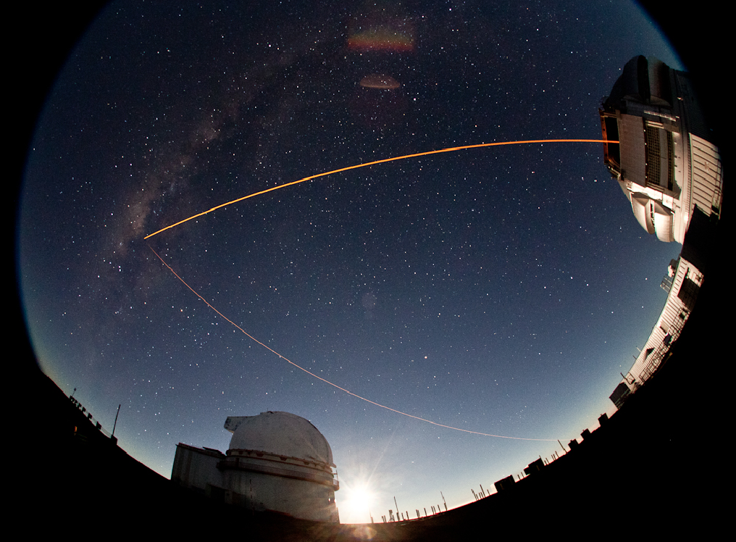
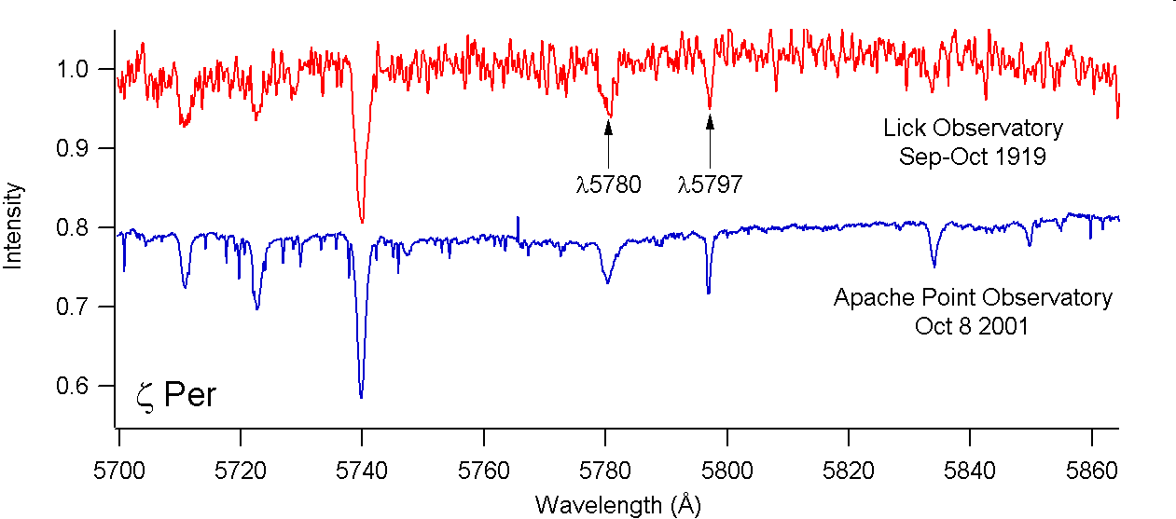
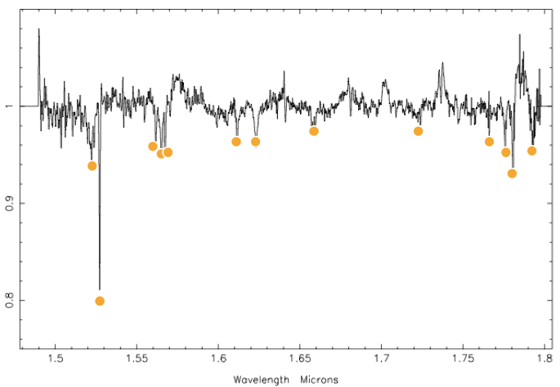
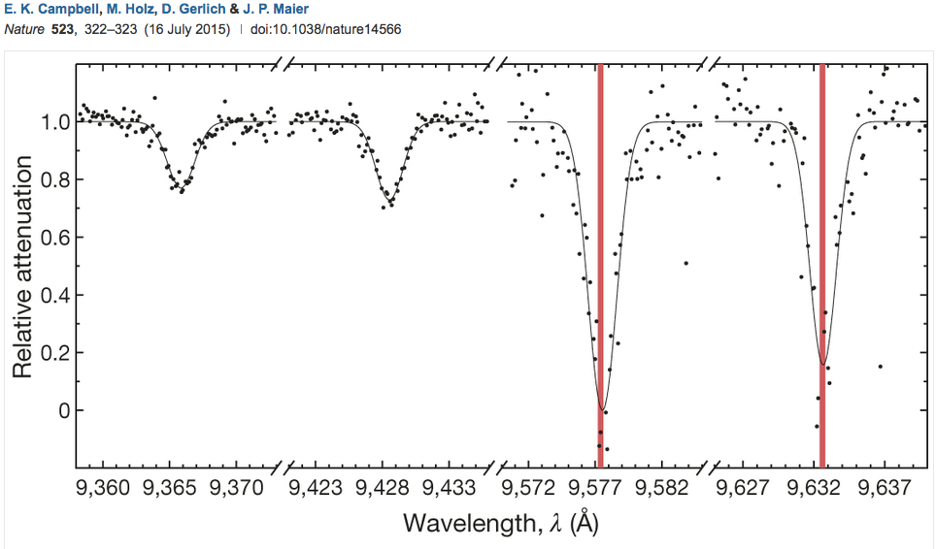

THE DIFFUSE INTERSTELLAR BANDS - A BRIEF REVIEW
DIBs carriers are another ingredient in the interstellar mix that is produced by evolved objects.
The bands have been a source of fascination and frustration for nearly a century.
THE DIFFUSE INTERSTELLAR BANDS –
A BRIEF REVIEW
OUTLINE
1. What are they?
2. Discovery
3. Why the name?
4. IDs - a “growing” problem
5. Interstellar environments
6. DIBs families
7. Solids or free molecules?
8. Transitions and linewidths
9. Proposed identifications
10. C₆₀⁺
11. The new IR DIBs
(with thanks to Ben McCall)
Tom Geballe (Gemini-N)
Pacific Rim Conference on Stellar Astrophysics, Hong Kong, 17 December 2015
Tom Geballe (Gemini-N) Pacific Rim Conference on Astrophysics, Hong Kong, Dec 14-17, 2015

Slide 2
What are DIBs ?
The Diffuse Interstellar Bands (DIBs) are a class of
absorption features found in the spectra of objects
that are observed through interstellar gas and dust,
but are not due to atoms or simple molecules.
DIBs are not formed in stellar atmospheres
(not demonstrated conclusively until ~15 years after discovery)
First ones found at found 96 years ago
Most are at optical wavelengths,
But many at near-UV, near-IR, and in IR (>1.0 microns)

Slide 3
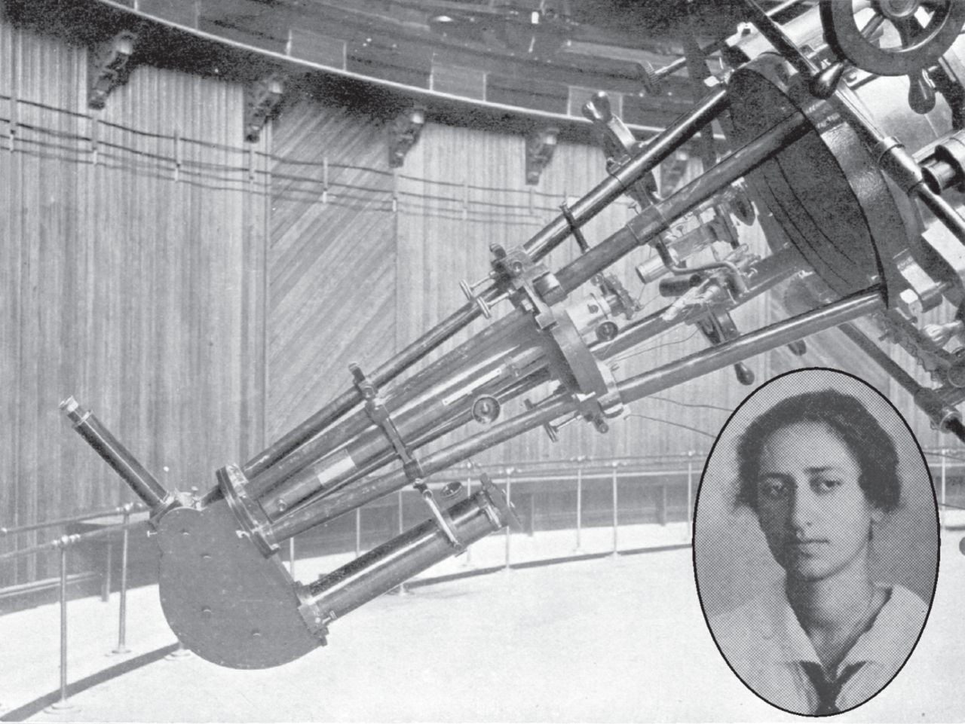
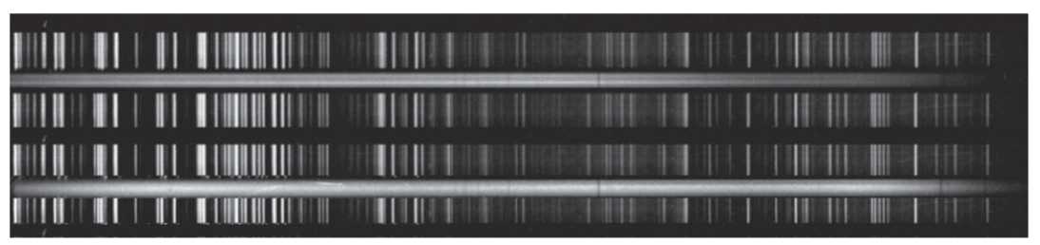
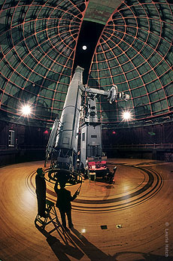
Discovery of DIBs
Mary Lea Heger Shane (1897-1983)
(while examining her spectra for “stationary” Na D lines a la Ca II – Hartman 1904)
Lick Obervatory 36” Refractor + prism spectrograph
Two of Heger’s photographic plates from 1919
DIBs
Na D
Lick Observatory
36”refractor
Plate scanned by McCall & Griffin (2013)
DIBs
“Do sodium clouds similar to the hypothetical
calcium clouds exist in space?... Finally, are there
any other [such] star lines?” - Heger in 1919.
5780 and 5797 published by her as “possibly stationary” in 1922.

Slide 4
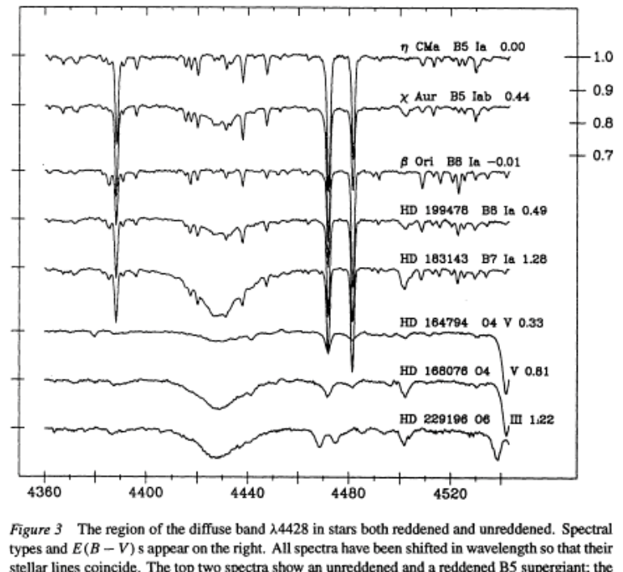
WHY “DIFFUSE”? WHY “INTERSTELLAR”?
“Diffuse”: the most prominent
of the DIBs are broader than
interstellar atomic lines.
Typical widths 1-20Å
“Interstellar:” strengths tend
to increase with increased
reddening (extinction).
(Paul Merrill’s series of
papers in the 1930s)
4430Å Diffuse Interstellar Band
E(B-V)
Herbig 1995

Slide 5
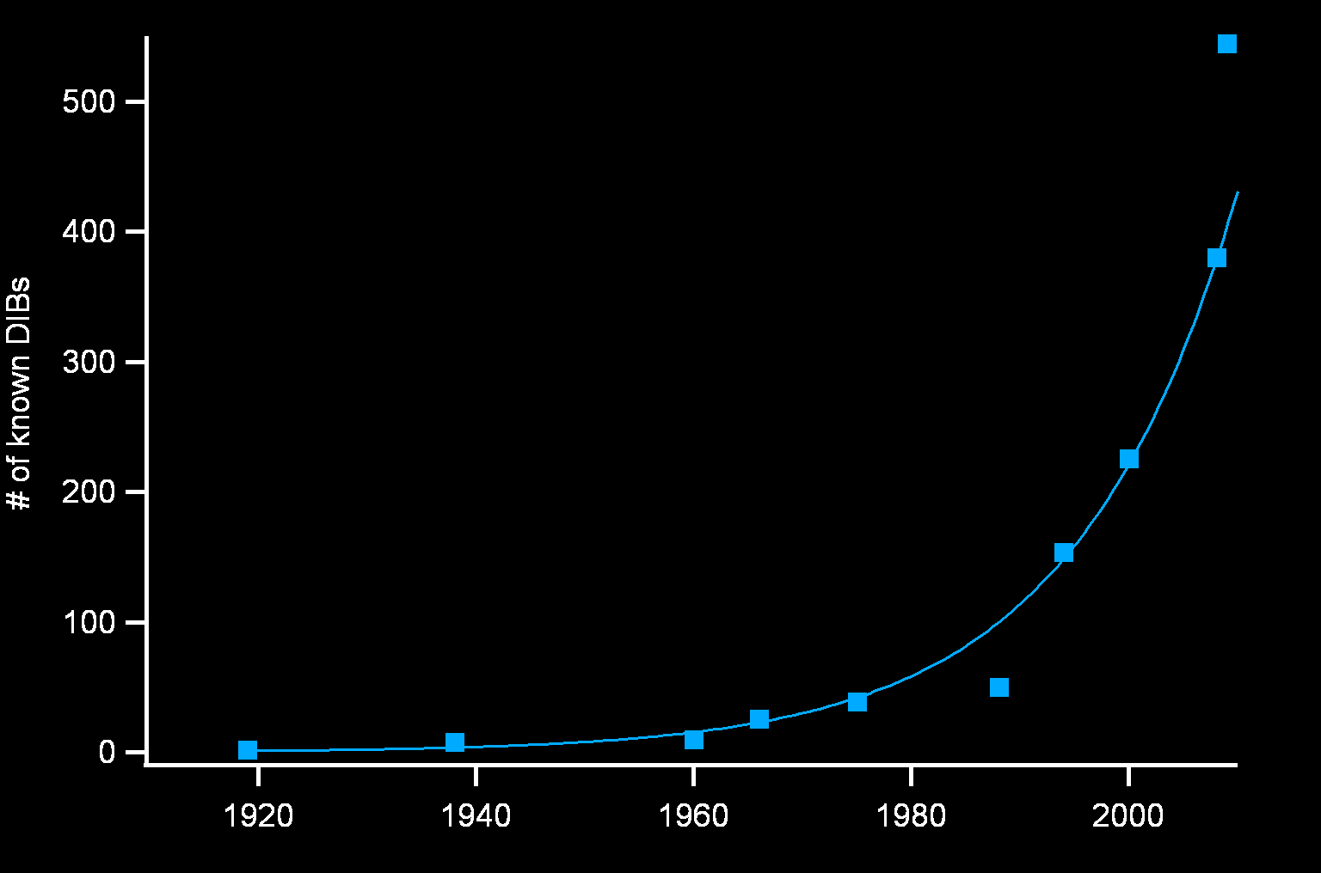
DIBs: a growing problem: none had been identified as of early 2015
“Greatest unsolved mystery in astronomical spectroscopy”
(Still true? What about IRC+10216?, massive SFRs?, …)
Tuairisg et al. 2000
Hobbs et al. 2009
Hobbs et al. 2008
Merrill & Wilson 1960
Herbig 1988
Merrill & Wilson 1938
Herbig 1975
Herbig 1966
Jenniskens & Desert 1994
Heger 1919
What can be learned about the DIBs carriers
(even if it is not known what they are)?

Slide 6
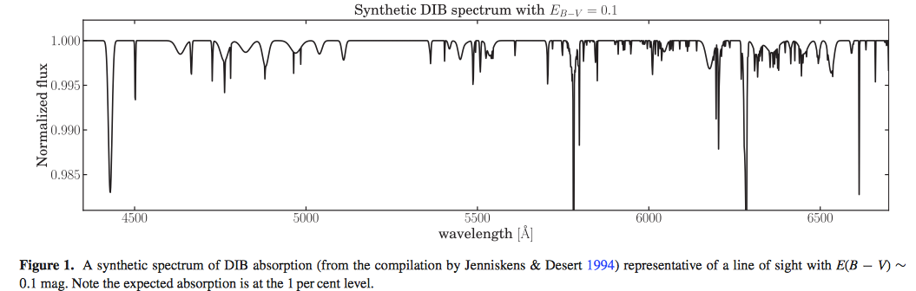
PURE DIB SPECTRUM
Jenniskens & Desert (1994)
Average of spectra of reddened stars with photospheric lines removed,
scaled to A_{V}~0.3 mag
About 1/3 of the optical spectrum contains DIBs (Herbig 1995 ARAA)
But only 200 DIBs then; now 500+ (although many new ones are in NIR)

Slide 7
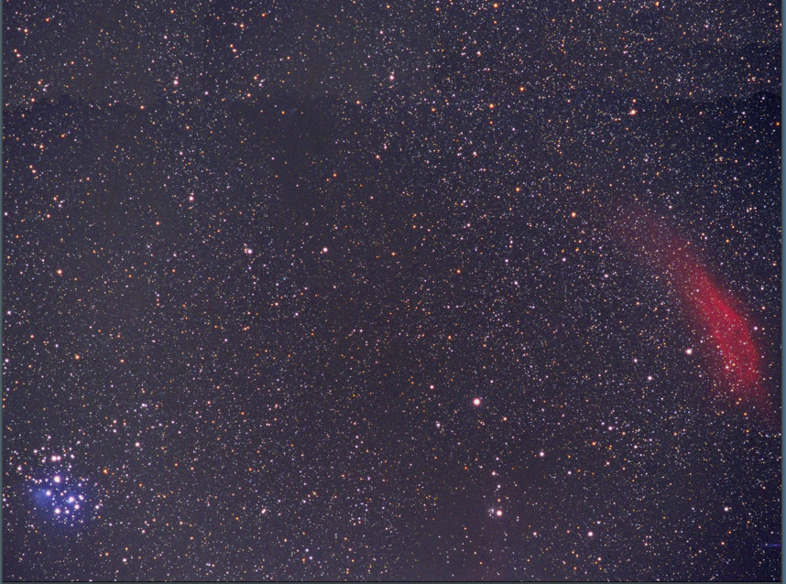
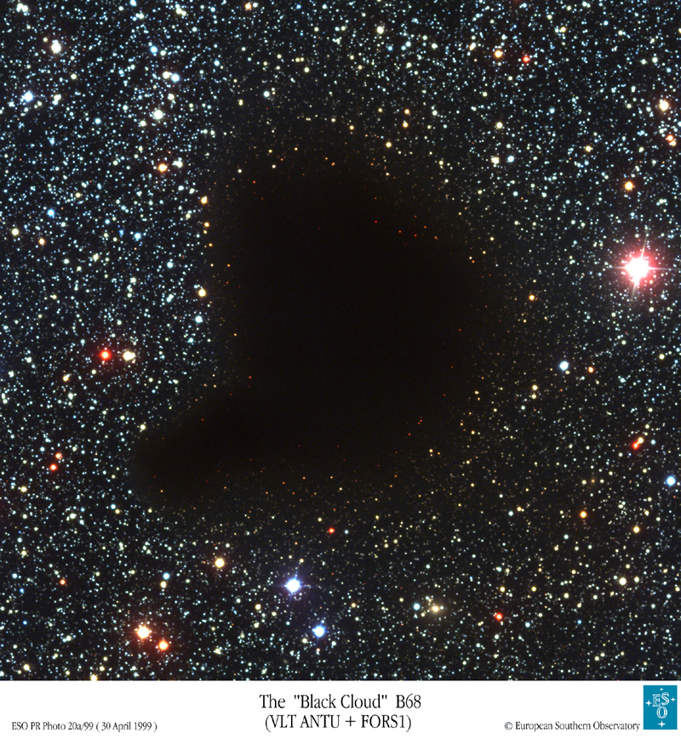
IN WHAT COMPONENT OF THE ISM ARE DIBS FORMED?
Diffuse clouds (typical A_{V} < a few mag):
n < 300 cm⁻³ 1-10 pc
λ< 912 Å (>13.6eV) is absorbed at surface,
but longer wavelength UV (<13.6eV) penetrates
some hydrogen is in H₂, some (most) is in H
99% of C is ionized, only 1% of C in CO
Translucent clouds (A_{V} ~ a few - several mag)
Molecular clouds (typical A_{V} > several mag):
300 cm⁻³ < n < 100,000 cm⁻³ 0.1-1 pc
no UV at all penetrates beyond a thin surface layer
interior hydrogen is all in H₂, all C in CO.
neutral, except tiny fraction (~10⁻⁹) ionized by CRs
………
Sightlines can be complex – contain more than one type
A sufficiently large “diffuse cloud” can have a shielded core with some of the properties of a molecular cloud.
Diffuse cloud
ζ Per
Molecular (dense)cloud
B68

Slide 8
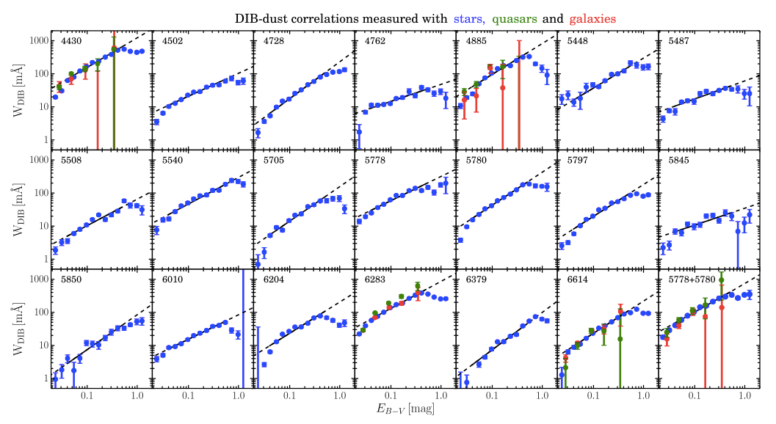
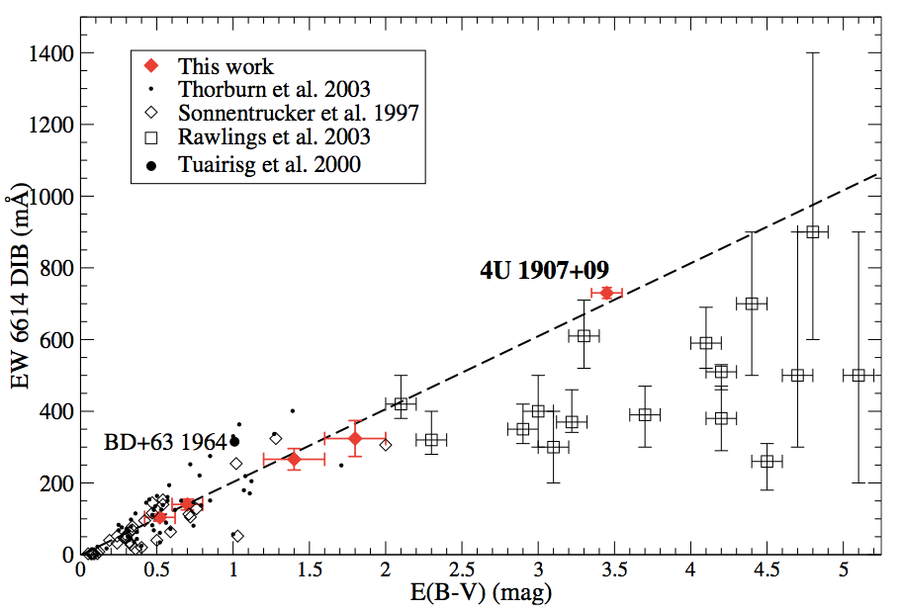
EVIDENCE FOR DIBs
IN DIFFUSE CLOUDS
Cox et al. 2004
Lan et al. 2015
(stars, quasars, external galaxies
Most DIBs strength vs reddening plots look like these
Good correlation with reddening - E(B-V) at low values;
flattening at higher values
Low reddening generally means the obscuring cloud is diffuse /low density
➔ Most DIBs carriers exist in the diffuse ISM.
But what is going on at higher reddening / extinction ?
Are there molecular cloud components present?Can this component be isolated?
Problem: difficult to test carriers of optical DIBs in molecular clouds at high A_{V} .

Slide 9
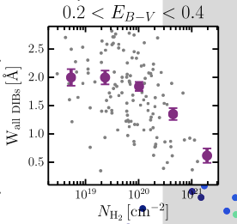
Are DIBs produced in molecular clouds ?
Plot W vs N(H₂) for narrow range of reddening
On average DIBs strengths are either uncorrelated or anti-correlated with N(H₂).
➔ Most DIBs carriers are not present in
molecular clouds.
Lan et al. 2015
Strengths of a few DIBs roughly scale with N(C₂)
their carriers reside preferentially in regions of clouds
where molecular fraction is high
(e.g., diffuse cloud cores)
Carriers “fragile” – destroyed by UV ?
.
Counterexamples: the C₂ DIBs
Lan et al. 2015)
Thorburn et al, ApJ 584, 339 (2003)

Slide 10
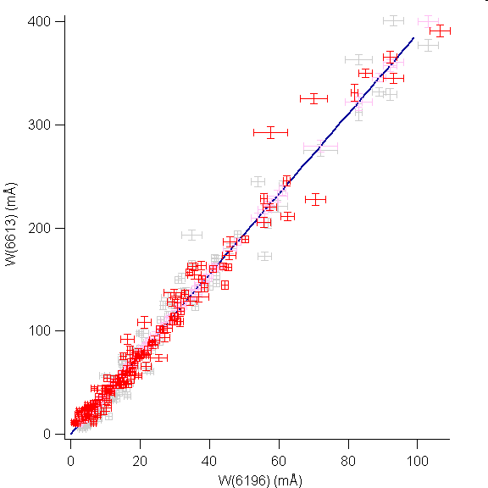
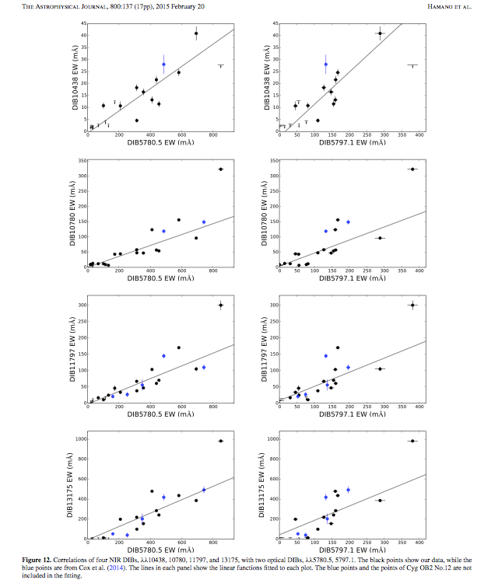
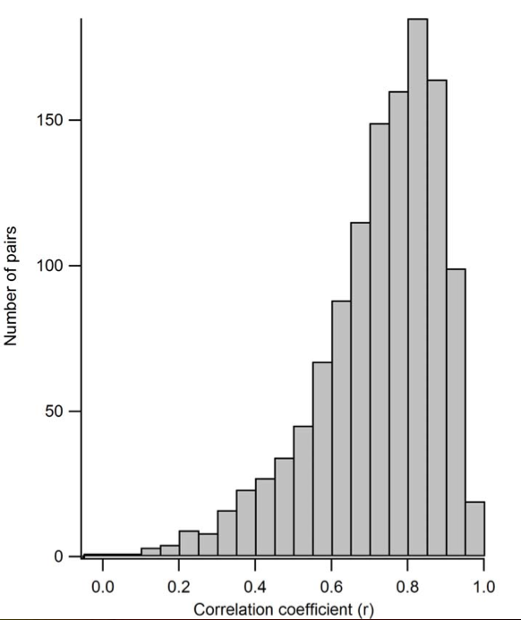
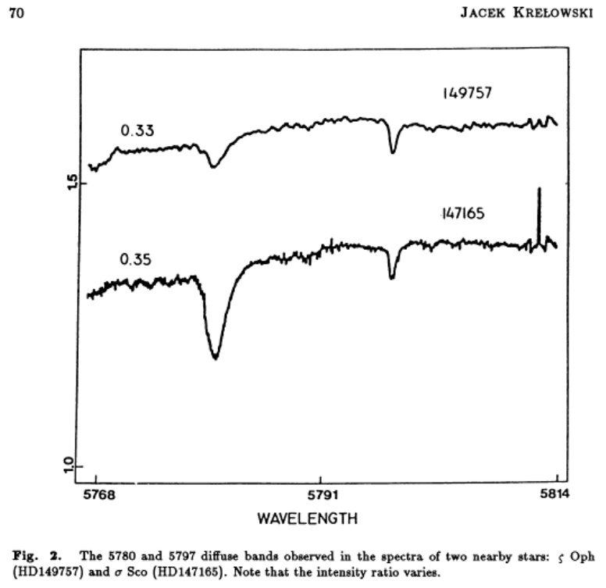
DIB CORRELATIONS
“The fundamental idea is that any group of features arising from a particular carrier, or set of chemically related carriers, must maintain the same relative intensities in all lines of sight.”
-Adamkovics et al. (2003) N.B. Varying excitation conditions might cause some differences.
.
Pair correlations
using 58 DIBs
observed toward 40 stars
1218 pairs studied
(McCall group)
Only 19 (1.5%)
with r>0.95
(Hamano et al 2015)
Typical correlations
High correlation
(McCall group)
carriers form under
similar conditions
CONCLUSION:
Although the strengths of many DIBs correlate
fairly well, none correlate perfectly (within
measurement errors)
Suggests that DIBs cannot be explained by a single or even only a few carriers. They must be numerous.
Poor correlation
(Krelowski)
Cannot arise from same carrier
Notes:
In the absence of specific IDs, how can possibilities be constrained?By looking for correlations between DIBs.

Slide 11
ARE THE DIBS CARRIERS SOLIDS OR IN THE GAS PHASE?
Solid state absorptions tend to be broad; many DIBS are too narrow to be produced by solids. Some broad DIBs profiles are suggestive of rotational structure, which also implies free molecules.
DIBs profiles are essentially invariant in shape and unshifted in wavelength from sightline to sightline. Not expected if the carriers are on/in dust grains – interactions with neighboring atoms/molecules create variable wavelength shifts.
Polarization studies of a few highly reddened stars (eg, Adamson et al. 1995) show no excess polarization at DIBs wavelengths compared to adjacent stellar continuum. Excess polarization at absorption wavelengths is predicted if the absorbing species is on grains (for either silicates or carbonaceous dust).
CONCLUSION: the vast majority of DIBs
are produced by free molecules

Slide 12
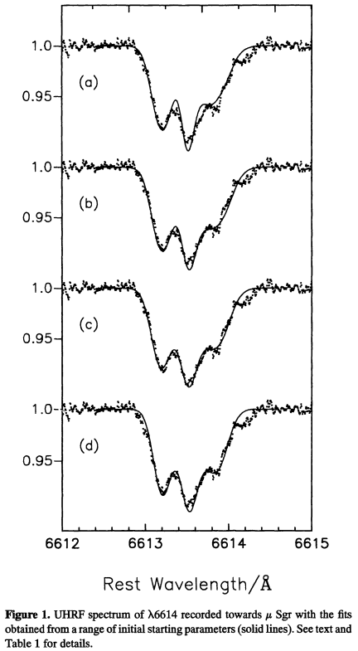

WHAT KINDS OF MOLECULAR TRANSITIONS?
Transitions at optical/NIR wavelengths likely to be vibronic (simultaneous changes
in electronic and vibrational states).
Cold gas ➔only ground electronic, v=0 populated
Molecules also rotate. Ro-vibronic transitions broaden
DIBs absorption profiles because more than one transition.
Less broadening for molecules with larger I ~ larger mass)
Broadening is small; high spectral resolution needed to
look for signs of it. May not be obvious even then.
But a few DIBs profiles show evidence for rotation.
v=2
v=1
A
v=0
X
v=0
HD166937
Oblate C-ring
Kerr et al. (1996) modeled 6614Å
DIB profile with oblate carbon-ring
molecules with 14-30 C atoms.
Bernstein et al. (2015) fit a more diverse set of 6614Å profiles (due to different T?) assuming two overlapping DIBs from two prolate carbon-ring molecules.
Kerr et al. 1996
R=600,000

Slide 13
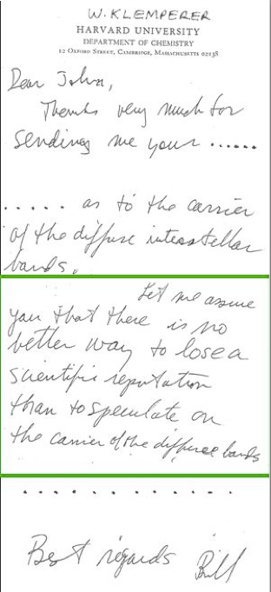
SOME PROPOSED IDENTIFICATIONS
SPECIFIC CARRIERS:
CO₂ (1937)
(O₂)₂ (1955)
NH₄ (1955)
Metastable H₂O on grains (1963)
Ca and Na atoms in hydrocarbons (1964, 1968)
Porphyrins (MgC₄₆H₃₀N₆ + 2 pyridines) (1972)
S2⁻ or S3⁻ in silicate grains (1981)
Cr³⁺:MgO and Mn⁴⁺:MgO (MgO particles) (1982)
HCOOH₊ (1988)
Carbon chain anions C_{n}⁻ n = 6,7,8,9 (1998)
H₂C₃ (2011)
HC₄H⁺ (2011)
…
CLASSES OF CARRIERS:
PAHs (1985)
Fullerenes (eg, C₆₀) (1987)
Fulleranes (eg C₆₀H_{n}) (1993)
Not proposed because of wavelength
matches.
Because of their:
- structural stability (relatively difficult
to destroy)
- C-based - don’t violate abundance
constraints
- known or likely presence in the ISM
REASONS FOR REJECTIONS:
- Wavelength matches inaccurate
- Other predicted absorptions of
candidate not observed
- violates abundance constraints

Slide 14
Failures point out need for better evaluation of proposed DIB carriers
Numerology alone does not work, esp now
when Dis cover so much of the spectrum.
Criteria for proper testing of IDs:
Example: high res spectra
prove proposed C₇⁻
is not a DIB carrier
  Need high-resolution astronomical spectra
  -- accurate wavelength; resolve DIB profile
Need laboratory spectra
  -- gas phase (to avoid matrix shifts)
-- simulate astrophysical conditions as closely as
possible
-- High spectral resolution to resolve line profile
Ideally DIBs and simulated lab spectra
should match
-- central wavelength & profile
  -- same bands present in lab and ISM
  -- relative intensities
Lab C₇⁻
McCall et al., ApJ 559, L49 (2001)
Notes:
But clearly in view of past failures and because DIBs cove so much of the spectrum

Slide 15
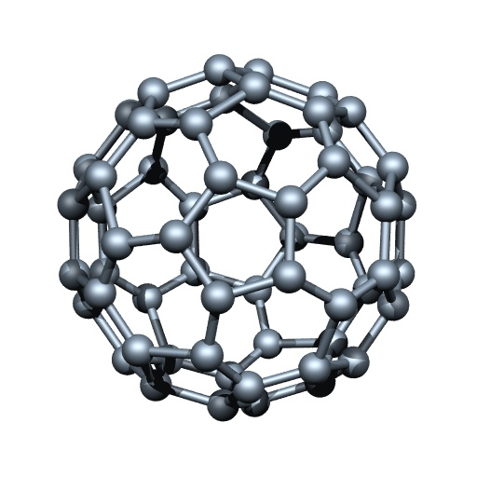
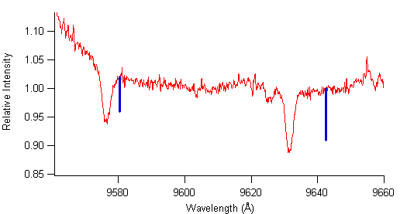
USING THIS KIND OF APPROACH HAS LED TO IDENTIFICATION OF SEVERAL DIBs AS DUE TO C₆₀⁺
+
1985: Production of C₆₀ in the laboratory from carbon
vapor and recognition of its high structural stability
- Kroto and colleagues at Rice.
1987: Propose presence in diffuse ISM as C₆₀⁺ (I.P.=7.6eV)
and to be a DIBs carrier. – Kroto
1990: Isolation of C₆₀ and C₇₀ tn the lab, allowing detailed
study. - Taylor et al.
1993: Laboratory observation of two transitions of
C₆₀⁺ , at ~9580Å and ~9642Å, in a low temperature
Ne matrix, - Maier group /Basel
1995: Discovery of two prominent DIBs at 9577Å
and 9632Å, close to the lab wavelengths and roughly
consistent with the expected wavelength shift
Proposed to be due to C₆₀⁺ - Ehrenfreund & Foing
2015: Lab spectrum of C₆₀⁺ in a low temperature and
much lighter and less constraining He matrix.
Four lines; central wavelengths of two match the
two bands observed in space. - Maier group
2015: Detection of two weaker DIBs matching the
two weaker lab absorptions (Walker et al.)
HD 183143
C₆₀⁺
Ne matrix
C₆₀⁺
Ne matrix

Slide 16
TO RE-EMPHASIZE:
THE C₆₀⁺ IDENTIFICATION IS CONVINCING
Not just a chance wavelength matches.
Based on a sequence of logical arguments and research steps.
Case strengthened even more by discovered presence of neutral
C₆₀ and C₇₀ in evolved C-rich objects (e.g., Cami et al. 2010, …)
SUGGESTS ADDITIONAL WORK AND QUESTIONS
Likely that significant number of C₆₀ analogues (e.g., impurity atoms inside fullerene cages or attached to them) are also present in the ISM.
Laboratory studies needed to see whether fullerene ion analogues are carriers of other DIBs.
Could fullerenes account for most or even all DIBs?
(Maybe spectro-chemists here will ignore Klemperer’s warning and give us their views -
if we promise not to criticize them if they turn out to be wrong.)

Slide 17
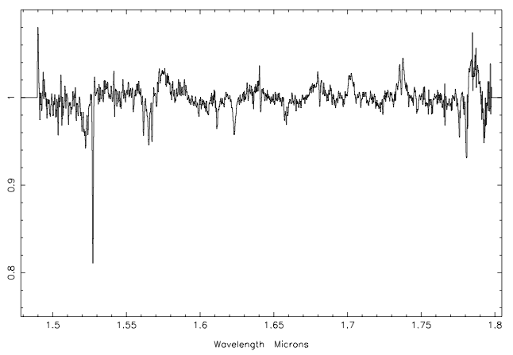
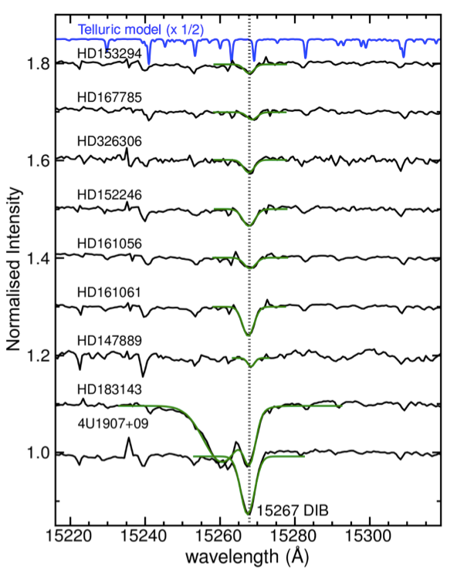
NEW DIBS AT LONGER WAVELENGTHS
GCS3-2
C₆₀ DIBs (1995, 2014) at 0.93-0.97μm.
DIBs at 1.18.μm and 1.31μm (Joblin et al. 1990).
13 new DIBS discovered in the 1.5-1.8μm interval toward stars in the Galactic center (Geballe et al. 2011). Confirmed by their presence in GC stars of different spectral types. Widths range from a few to 30-40Å. (High extinction precludes searching for optical DIBs on these sightlines.)
Also found at about the same time by Cox et al. (2014) toward known optical DIBs sources. Identification of additional DIBs candidates in the J, H, and K bands.
Several additional weak DIBs identified, mostly in the J
band. Hamano et al. (2015)
DIBs may fill the J and H bands as densely
as they fill the optical wavelengths.
IR DIBs can be used to do “real astronomy” - observe and characterize diffuse gas in distant highly obscured regions of the Milky Way (and external galaxies).
e.g., APOGEE survey spectra used to map diffuse ISM in the Galaxy using1.53μm DIB (Zasowski et al. 2015), much more deeply that would be possible with optical spectroscopy.
Geballe et al. (2011)
Gemini-N / GNIRS
GCS 3-2
Geballe et al. (2011)
Gemini/GNIRS
2010
Cox et al. (2014) X-Shooter / VLT
Gemini North (NIFS)

Slide 18
SUMMARY OF CURRENT SITUATION
Great progress made recently in (1) of understanding DIBs
behavioral patterns, (2) isolating DIBs families, and (3) esp in defnitively
identifying a few as due to the C₆₀ fullerene. More progress anticipated.
Hopefully, fullerenes and their analogues, maybe eventually PAHs, maybe other plausible suspects will be shown to be the keys to understanding most of the DIBs.
But if not …
A sobering thought:
~10⁷ organic molecules known on earth;
~10²⁰⁰ stable molecules of atomic mass < 750 containing only C, H, O, N, and S
Ben McCall
Blind suggestions, wavelength coincidences, or laboratory searches unlikely to work.
Need educated guesses followed by lab spectroscopy.
…………..
Big challenges remain to be overcome in order to solve
this “great(est) mystery in astronomical spectroscopy.”

