Slide 1
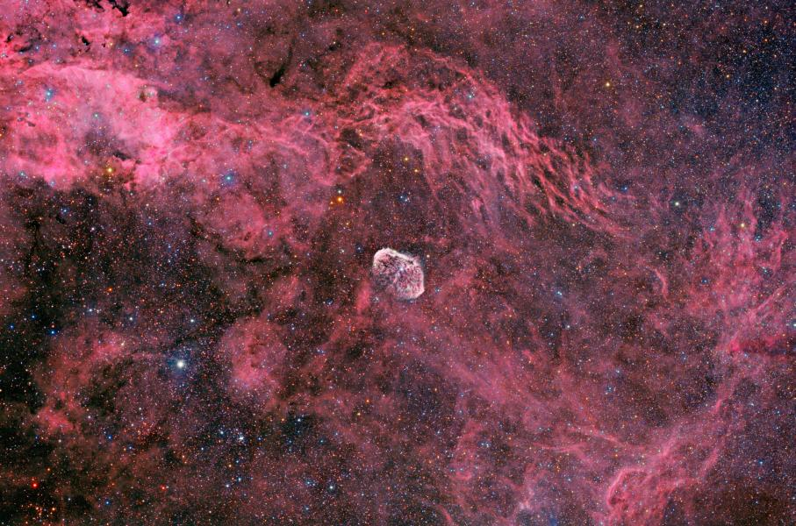
Wolf-Rayet Nebulae
You-Hua Chu
Institute of Astronomy and Astrophysics, Academia Sinica
(ASIAA, Taiwan)
University of Illinois at Urbana-Champaign

Slide 2
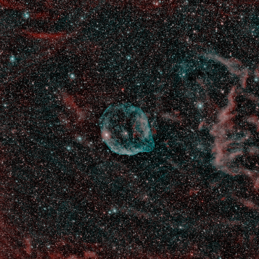
I stumbled upon Wolf-Rayet nebulae in 1978, when the evolutionary stage of Wolf-Rayet stars was not very clear and the physical nature of their nebulae was unknown.
S308 is very bright in
[O III]5007. It would
be effective to use Hα
and [O III] images to
search for WR nebulae
in the Galaxy and the
Magellanic Clouds.
HD 50896 (WN5) S308
[N II] & [O III]
Credit: avandonk

Slide 3
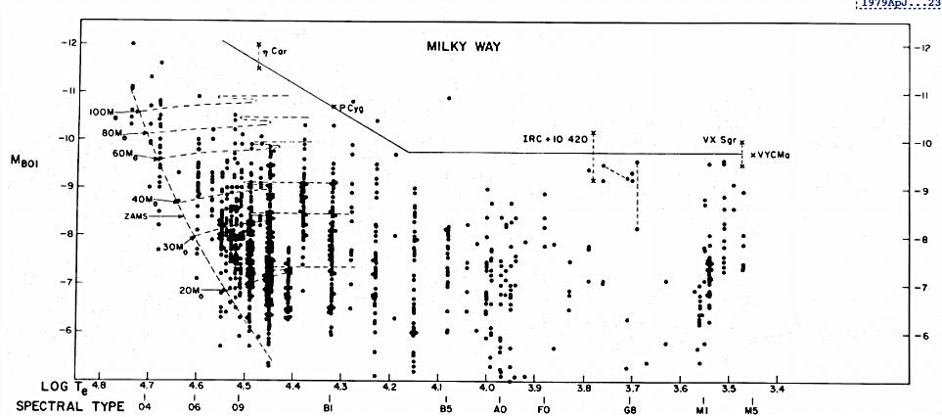
Distribution of Massive Stars in HRD
Humphreys and Davidson Limit
Humphreys and Davidson 1979

Slide 4
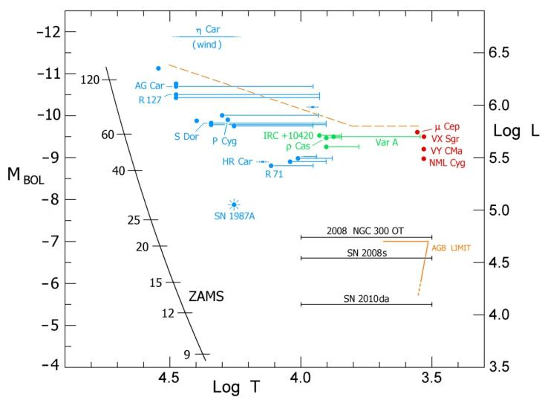
Evolved Massive stars: the Wild Things
Schuster, Humphreys, & Marengo (2006)

Slide 5
Massive Stars in the HR Diagram
LBV
100
80
WR
60
RSG
Intrinsic Brightness
40
BSG
30
20
M
O B A F G K M
Temperature
Color
Notes:
LBV = luminous blue variable
BSG = blue supergiant
RSG = red supergiant

Slide 6
Interstellar & Circumstellar Bubbles
O star → LBV → WR (60 M)
O star → RSG → WR (35 M)
fast wind slow wind fast wind
1000 - 2000 km/s 10 - 50 km/s 2000 - 3000 km/s
10⁻⁷ M/yr 10⁻⁴ M/yr 10⁻⁵ M/yr
↓ ↓ ↓
interstellar circumstellar circumstellar
bubble nebula bubble
Low-mass  → RG, AGB → planetary neb.

Slide 7
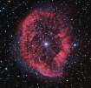
Massive Stars in the HR Diagram
LBV
100
80
WR
60
RSG
Intrinsic Brightness
40
BSG
30
20
M
O B A F G K M
Temperature
Color
Notes:
LBV = luminous blue variable
BSG = blue supergiant
RSG = red supergiant

Slide 8
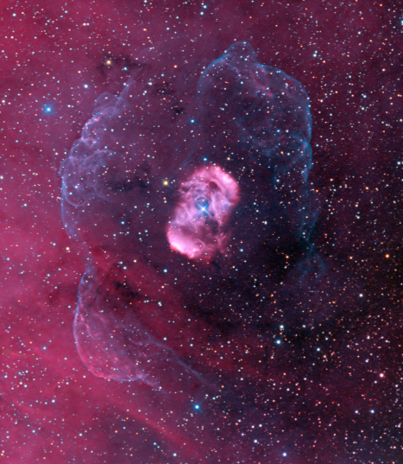
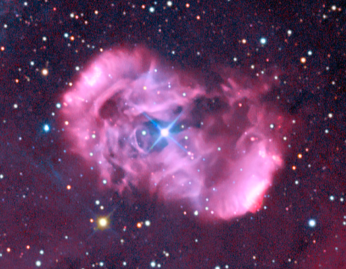
NGC 6164-5 O6.5f?p
Credit: Astrodon
2×3 pc along major axis
10×15 pc filamentary shell

Slide 9
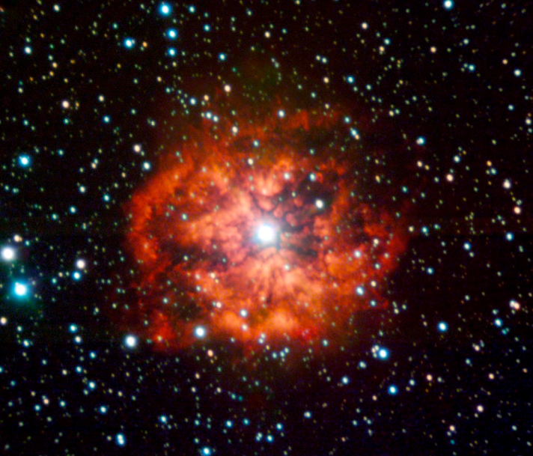
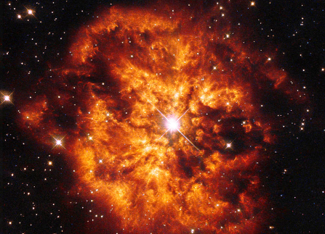
M 1-67 (WR 124; a runaway WN8)

Slide 10
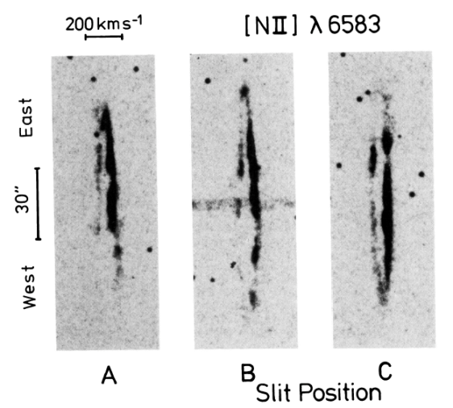
Despite M1-67’s chaotic morphology, its
expansion is remarkably regular!
Solf & Carsenty 1982

Slide 11
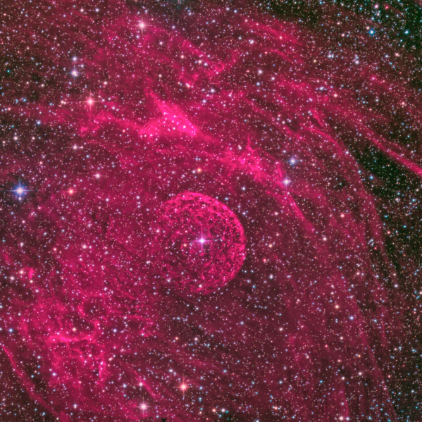
Anon (WR 16; WN8)
Credit: Astrodon

Slide 12
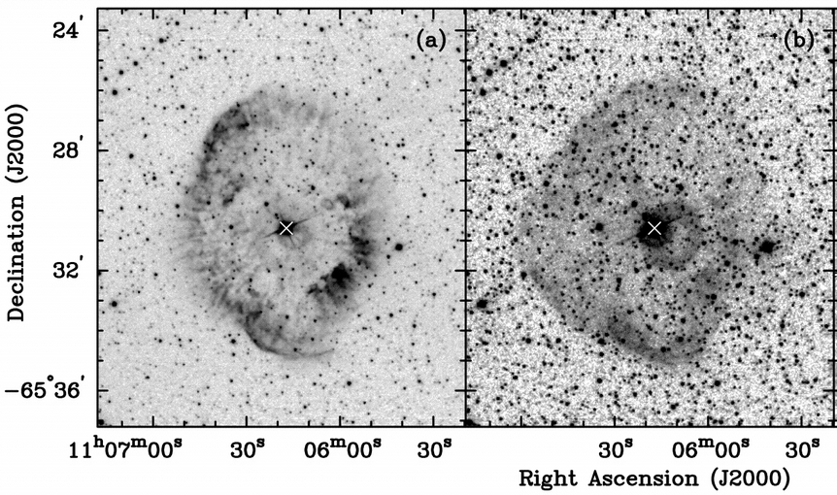
RCW 58 (WR 102; WN8)
Gruendl, Chu, et al. 2000

Slide 13
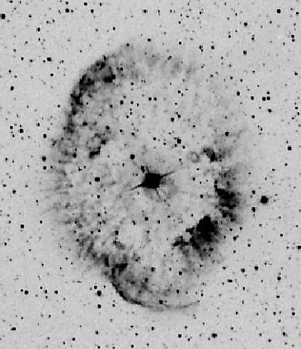
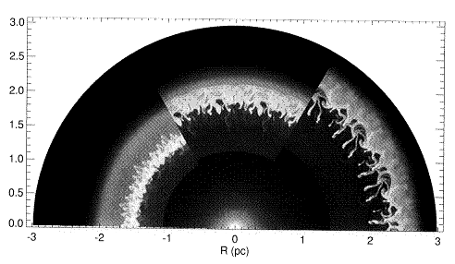
RCW 58 (WR 102; WN8)
Circumstellar bubble - instabilities in the dense shell produce clumps.
RCW58
Inside an
Interstellar
Bubble
RSG
wind
O → RSG → WR
LBV
Garcia-Segura, Langer, Mac Low 1996

Slide 14
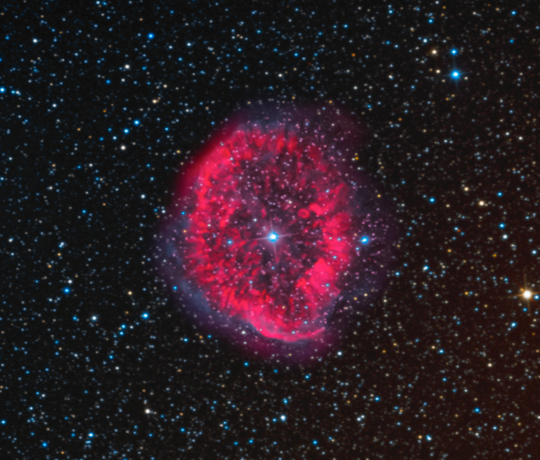
RCW 58 (WR 102; WN8)
Credit: Astrodon

Slide 15
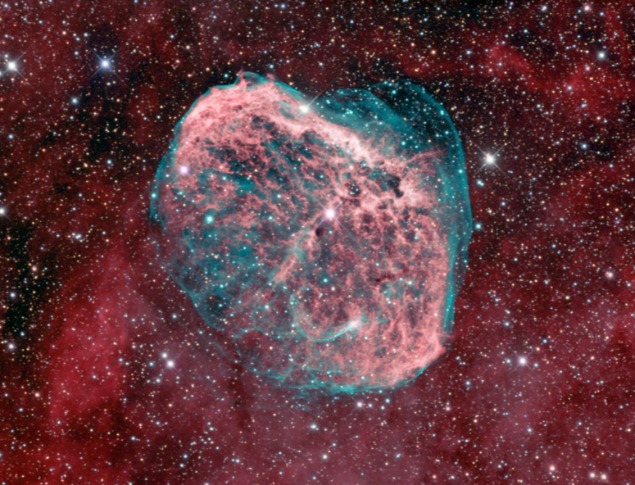
NGC 6888 (WR 136; WN6)
Credit: Bob Franke

Slide 16
NGC 6888 (WR 136; WN6)
Credit: Eric Africa

Slide 17
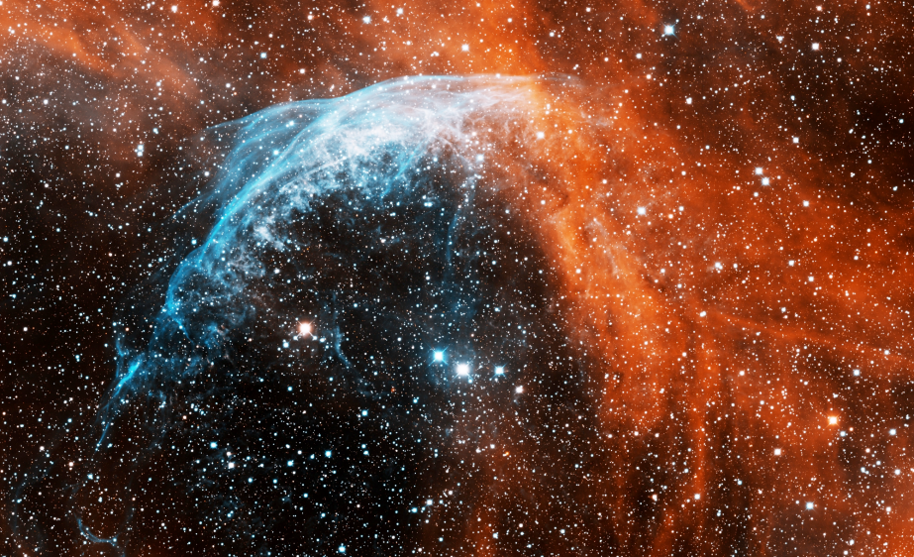
Anon (WR 134; WN6)
Credit: T.A. Rector

Slide 18
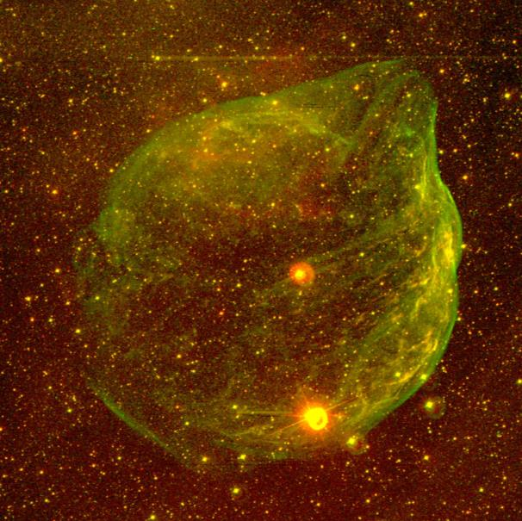
S 308 (WR 6; WN5)
Gruendl & Chu

Slide 19
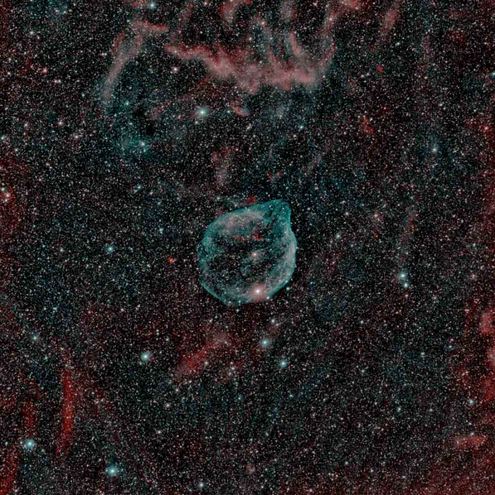
S 308 (WR 6; WN5)
Credit: avandonk

Slide 20
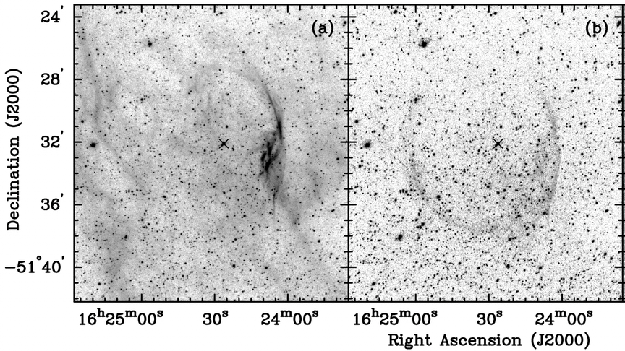
RCW 104 (WR 75; WN5)
Gruendl, Chu, et al. 2000

Slide 21
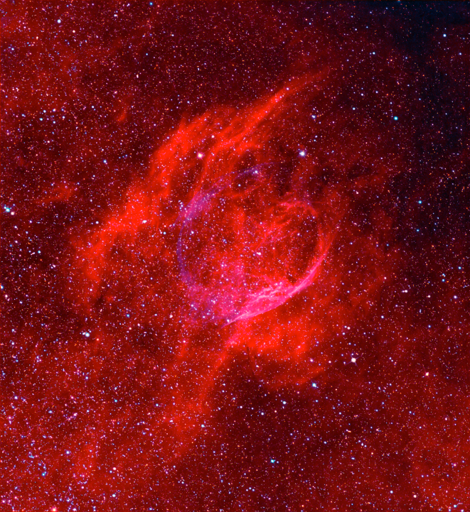
RCW 104 (WR 75; WN5)
Credit: Astrodon

Slide 22
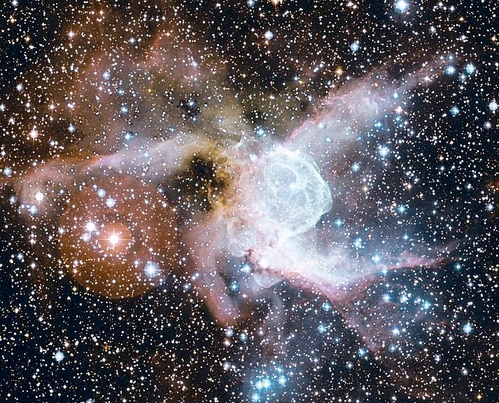
NGC 2359 (WR 7; WN4)
Credit: CFHT

Slide 23
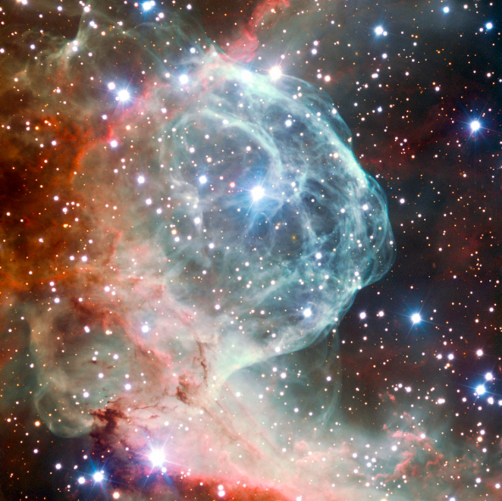
NGC 2359 (WR 7; WN4)
Credit: ESO/VLT

Slide 24
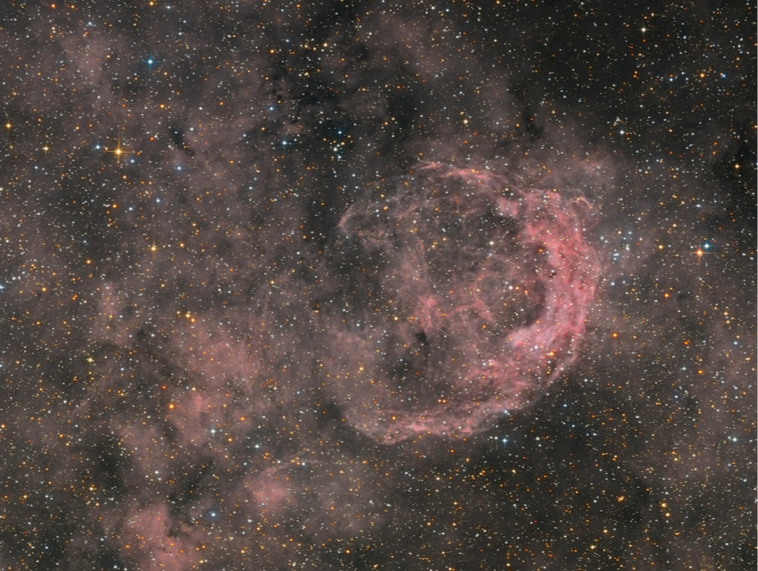
NGC 3199 (WR 18; WN4)
Copyright: Velimir Popov and Emil Ivanov

Slide 25
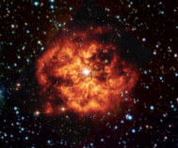
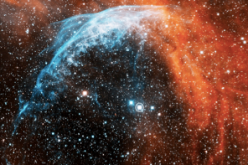
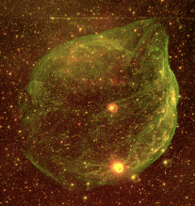
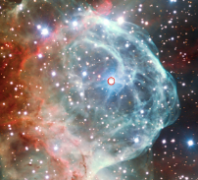
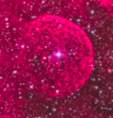
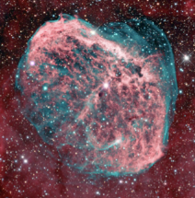
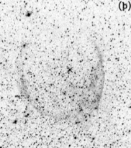
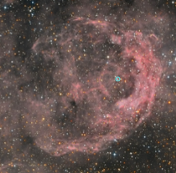
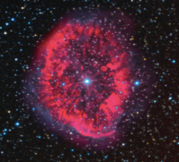
WN8 WN6 WN5 WN4

Slide 26
NGC 6164-5 O6.5f?p
Credit: Astrodon
2×3 pc along major axis
10×15 pc filamentary shell

Slide 27
Interstellar Bubbles of
the progenitor O stars?

Slide 28
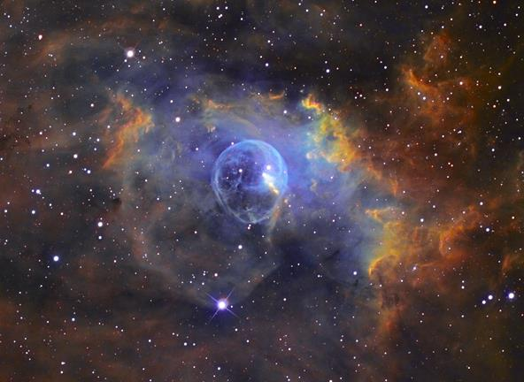
The Bubble Nebula
Copyright ©2002-2005 by Russell Croman

Slide 29
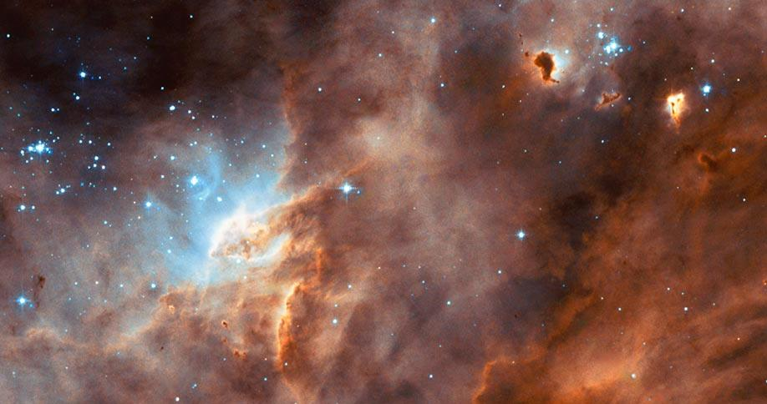
N11B - Young OB Association LH10

Slide 30
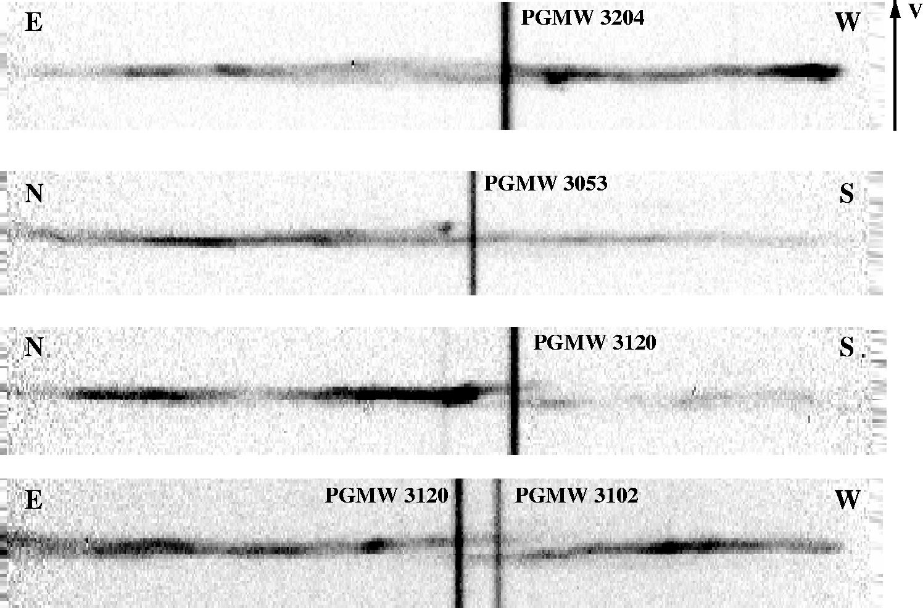
Echellogram of [N II] 6583 Line

Slide 31
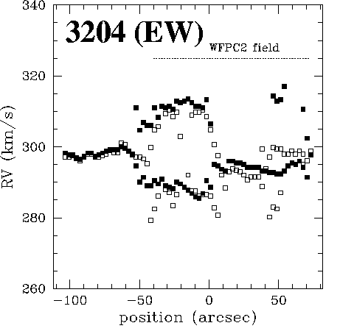
Bubble Size ~ 15 pc
Exp Vel ~ 15-20 km/s
Ionized shell (H II)
- sound vel ~ 10 km/s
- no strong shocks
- no large density jump
- no limb-brightening
Naze, Chu, et al. 2001

Slide 32
Extragalactic WR Nebulae

Slide 33
Chu and Lasker 1980 LMC & SMC
Dopita et al. 1994 LMC & SMC
Yeo, Irteza, Chu 2016 LMC & SMC
Drissen et al. 1991 M33
Bransford et al. 1999 M31
Chu & Lasker found that the WR bubbles
in the Magellanic Clouds were in general
larger than their Galactic counterparts.
But some of large shells are superbubbles,
and many small shells are later discovered.

Slide 34
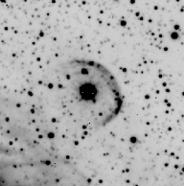
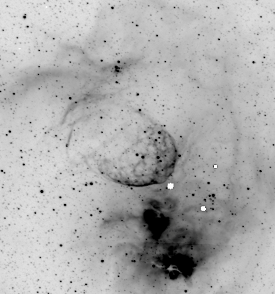
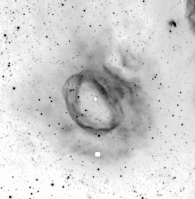
Small WR Bubbles in the LMC
Br13, WN8
Br10, WC5
Br48, WN4+OB

Slide 35
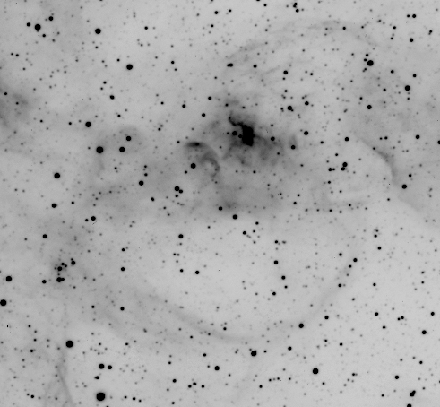
Small WR Bubble in a Large Bubble
Br2; WN2

Slide 36
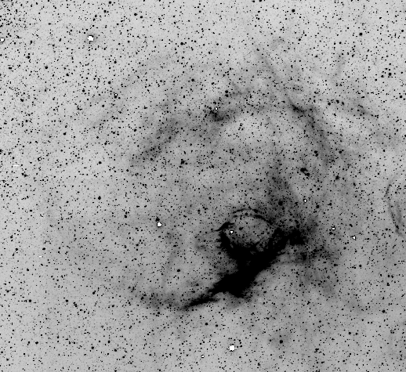
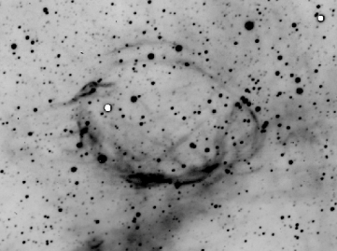
Small WR Bubble in a Superbubble
Br100; WN3-4
CTIO 4m MOSAIC Hα image (MCELS2)

Slide 37
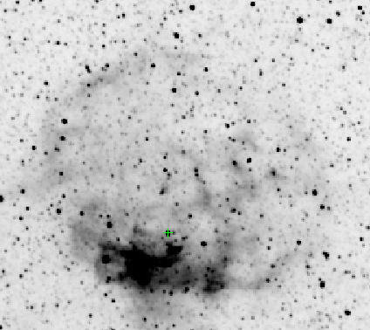
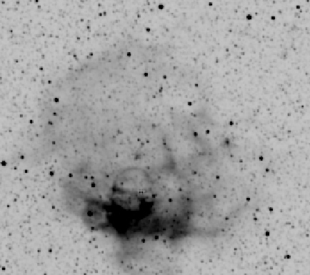
Small WR Bubble in a Superbubble
DEM L45 (Br 12; WN3)
MCELS Hα
MCELS [O III]
200 pc x 180 pc

Slide 38
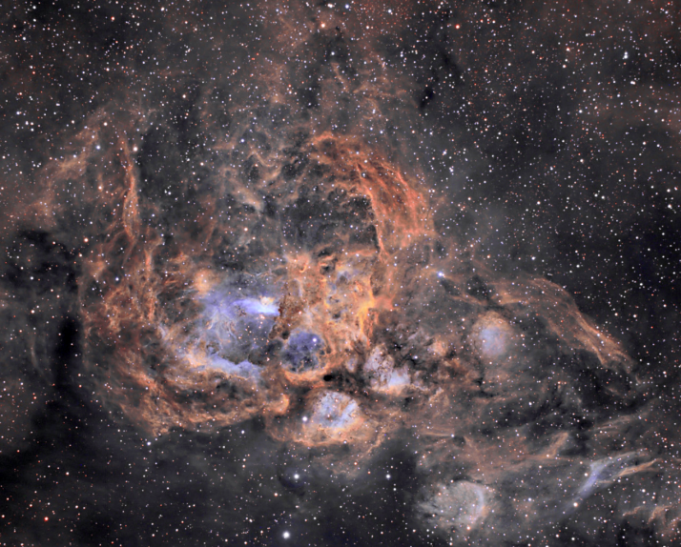
NGC 6357 (WR 95; WN4)
Superbubble blown by the open cluster Pismis 24.

Slide 39
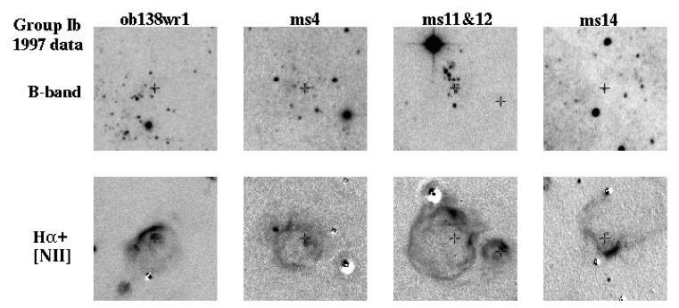
HII Shells around WR Stars in M31
Bransford et al. 1999
FOV = 300 pc x 300 pc

Slide 40
He⁺² in WR Nebulae

Slide 41
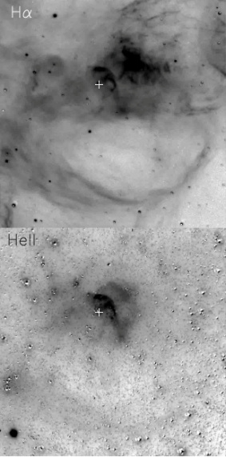
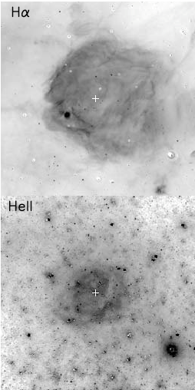
He II – Emitting WR Nebulae
Hα Hα
Br 2
WN2
N79
in the
LMC
AB7
WN2
N76
in the
SMC
He II He II
4686 4686
Naze et al. 2003

Slide 42
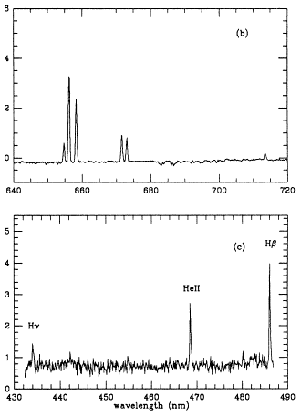
He II – Emitting WR Nebulae
G2.4+1.4 (WR 102, WO)
Credit: Lionel Mulato
Polcaro et al.1995

Slide 43
Hot Gas in WR Nebulae

Slide 44
Diffuse X-rays very soft! 1-2 x 10⁶ K
Toalá, Guerrero, Chu, Arthur, & Gruendl 2015

Slide 45
Probes of the 10⁵ K Gas at Interface Layer
C IV (C⁺³) N V (N⁺⁴) O VI (O⁺⁵)
λλ (Å) 1548, 1550 1238, 1242 1031, 1037
Obs. HST/STIS HST/STIS FUSE
I.P. (eV) 47.9 77.5 138.1
T_{e} (K) 1.0×10⁵ 1.8×10⁵ 3.0×10⁵
T_{eff} (K) <35,000 <75,000 <125,000
*

Slide 46
“Interface” of the WR Bubble S308
0
Good
N V
0
0
C IV
S II
Not
Good
No
HST GHRS / absorption lines (Boroson et al. 1997)

Slide 47
S 308 - ideal for conduction study
Boroson et al. (1997) detected N V absorption from the conduction layer.
FUSE obs of O VI emission were awarded, but it died.
HST STIS obs of N V & C IV
emission were awarded in Cycle 13, but STIS died…
STIS obs are re-awarded in Cycle 20; we got the data,
but not obvious…
HD 50896
*
R: Hα G: [O III] B: X-ray

Slide 48
FUSE Observations of O VI in NGC 6543
Star
Pos 1
Pos 2
Outside
Pos 2
Pos 1
Gruendl et al. 2004

Slide 49
HST STIS Obs of N V in NGC 6543
Long-slit spectra
Guerrero et al. In prep

Slide 50
Stellar Evolution Constrained
By WR Nebulae

Slide 51
Abundance of Ejecta Nebulae
Stellar evolution
Models
⬆⬇
Abundance of
Stellar Ejecta
Esteban et al. 1992

Slide 52
Ejecta Nebulae + IS Background
Esteban & Vilchez (1992) studies chemodyanics of
NGC6888 – resolving ejecta and IS components
Approaching shell ISM Receding shell
Chu 1988

Slide 53
Summary
1. Amateurs are taking the best images of WR
nebulae in the Galaxy.
2. Don’t expect to see a nice ISB outside the
CSB of a WR nebula.
3. HeII emission from nebulae of WN2 and WO.
4. Hot gas and interfaces are detected in WR
bubbles.
Extragalactic WR (super)bubble contaminants.
Future: high-disp spec obs of WR ejecta
abundances to constrain stellar evolution.

Slide 54
NGC 6888 (WR 136; WN6)
Credit: J-P Metsävainio

