Slide 1
Combining Undersampled Dithered Stars
Guoliang Li & Lei Wang
Purple Mountain Observatoy

Slide 2
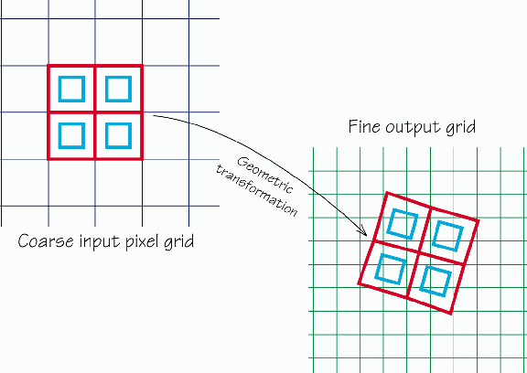
Classic Methods
1.Interlace
2.shift-and-add
3.Drizzle

Slide 3
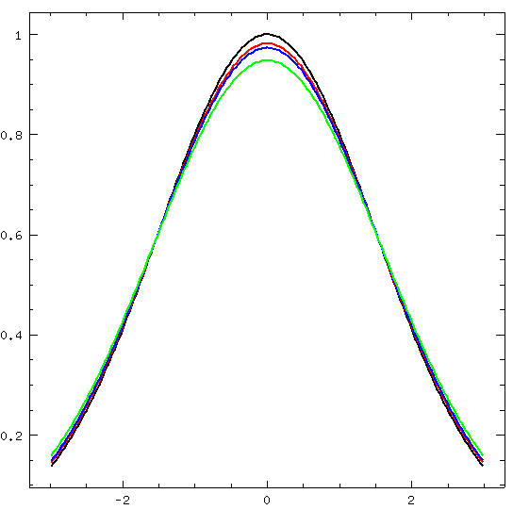
Convolution effects
The original image is a Gaussian profile with sigma=1.5, i.e., FWHM~4 pixels (black line).
The ideal observation is a sampling on the red line since of pixel response.
Drizzle and shift-and-add method Introduce further pixel convolution effects shown as blue and green lines.
The results of Drizzle is “restoration” rather than “reconstruction”--Fruchter

Slide 4
Deconvolution with Forward Method
Set a target image with same pixel size.
The light distribution in each pixel is represented by a 2D polynomial function.
Bin this image according the shifts of dithered images and calculate the chi square.
Modify the coefficients of each polynomial function to minimize the chi square.
Out put the target image with certain pixel size.

Slide 5
Iteration
P_{j} is the contribution form the j-th pixel of the target image to the i-th pixel of the
k-th dithered images. The minimization of chi –square function gives
where C_{jl} is the l-th polynomial coefficient in the j-th pixel of the target image.
This will produce a huge linear function array and it’s very time consuming to solve it.

Slide 6
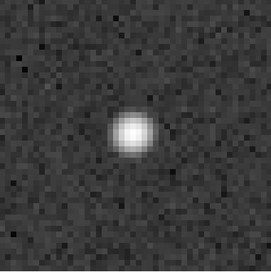
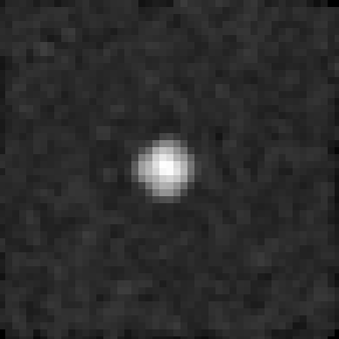
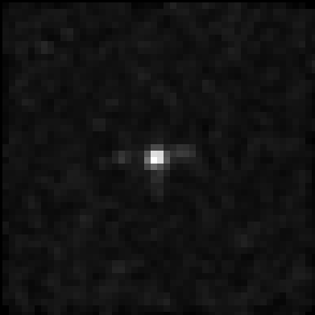
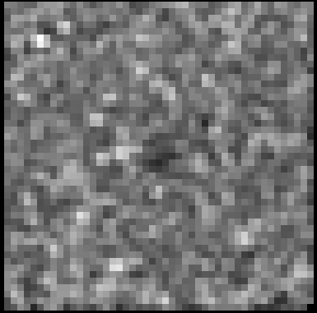
Chose the order of the polynomial
Test with a Gaussion
Distribution,
FWHM=3 pixels,
Gaussion noise=0.0001
Dithered image
Chi-square map( zero-th order )
Chi-square map (1st order)
Chi-square map 2nd order

Slide 7
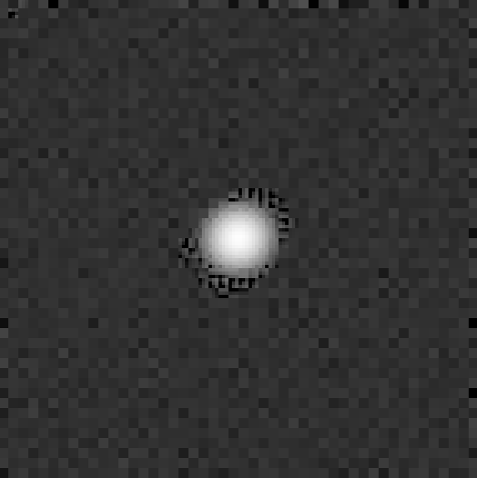
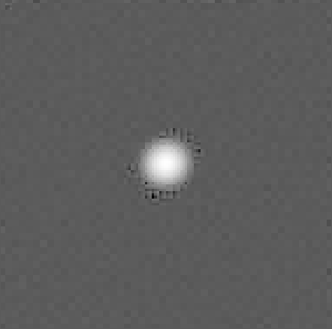
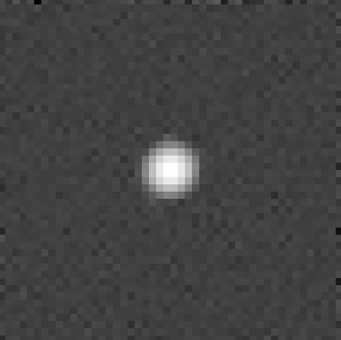
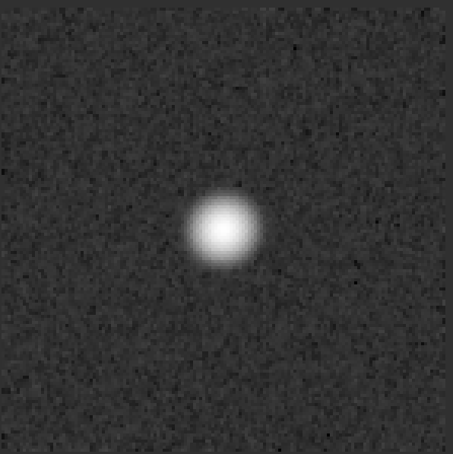
Results
Deconvolved distribution
Convolve with a square window of 1/3 pixel
Convolve with a square window of 1 pixel
Output of Drizzle

Slide 8
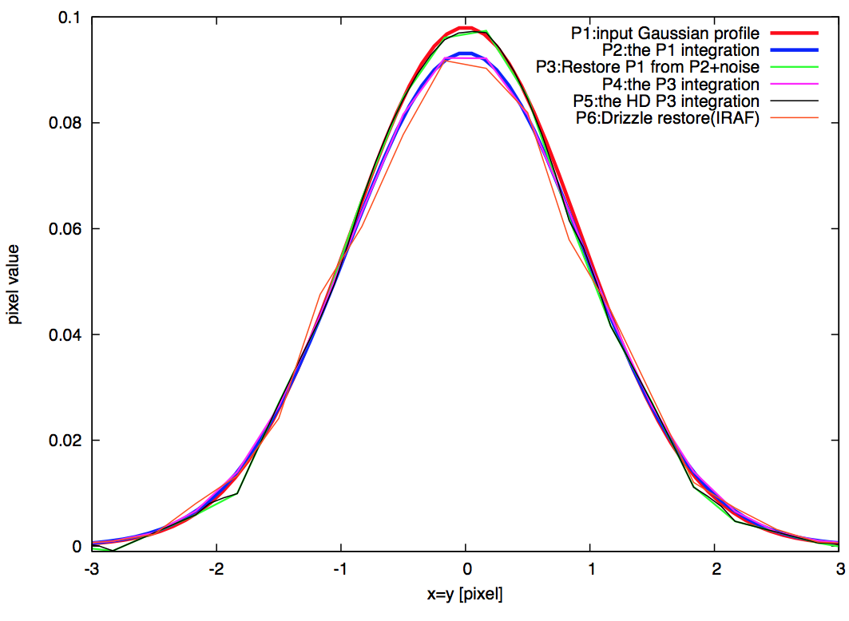
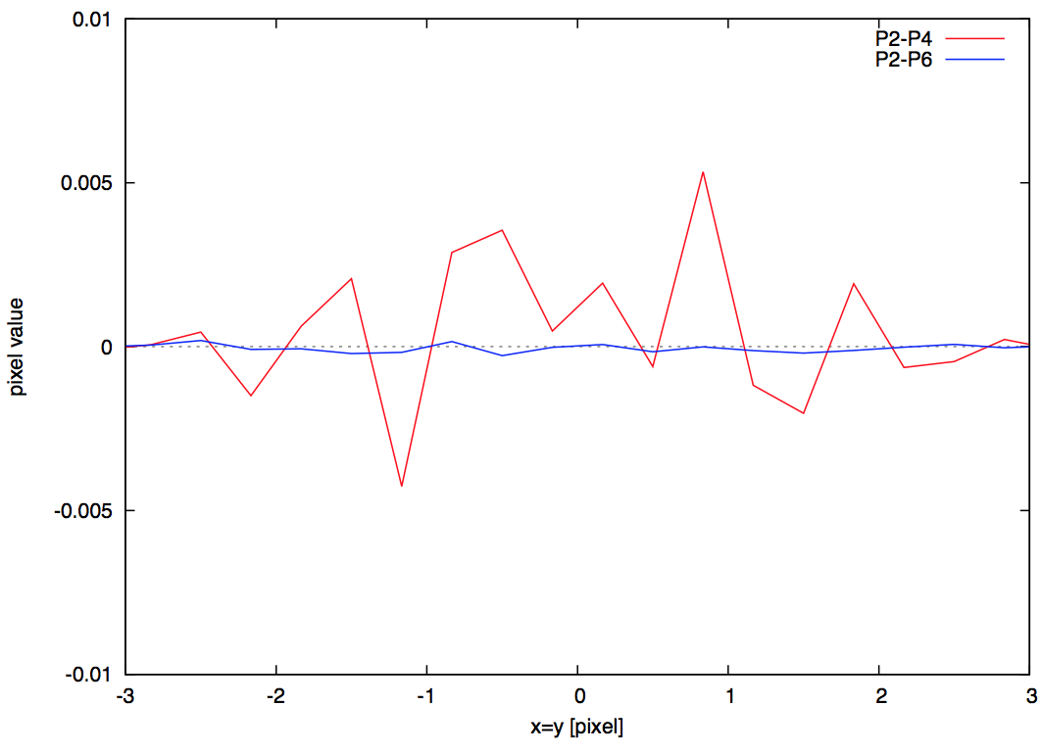
Results

Slide 9
Summary and 0utlook
The traditional algorithms focus on the pixelated profile. They are algorithms of restoration rather than reconstruction
Our program could deconvole the pixelation effect and also could do the same thing as Drizzle can or even better.
Next:
Rotated image
Adaptive chi-square threshold
Geometric distortion
Compare with iDrizzle
Regularization?

