Slide 1
The second generation Kunlun Automated Weather Station
Hu Yi, Shang Zhaohui, Ma Bin, Wei Peng, &Hu Keliang
2015/03/09

Slide 2
Outline
Why we need an AWS？
Building & Testing
Running at Dome A

Slide 3
Why build an AWS
Meteorological condition is very import astronomical site evaluation.
Inspiring results from weather data during 2011.
Knowing weather condition is also helpful for operating telescopes, especially remotely.
The original AWS fell down and stopped working in Jan 2012.

Slide 4
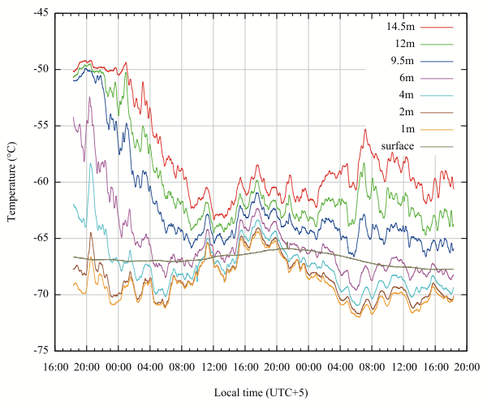
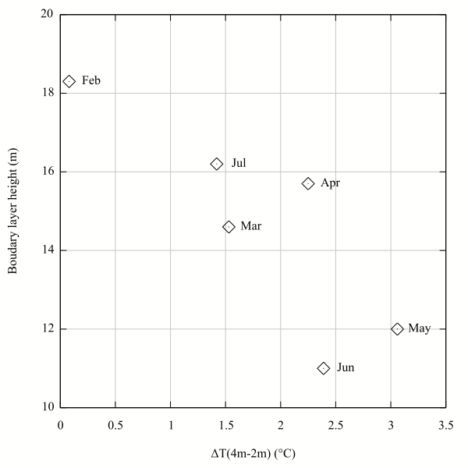
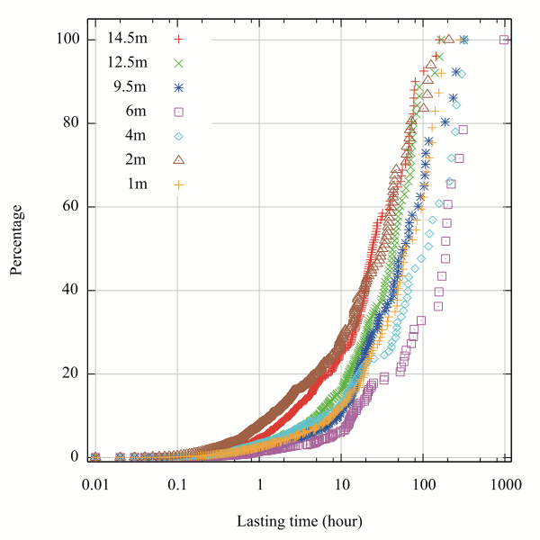
Hu et al. 2014

Slide 5
Why build an AWS
Meteorological condition is very import astronomical site evaluation.
Inspiring results from weather data during 2011.
Knowing weather condition is also helpful for operating telescopes, especially remotely.
The original AWS fell down and stopped working in Jan 2012.

Slide 6
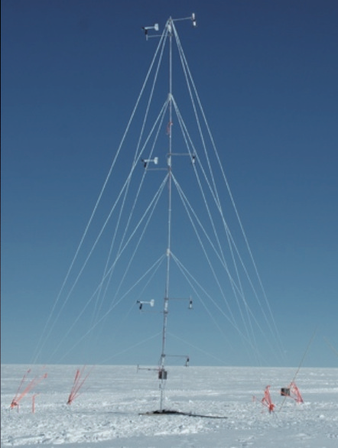
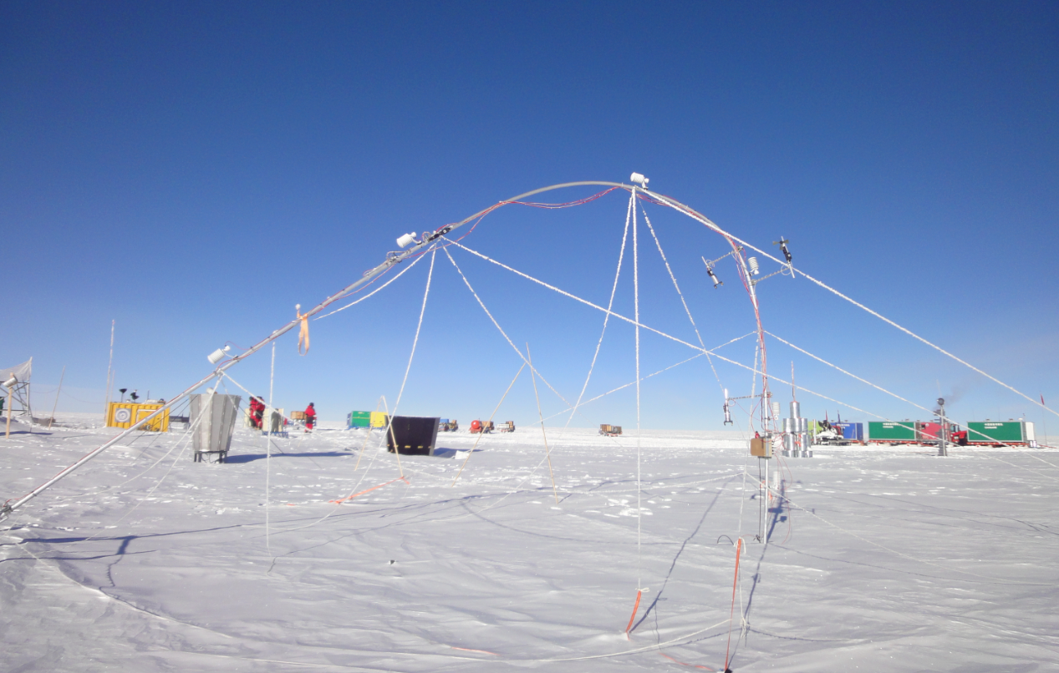
The original AWS
Jan 2011 😊
Jan 2012 😭

Slide 7
KLAWS-2G Designation
15-meter-tall mast.
10 temperature sensors at -1m, 0m, 1m, 2m, 4m, 6m, 8m, 10m, 12m and 14m.
7 anemometers at 2m, 4m, 6m, 8m, 10m, 12m and 14m.
1 barometer and 1 humidity sensors at 2m.

Slide 8
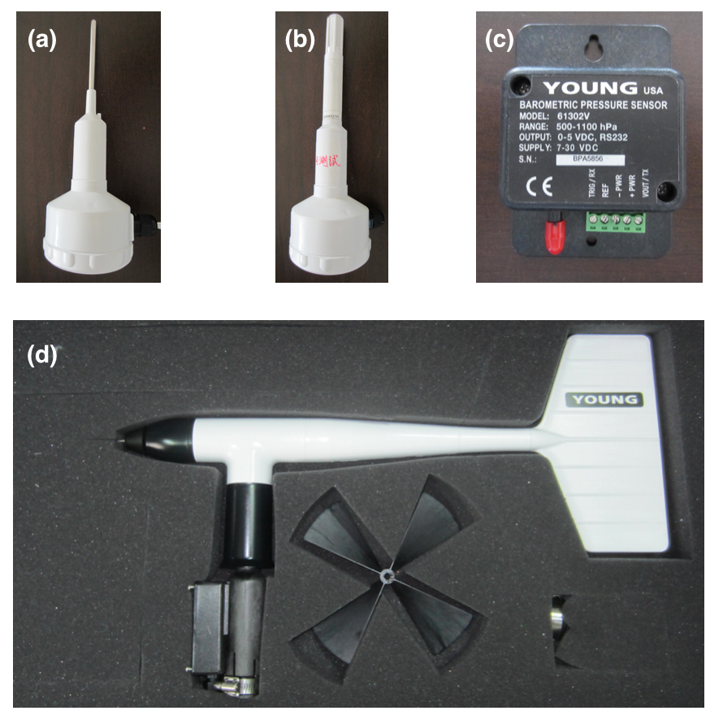
The sensors
Thermometer
Humidity sensor
Barometer
Propeller anemometer

Slide 9
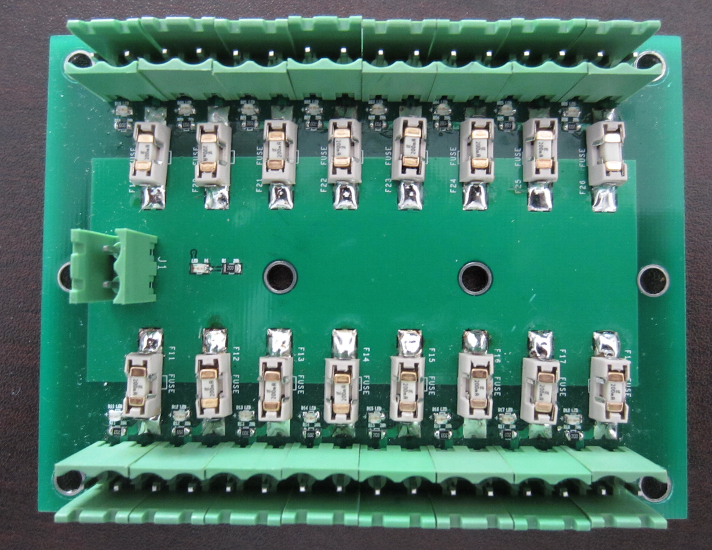
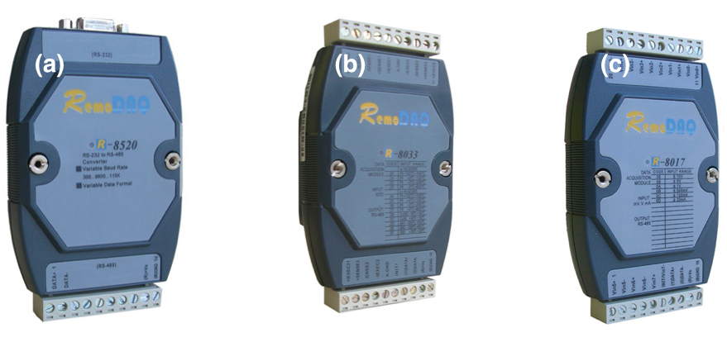
Data Acquiring Models
4-wired temperature I/O model
Analog voltage signal to digital signal I/O model
RS485 to RS232 model

Slide 10
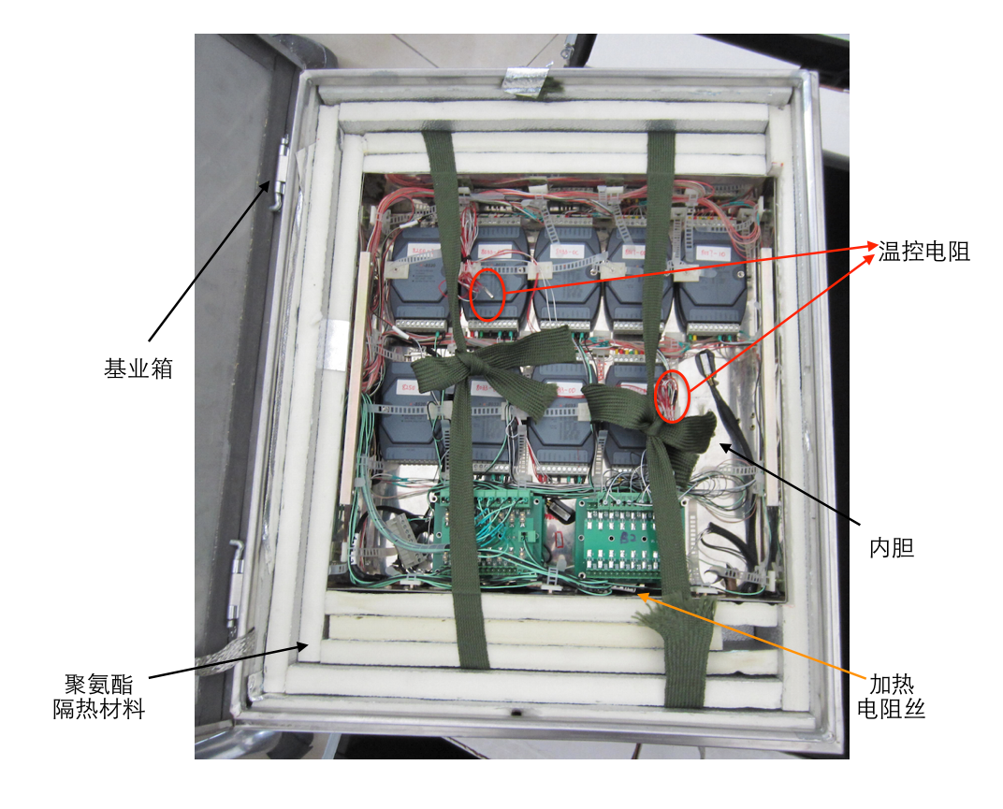
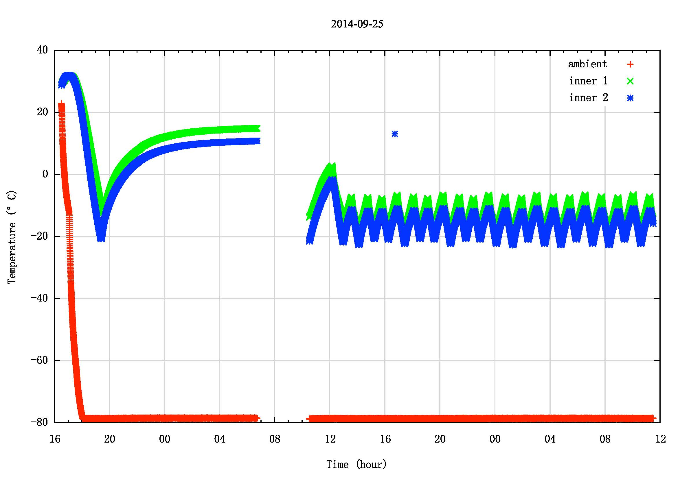
Thermal control for Electronic Box
Filling insulation PU boards.
Active heating.
A daemon program doing thermal control.

Slide 11
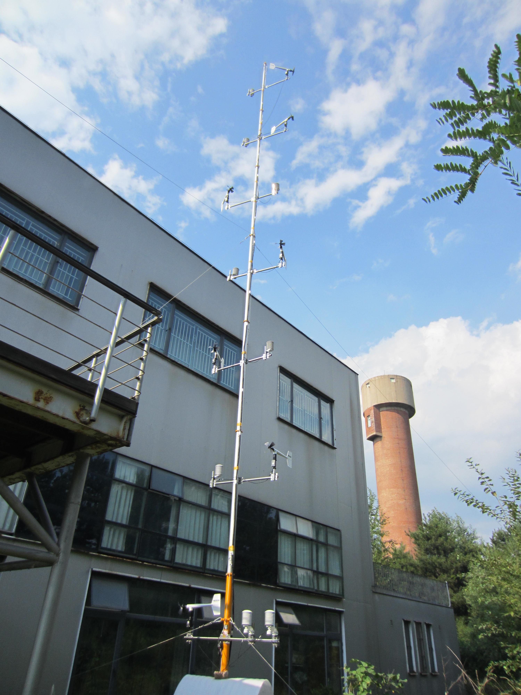
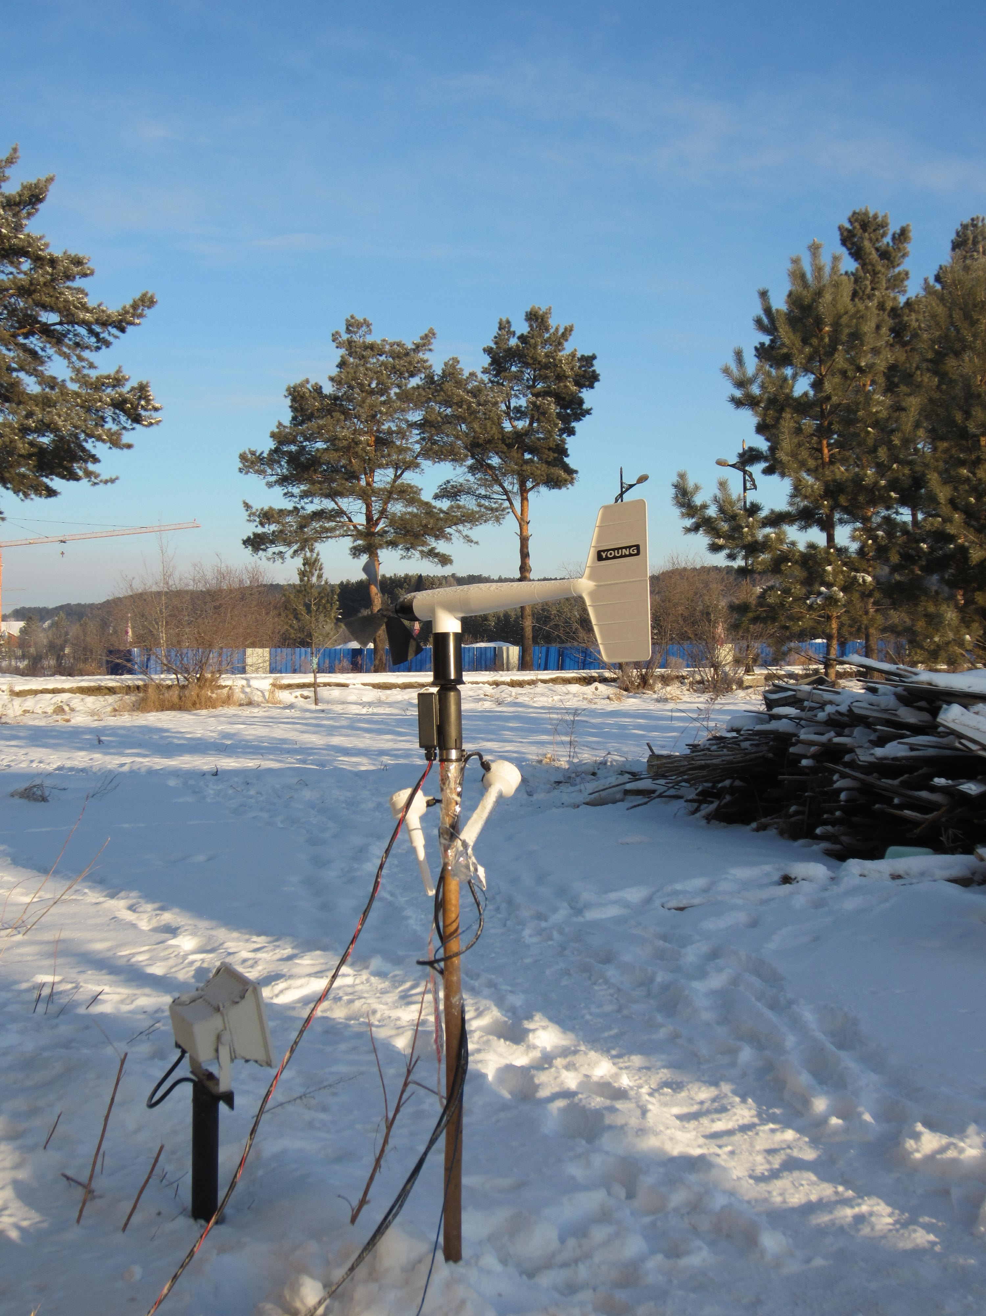
Testing
Prototype Mohe, 2013
KLAWS-2G Xinglong, 2014

Slide 12
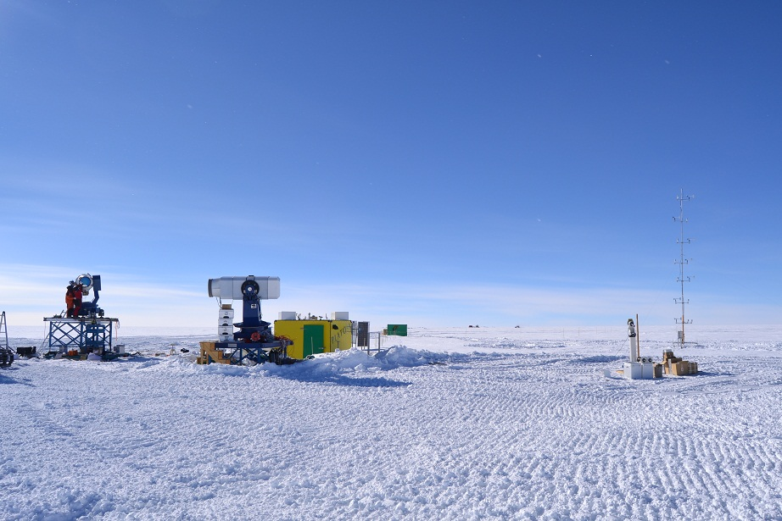
Running at Dome A
Installed on Jan 12 2015, provided by Du & Li

Slide 13
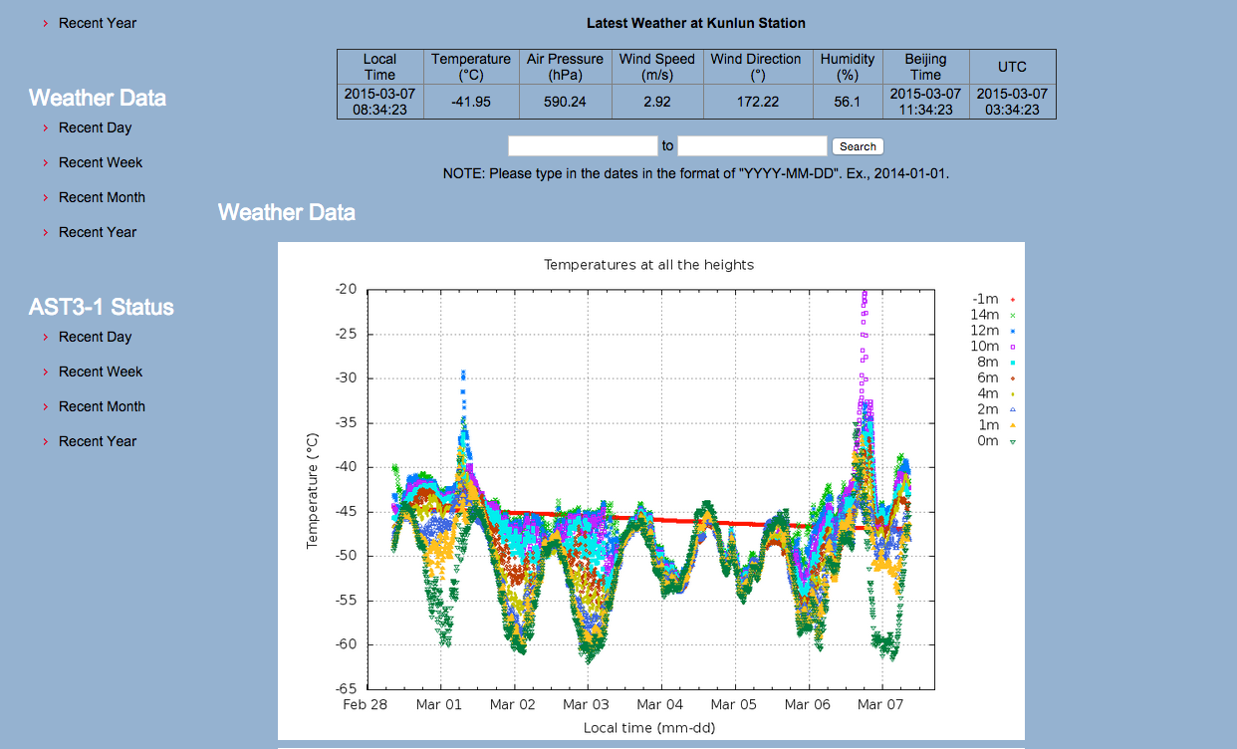
Running at Dome A
http://aag.bao.ac.cn/klaws/index.php?type=weatherdata

Slide 14
Thanks !!

