Slide 1
AST3-1 photometry from Dome A
Bin Ma, Peng Wei, Yi Hu, Zhaohui Shang
NAOC
2015.03.10

Slide 2
Variables by Lingzhi Wang

Slide 3
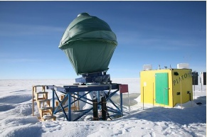
Outline
1 Overview of the data
2 Image Reduction
3 Astrometry
4 Aperture Photometry
5 Summary

Slide 4
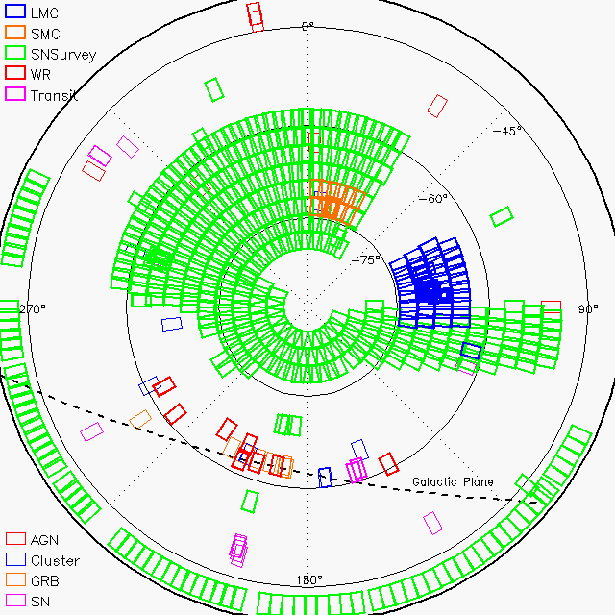
1 Overview of the data
AST3: 50/68cm telescope
10K * 10K STA CCD
1”/pix, 4.3 deg² FoV
SDSS-i filter
Installed in Jan 2012
Obs 2012.03.16 - 05.07
~26,000 frames (1.6TB after compressed), including both test and scientific images

Slide 5
Obs. targets
Survey | Num of fields | Sky coverage (deg²) | Num of frames | Total exptime (hr)
LMC | 50 | ~200 | 664 | 10.60
SMC | 12 | ~50 | 55 | 0.90
SN Survey | 496 | ~2000 | 3334 | 55.55
Monitoring | Num of frames | Total exptime (hr)
LMC-center | 4753 | 62.00
Transit | 3398 | 36.43
WR stars (9 fields) | 3454 | 23.70

Slide 6
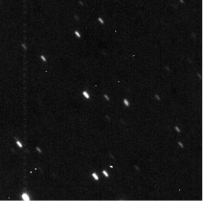
Image quality
Test phase, the system not stable yet
FWHM: seeing, optics, tracking
Dark: 1.5 ADU/s @ -45C

Slide 7
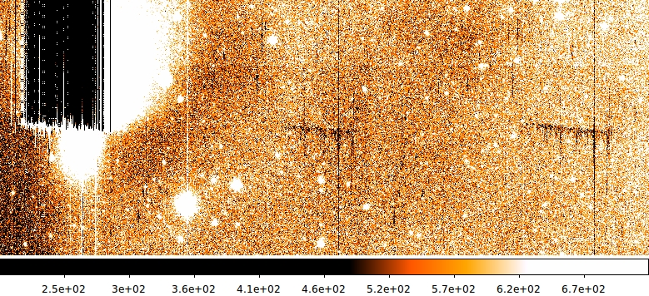
2 Image Reduction
Cross-talk during readout
Overscan (bias)
Dark current
Flat field (by Wei Peng)
3 readouts

Slide 8
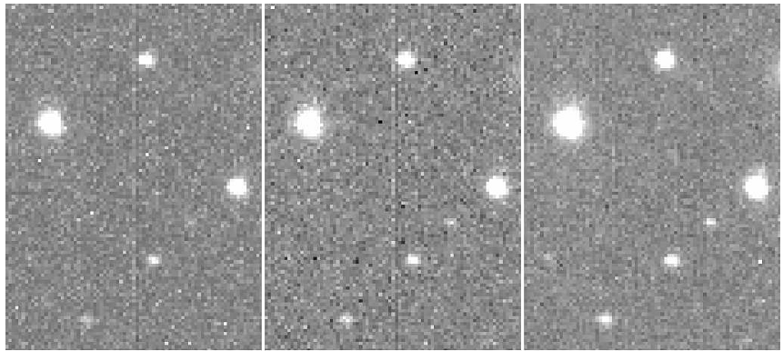
Dark current correction
Higher CCD temperature, Dark current non-uniform
Dark frame not available @ Dome A
Dark current changed since lab test
Deriving dark frame from a pair of obs. Images (Ma+14)
-41℃
Raw
RMS ~ 56 ADU
Corrected by lab dark
RMS ~ 45 ADU
Corrected by derived dark
RMS ~ 24 ADU

Slide 9
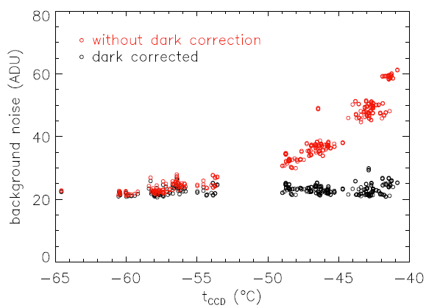
For images with similar background level (500 – 600 ADU), similar photon shot noise, correction by derived dark frame works efficiently

Slide 10
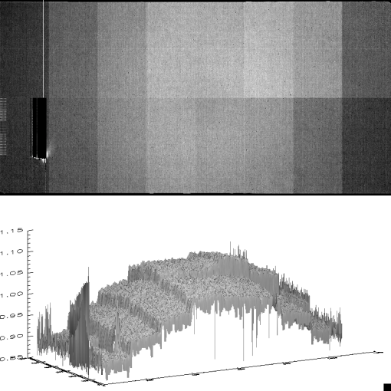
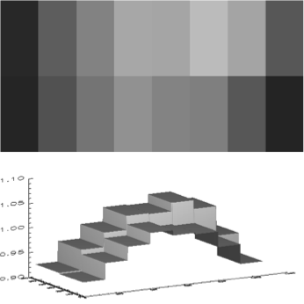
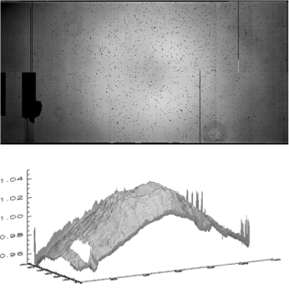
Flat field (Wei+14)
Master twilight
Gains between readouts, vignetting, twilight gradient

Slide 11
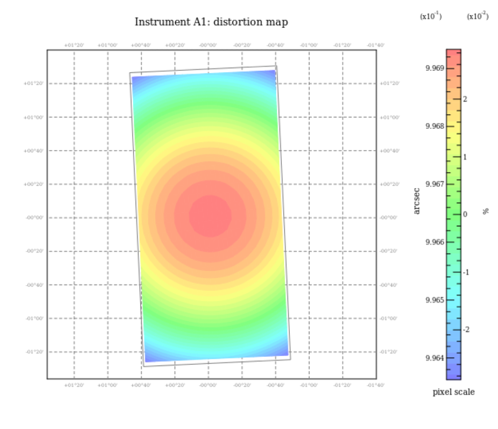
3 Astrometry
0331.116 (280.4, -73.0) 60-sec, 2.8” FWHM
SCAMP ref. cat: PPMX (~0.04”)
ΔRA RMS ~ 0.09”; ΔDEC RMS ~ 0.13”

Slide 12
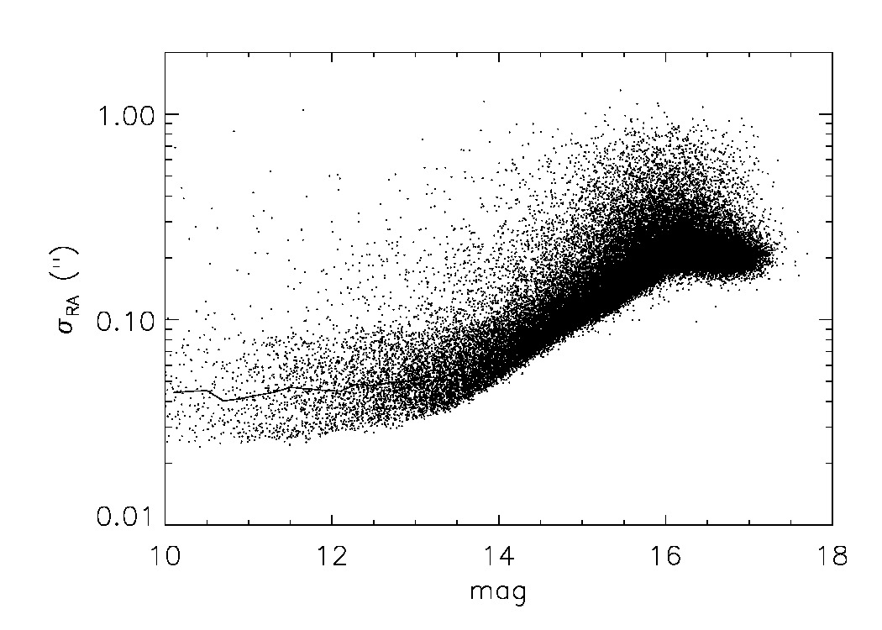
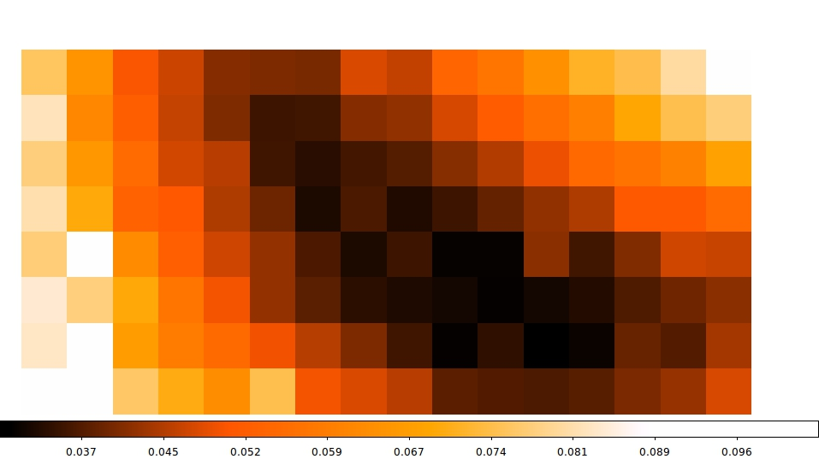
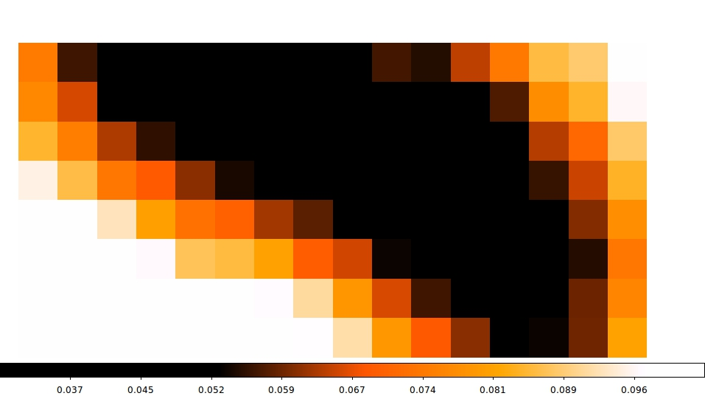
Astrometry: internal precision
40mas for bright stars
σ_{RA} and σ_{DEC} for bright stars vary a lot across the CCD

Slide 13
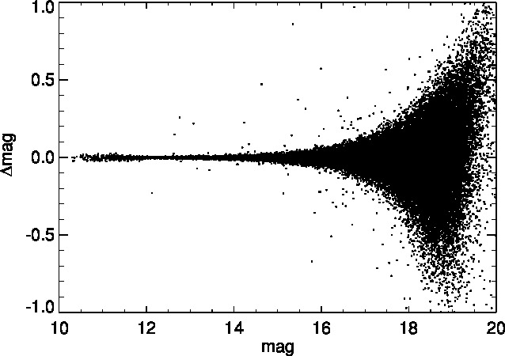
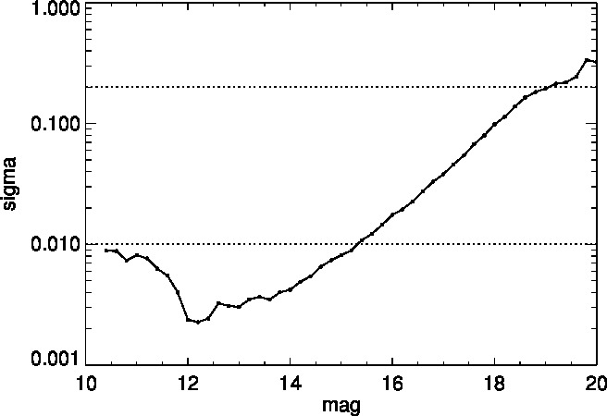
4 Aperture Photometry
Photometry: Sextractor
Δmag between a0331.116 and a0331.117:
5-σ: 19mag, bright end: ~ 2 mmag

Slide 14
Photometric calibration
APASS: The AAVSO Photometric All-Sky Survey
Johnson B and V, plus Sloan g′, r′, i′. It is valid from about 10 to ~ 17 mag
We compared APASS with SDSS, and found ~5% fields are not well calibrated
To calibrate AST3 2015

Slide 15
Relative calibration
HD 143414 field
continuous obs. on April 8,9,10,11, May 5,6
1450 exposures (10s – 30s)
FWHM ~4”, BACKGROUND 110ADU/s
t_ccd: -45C
Non-crowded

Slide 16
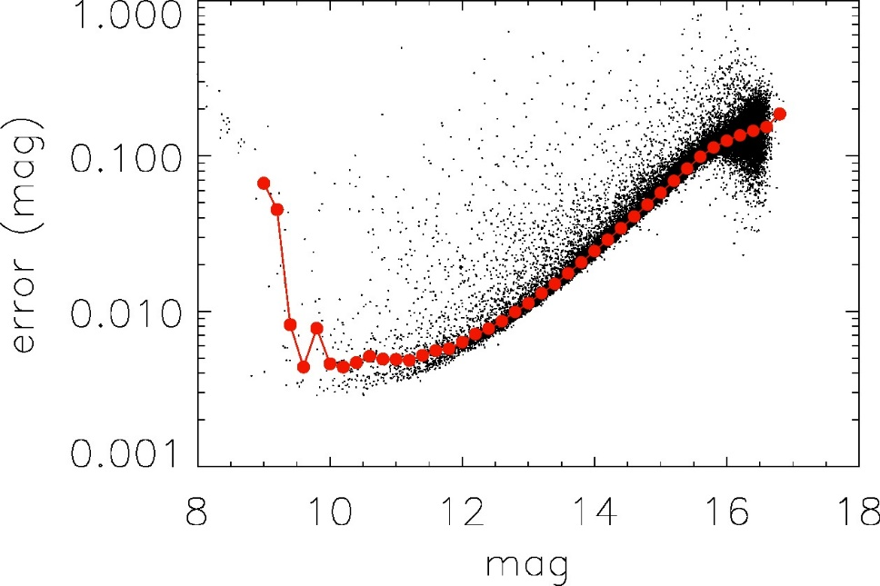
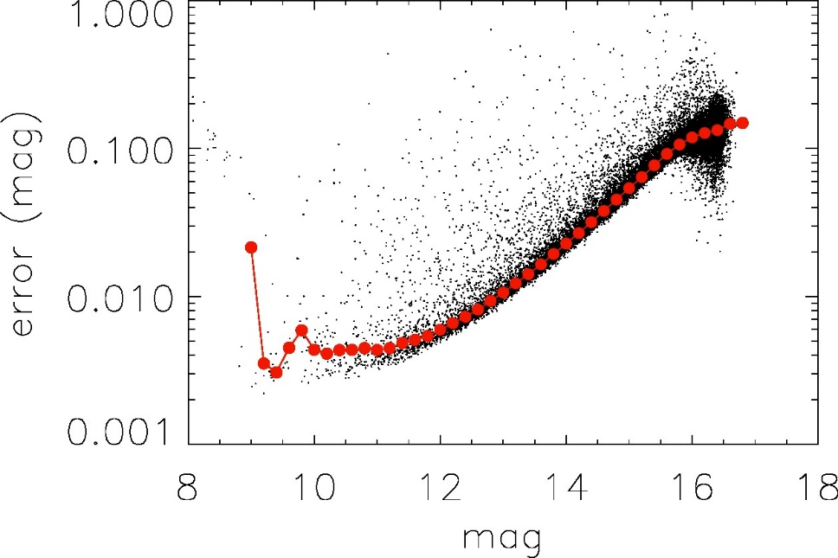
RMS of 10s-exposure at bright end all (N=730): 4mmag; 4”<FWHM<5” (N=336): 3mmag
May be reduced by further detrending
All 10s-exposures
10s-exposures, 4”<FWHM<5”

Slide 17
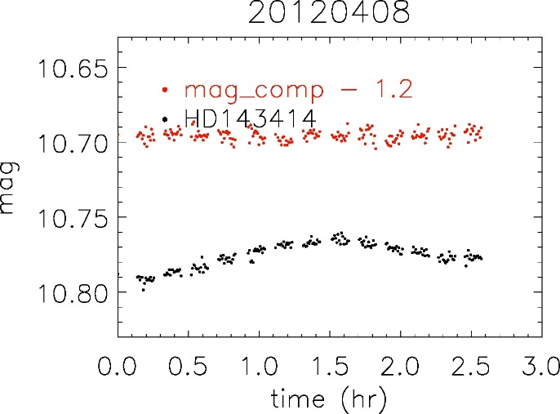
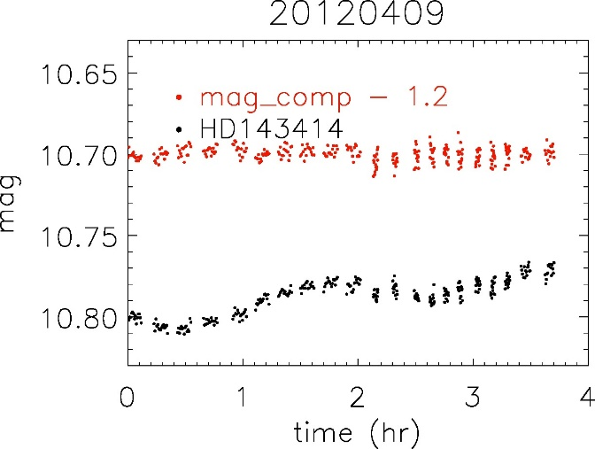
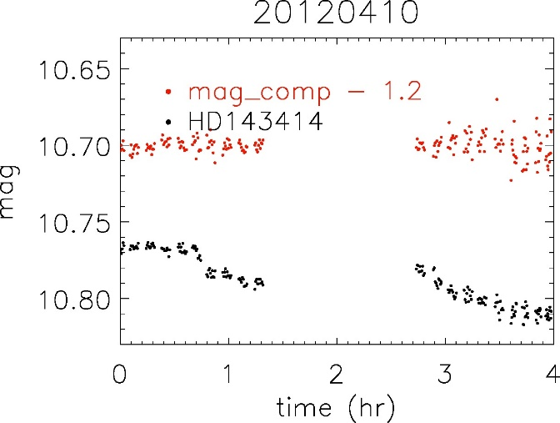
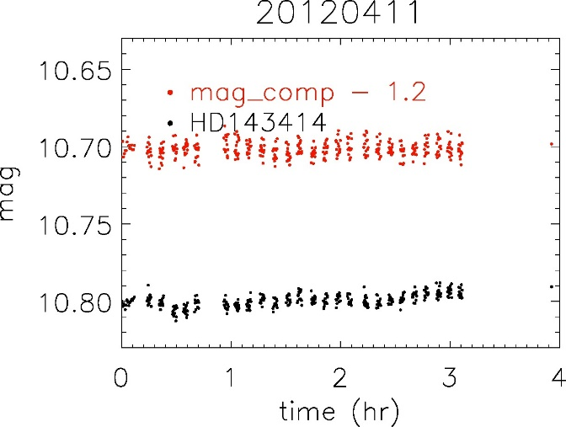
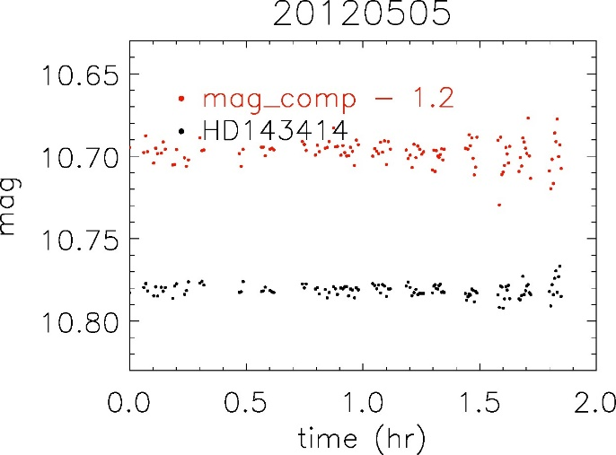
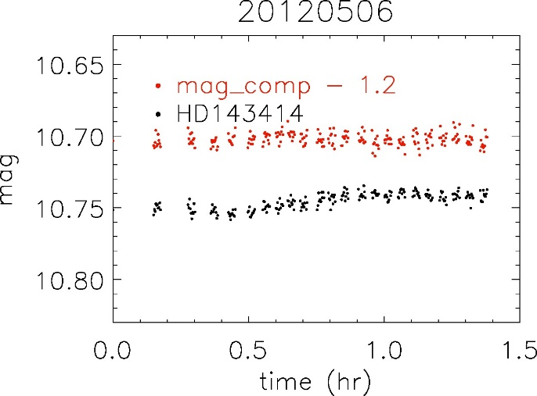
Light curves of HD 143414

Slide 18
5 Summary
Images not so good during test phase, however, we have achieved:
Astrometry precision: ~0.1” (40mas internal)
Limiting mag: i ~ 19 mag @ 60sec ->SNe (low t_{CCD}, small FWHM)
Photometric precision @ bright end: ~3 mmag (single frame) ->transit (stable t_{CCD}, tracking & pointing)

Slide 19
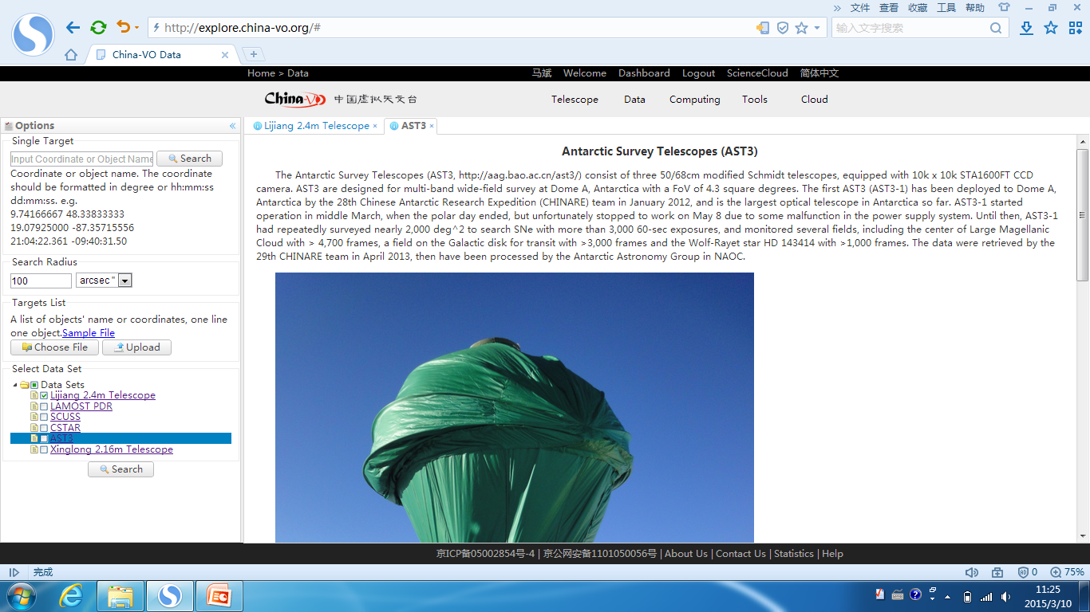
Data release
China-VO is working on data release
Copies of raw images, correct images, reduced images, catalogues are available if PI authorizes

Slide 20
We are looking forward to observations in weeks with more & better data based on the lessons & experience. Thanks!

